Slide 1
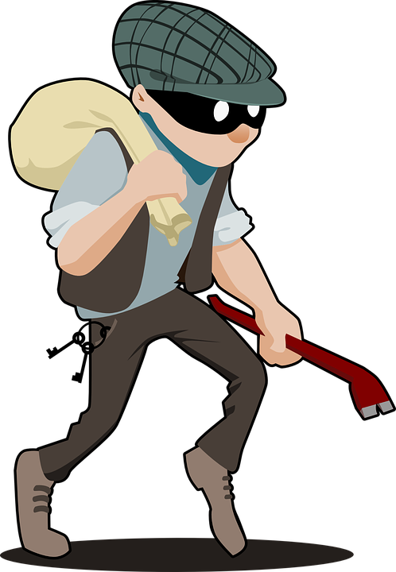
Stealing

Slide 2
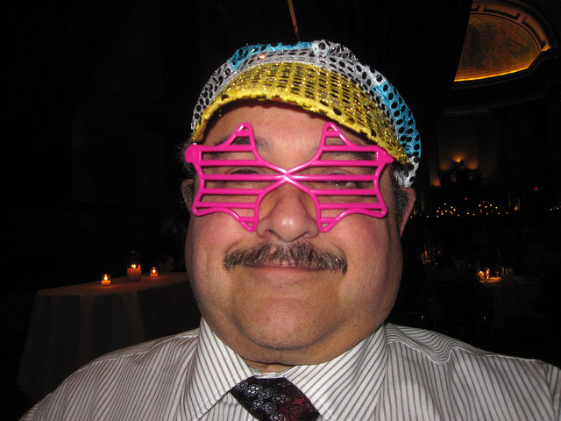
You wake up and decide to go to the park for some $cash$
Steal from this guy
Leave him alone

Slide 3
He throws his purse at you and you get KNOCKED OUT
the guy calls the cops and you go to jail.
YOU LOSE
. RETRY

Slide 4
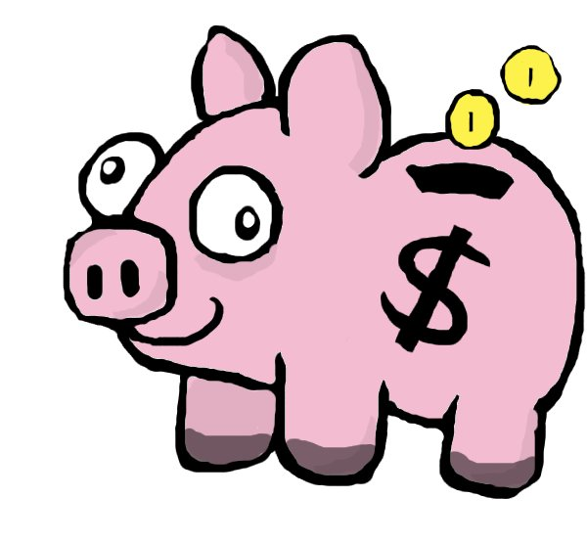
Then Next Day
You go to the bank to get some thing valuable
Kick the door open and say give me money
Ask politely

Slide 5
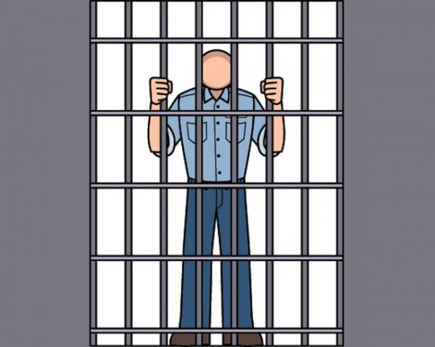
They say NO!!!!!!!!!!!!!!!!!!!!!!!!!!!!!!!!!!
You lose

Slide 6
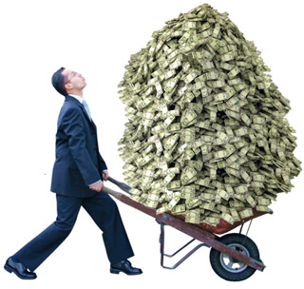
THE PEOPLE IN THE BANK FEEL THREATENED
ALL THE CASH IS YOURS $$$$$$$$$$$$$$$$$$$$$$$$$$$$$$$$$$$$$

