Slide 1
Dog lick

Slide 2
You get licked
You run

Slide 3
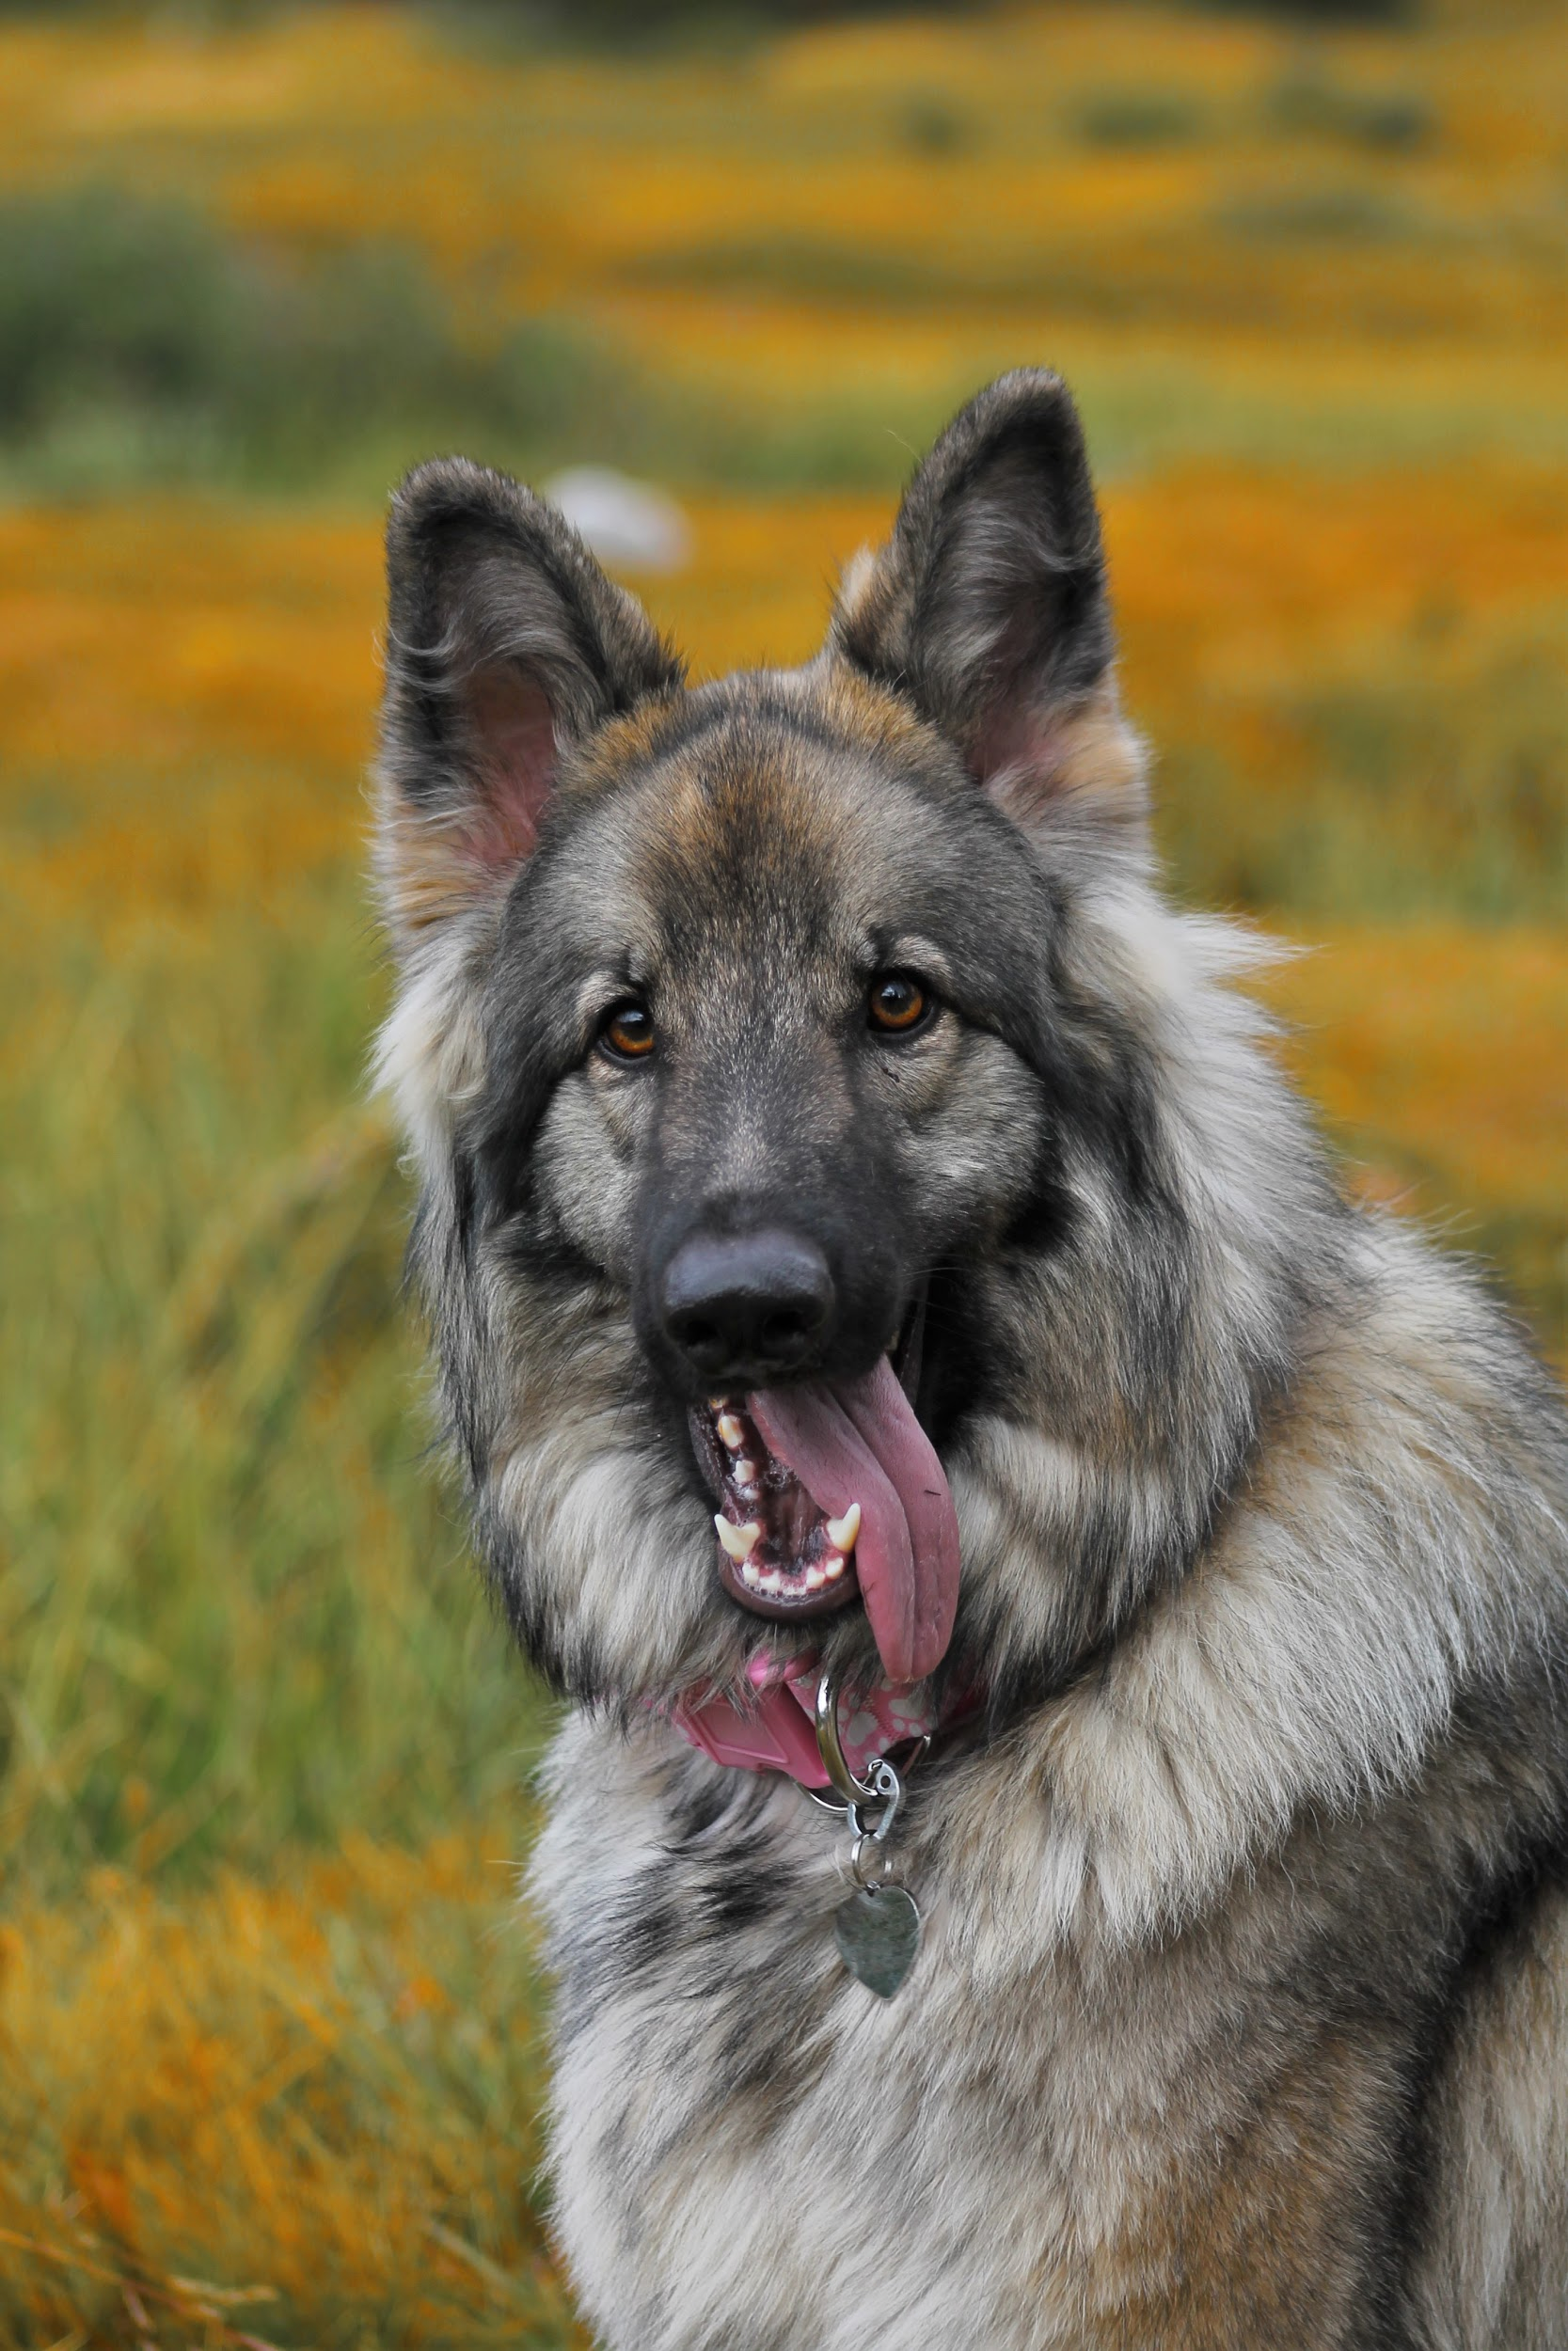
You lose

Slide 4
You win
John
Cena
saves
you

