Slide 1
WATCH OUT!!!!
By payam a

Slide 2
Dealing with my Car time
your kids say I want to go to 7 eleven but then you noticed that
Car has been toed because someone spray painted no parking underneath were you parked your car.
choice 1 go to the police station and tell them what happened
choice 2 you ignore

Slide 3
Path 1
Police station
The dumb police said no we cant do anything about it.
Choice one hit the police officers
But a new car

Slide 4
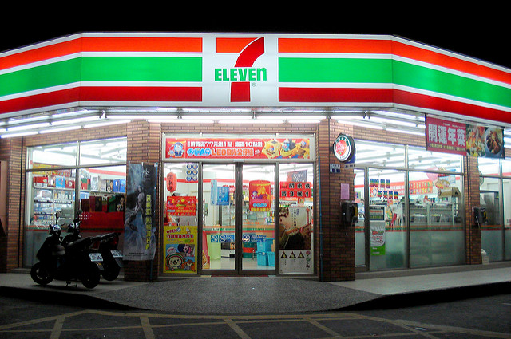
Path 2
7 eleven
You take your kids to 7 eleven and you buy them a chips but one of them cries because they want a bag of candy instead.
choice 1 hit the kid
choice 2 Buy them candy

Slide 5
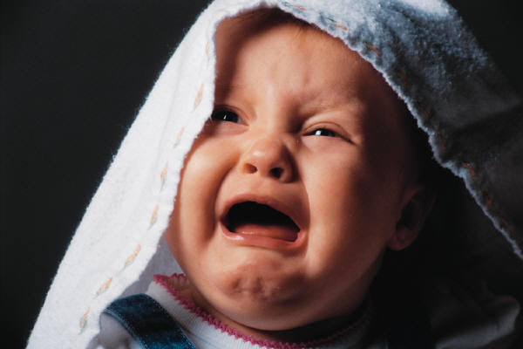
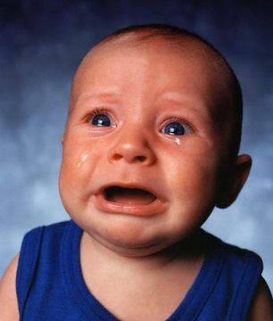
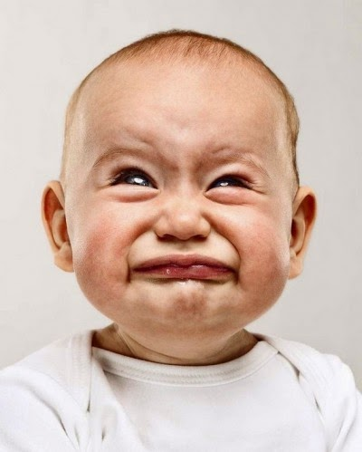
GIVE UP
YOU LLLLLLOOOOOSSSSSSSSEEE
You got arrested

Slide 6
Did not care how muck it cost
Yyyyyooooooooouuuuu
wwwwwwwiiiiiiiiinnnnnnnn
You bought a new car and it looks better than the old one.

