Slide 1
Abednego L3
Video games

Slide 2
Video games Releashed date
Video games were made in 1972 By Nolan Bushnell The first game was Pong

Slide 3
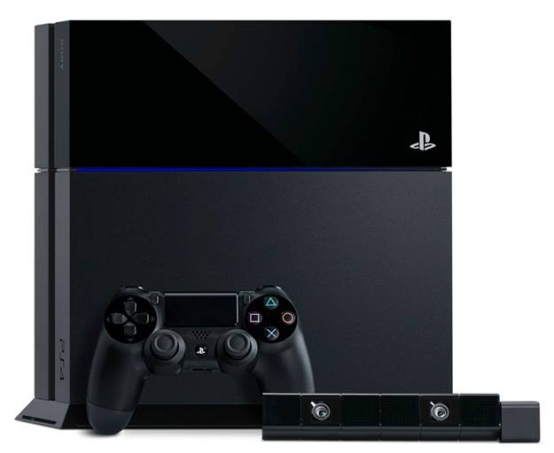
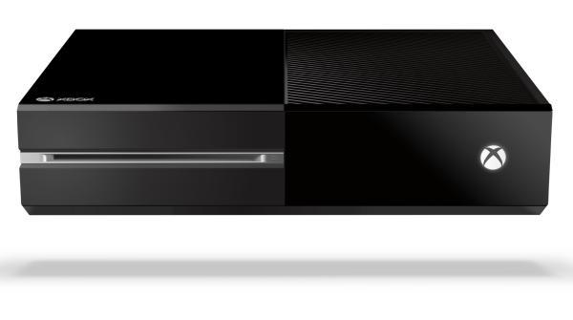
The video game price
The price of most video games were 60 and the first console was The Magnavox Odyssey and their even more like that today! xbox one,play staion and The wii-u

Slide 4
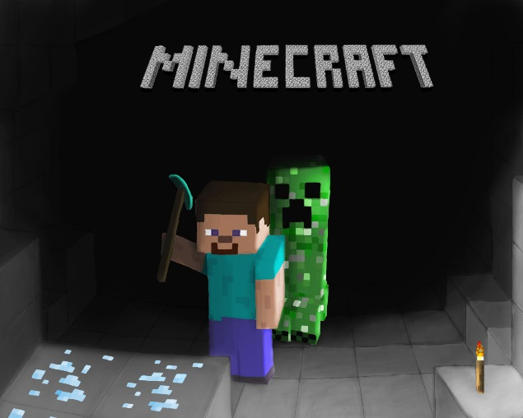
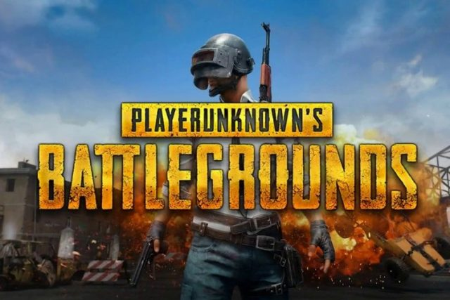
Games
The poplaur games in 2018 (Right Now)

