Slide 1
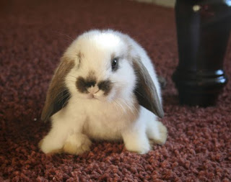
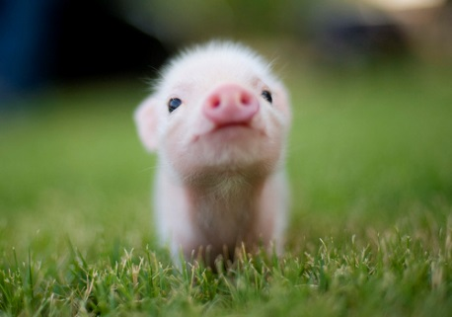
Addie Rook 4
Cute animal kingdom

Slide 2
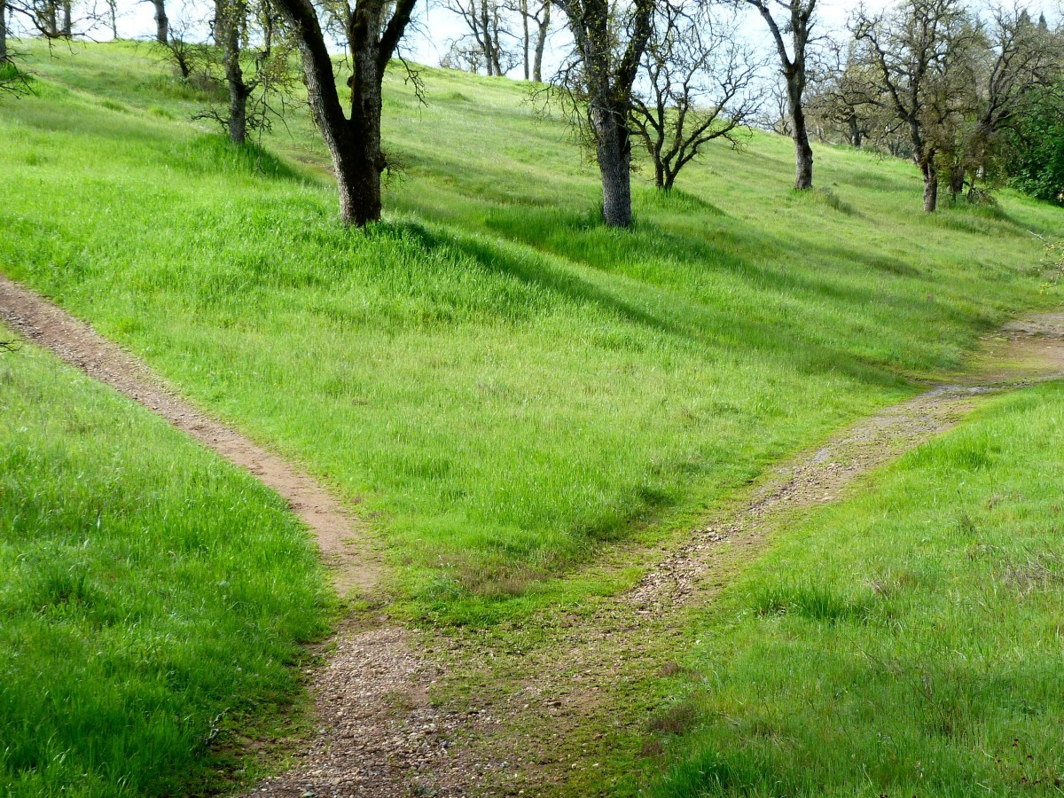
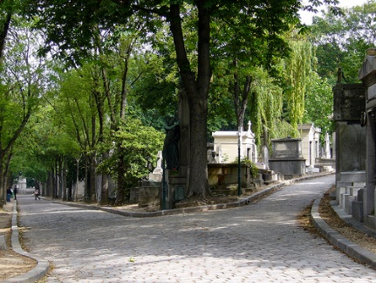
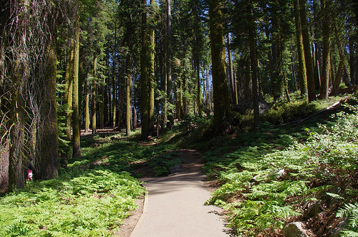
You were walking in the meadow of joy when you came to a fork in the middle of the road.
Go left
Go right

Slide 3
You ran into a lake!

