Slide 1
Dragon trainer
By cady 4th grade

Slide 2
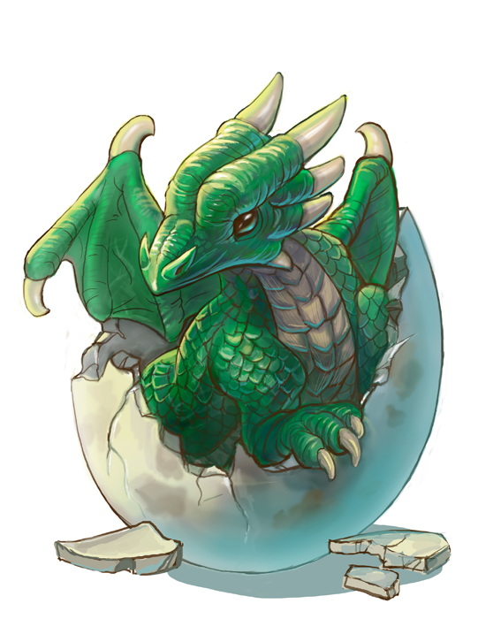
Once upon a time…
You were begging your parents for a pet dragon! You were very exited when they said yes. You went to the dragon shop. Which one do you choose?
Fire dragon egg
Water dragon egg

Slide 3
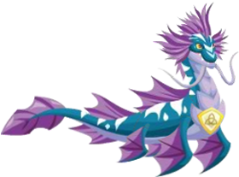
Water dragon
You place your egg in your bath tub and a baby dragon hatches out with a smile!
The end!

Slide 4
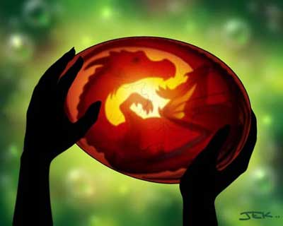
Fire dragon
You wait paitently for you baby dragon to peak out but days have past. Suddenly, you see on the instructions that you have to incubate it!
.Do you heat the egg
.or do you wait

Slide 5
you wait but no dragon!
.you wait more than a year and finally, a dragon pops out! You are mad you didn’t heat the egg!
.The end!

Slide 6
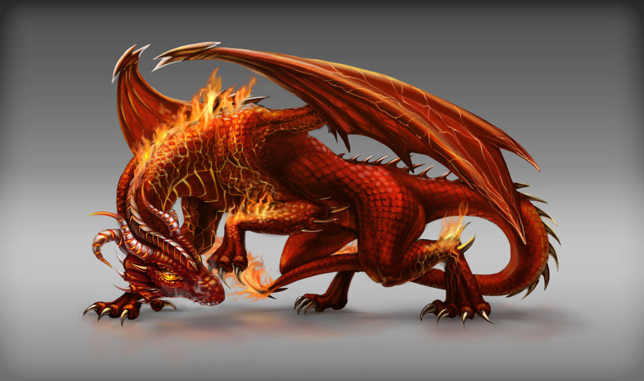
Heating
You heat the egg and a fierce dragon pops out! You turned up the heater too high but, with some traning your dragon is okay!

