Slide 1
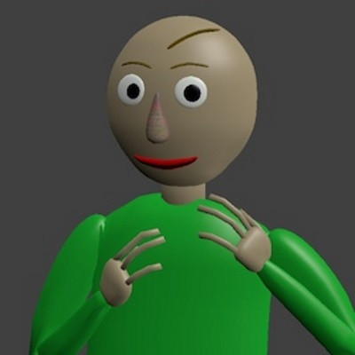
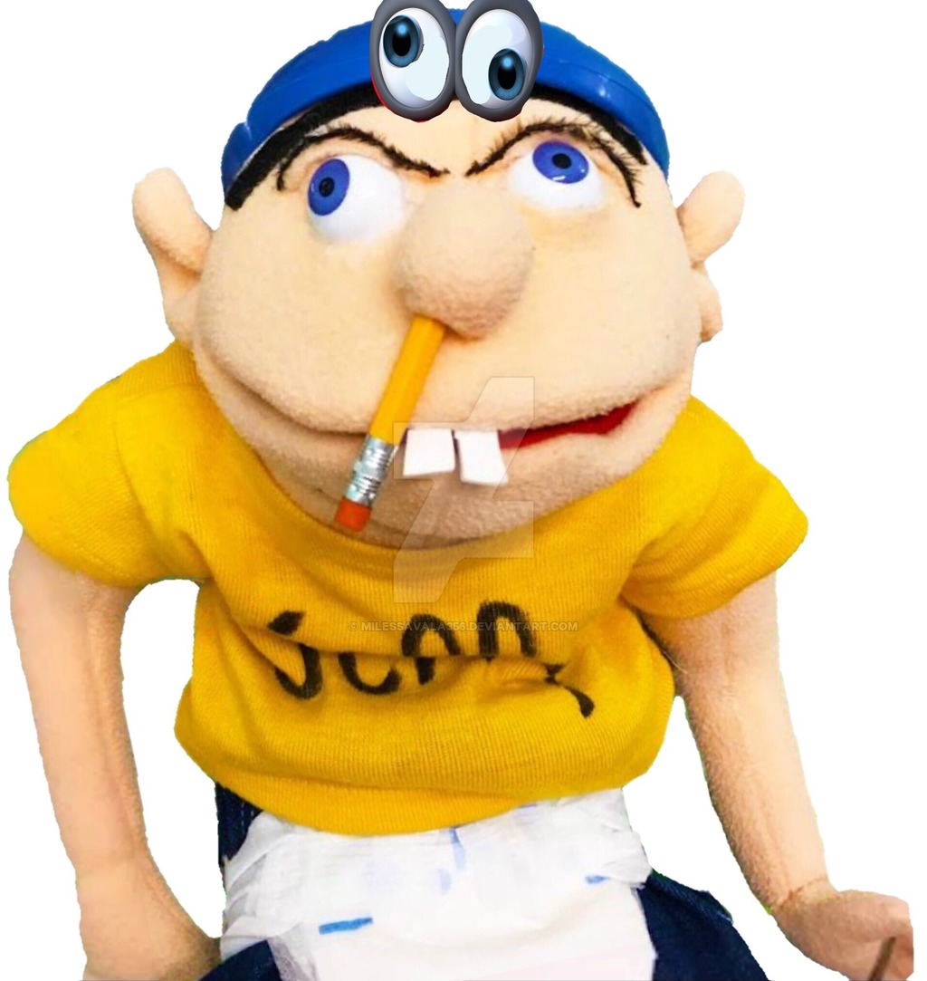
Fahad A4
Jeffy vs Baldi

Slide 2
Once upon a time there was a guy named jeffy
Jeffy was walking until he found a guy named Baldi .Baldi wanted to fight Jeffy.
What should he do?
Fight now.
Get supplys and then fight.

Slide 3
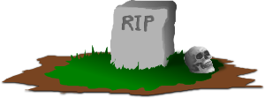
hammer
Jeffy grabs the hammer and runs to baldi
Jeffy hit baldi but baldi didn’t get hurt
Baldi spanks jeffy and jeffy dies

Slide 4
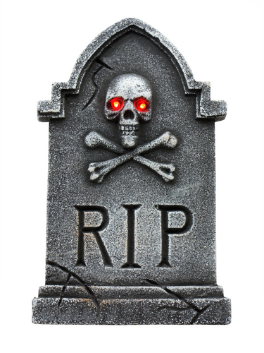
Bow
Jeffy grabs the bow he aims at baldi and baldi got hit
Baldi fainted and died R.I.P

Slide 5
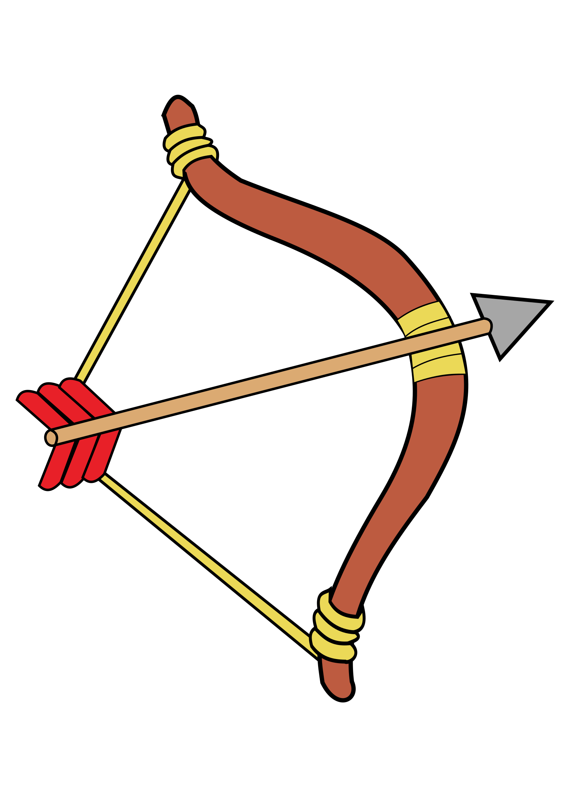
Get supplys and then fight
Jeffy runs home and finds a hammer and a bow
What should be pick?
Hammer
Bow

Slide 6
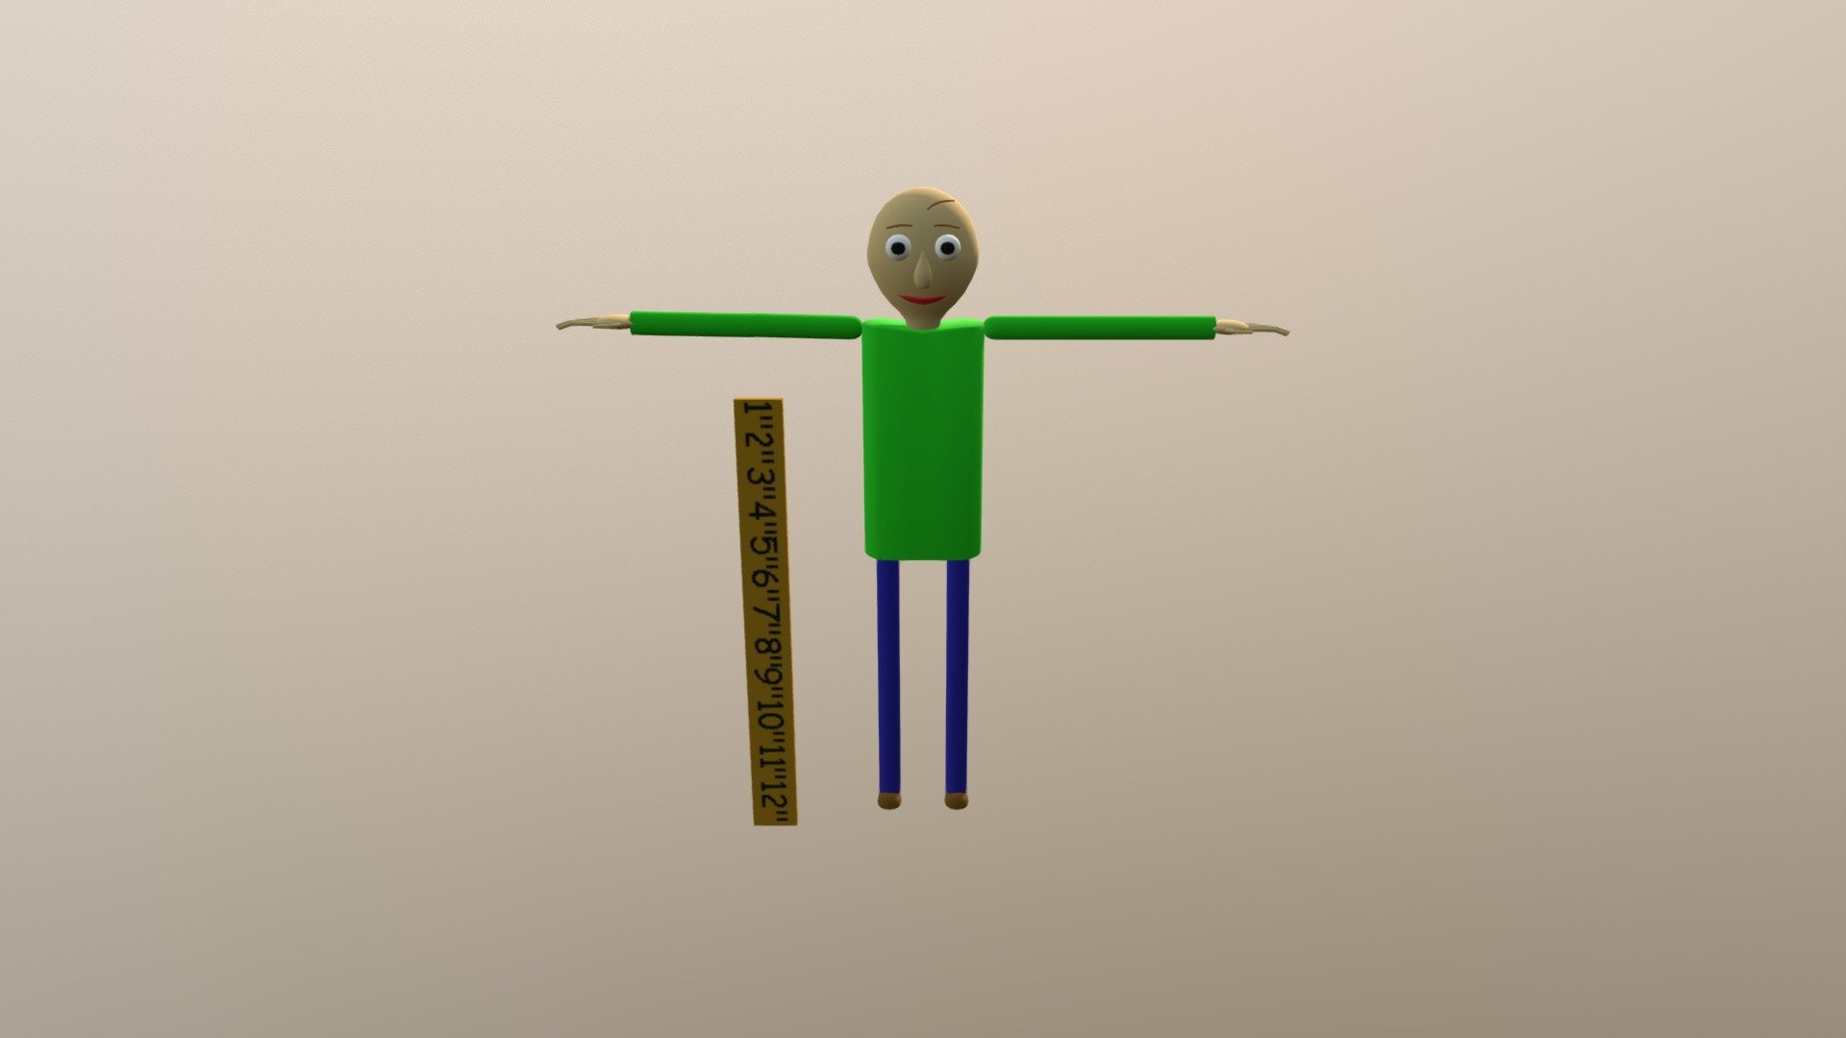
Fight now!
Baldi spanks jeffy with his ruler and jeffy had nothing to use with. So jeffy
cried and ran home.

