Slide 1
HENRY A4
DIE

Slide 2
YOU HAVE A RIDE
DIE IN STIER
CAR
BUS

Slide 3
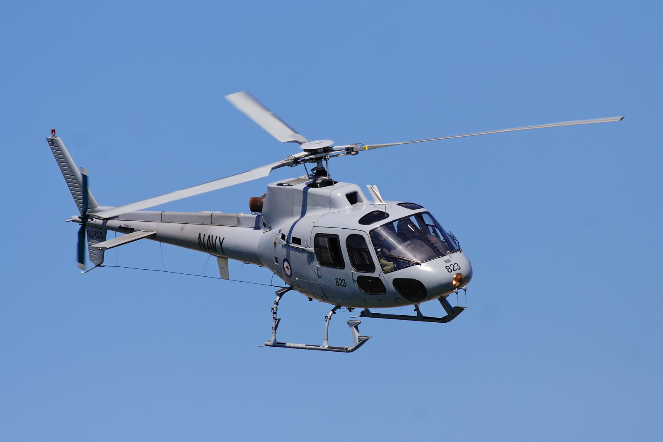
YOU ARE HIT AND YOU DIE
AIR PIANE
HELICOPTER

Slide 4
AIR PIANE

Slide 5
HELICOTER NO

Slide 6
IT RUNS OVER YOU FAIL

