Slide 1
IMAN A4
A Evil cat

Slide 2
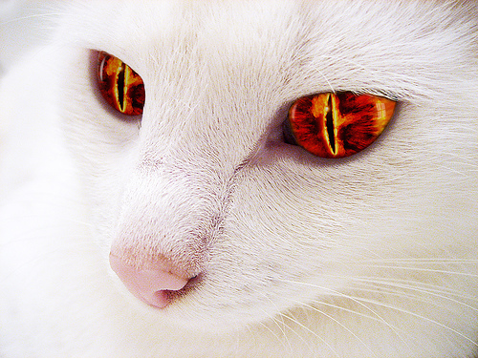
One dark night a evil cat was trying to start a fire in someone’s house…
Do you …
STOP IT
RUN OUTSIDE

Slide 3
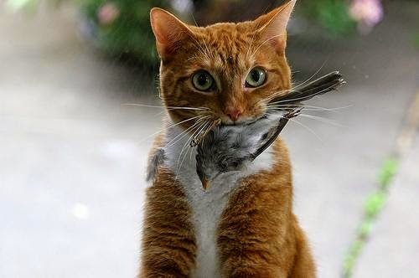
If you stopped it ...
You Dieeed!!!

Slide 4
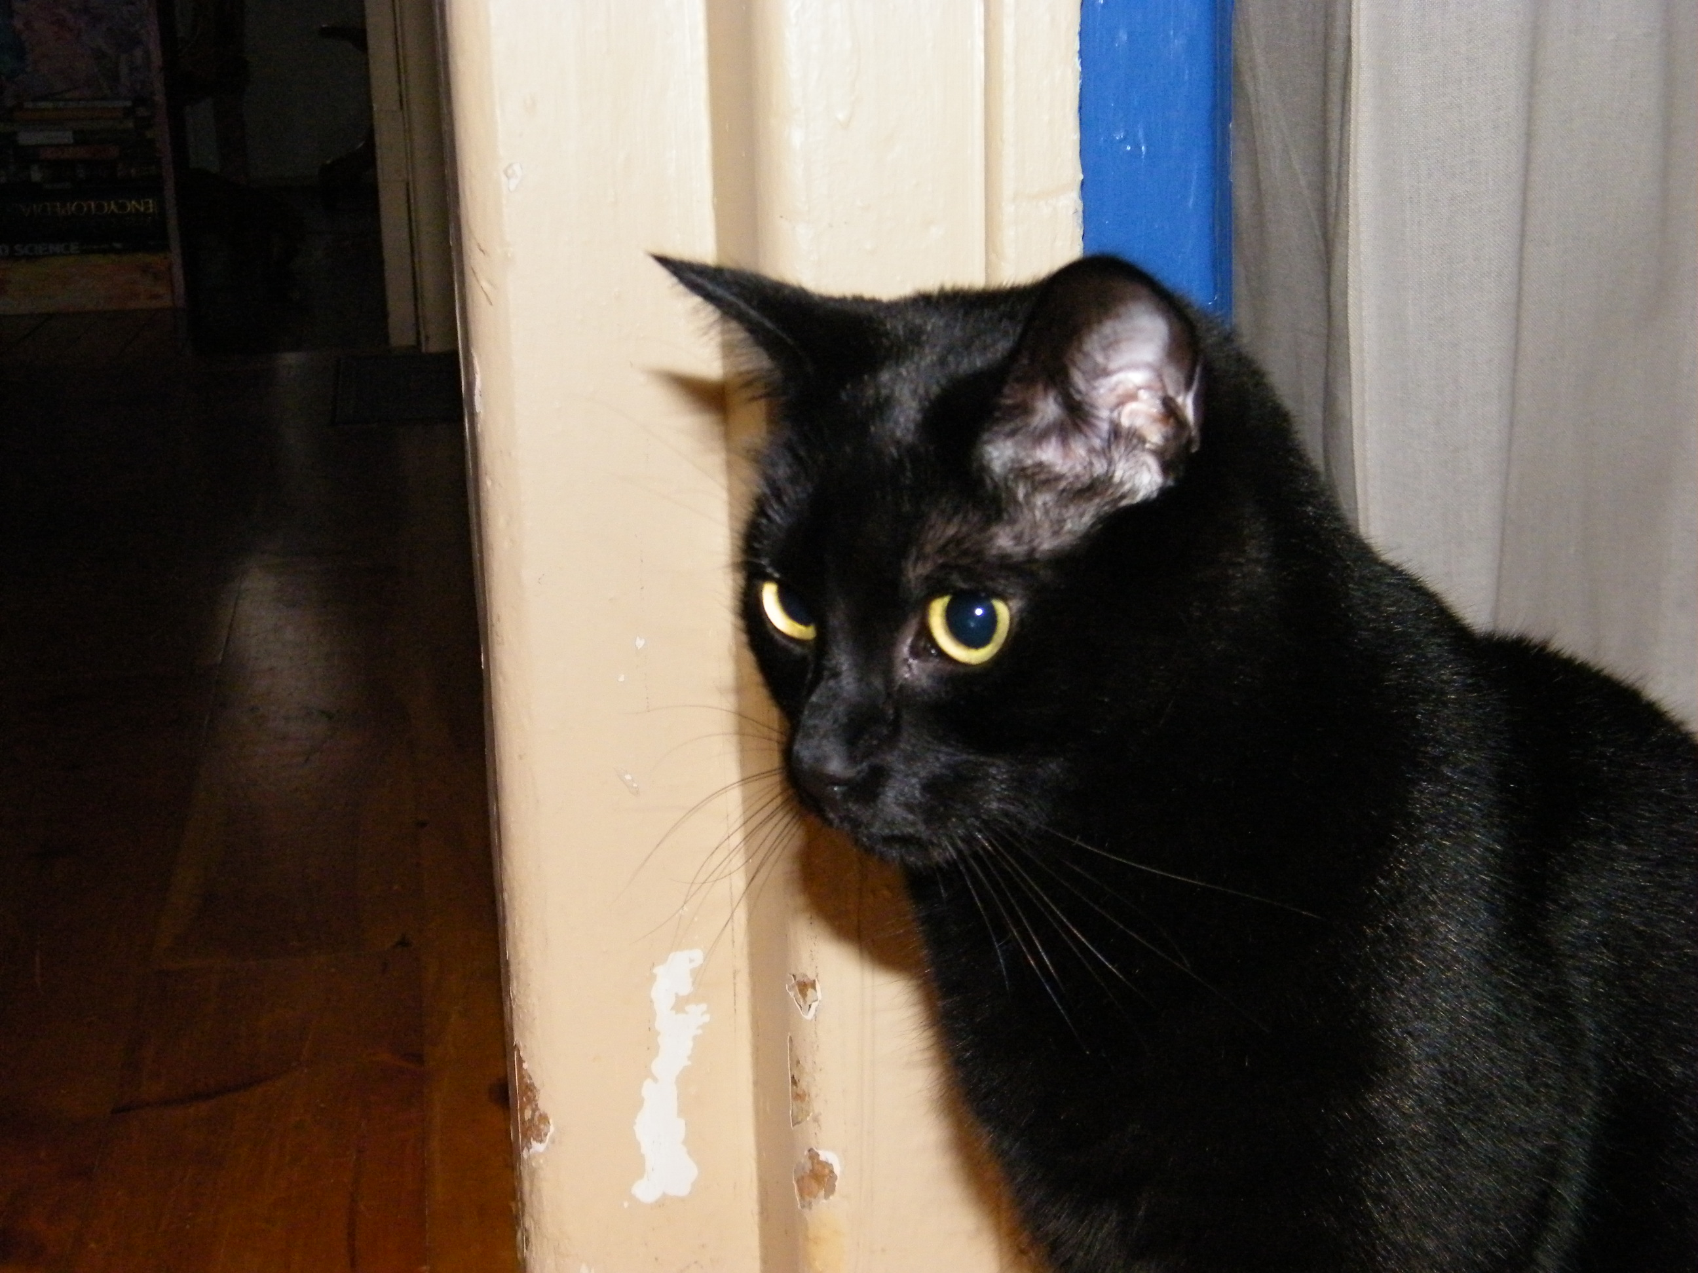
If you ran outside …
you will survive because you are not in a house full of toxins and smoke.

