Slide 1
Jack W4
The order of the Phoniex rises

Slide 2
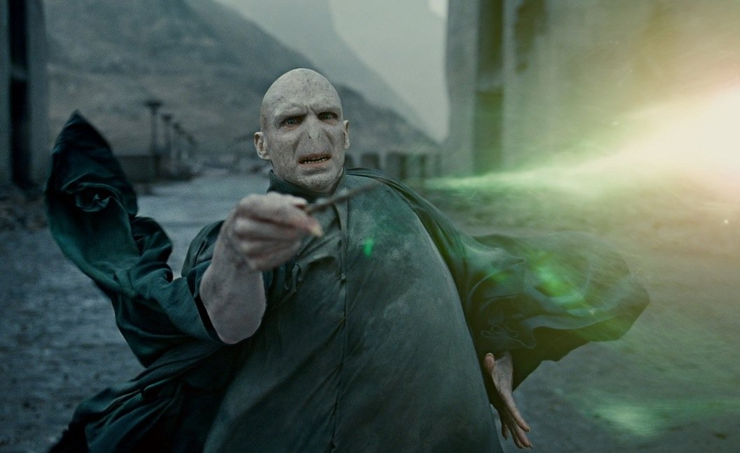
Once upon Hogwarts
Lord Vortemort strikes Hogwarts with
The killing curse
Will you
Strike back
Deal with it
Fly away on your broom

Slide 3
Strike back
You try to but sadly died
Death by Lord Voltemore

Slide 4
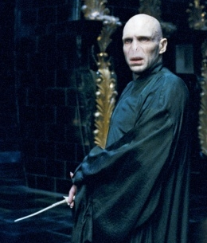
Deal with it
You have died instantly

Slide 5
Fly away on your broom
Congrats you have escaped from lord Voldemort

