Slide 1
kaitw4
Attack of the cute puppies

Slide 2
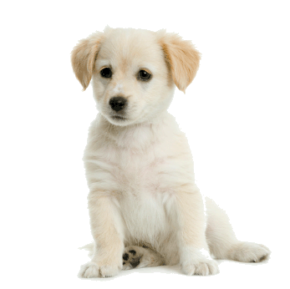
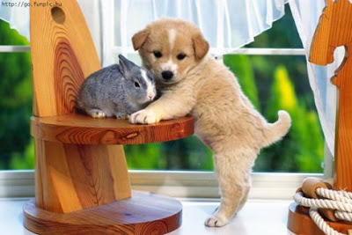
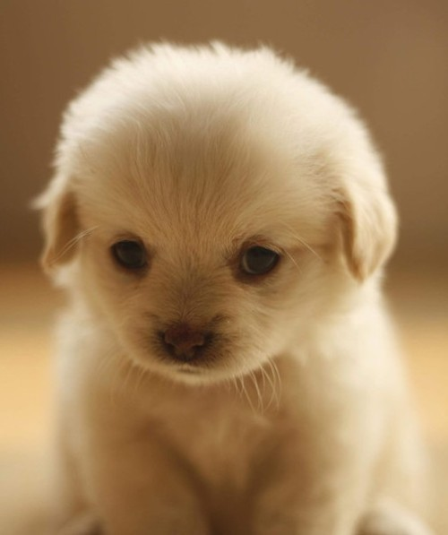
you

Slide 3
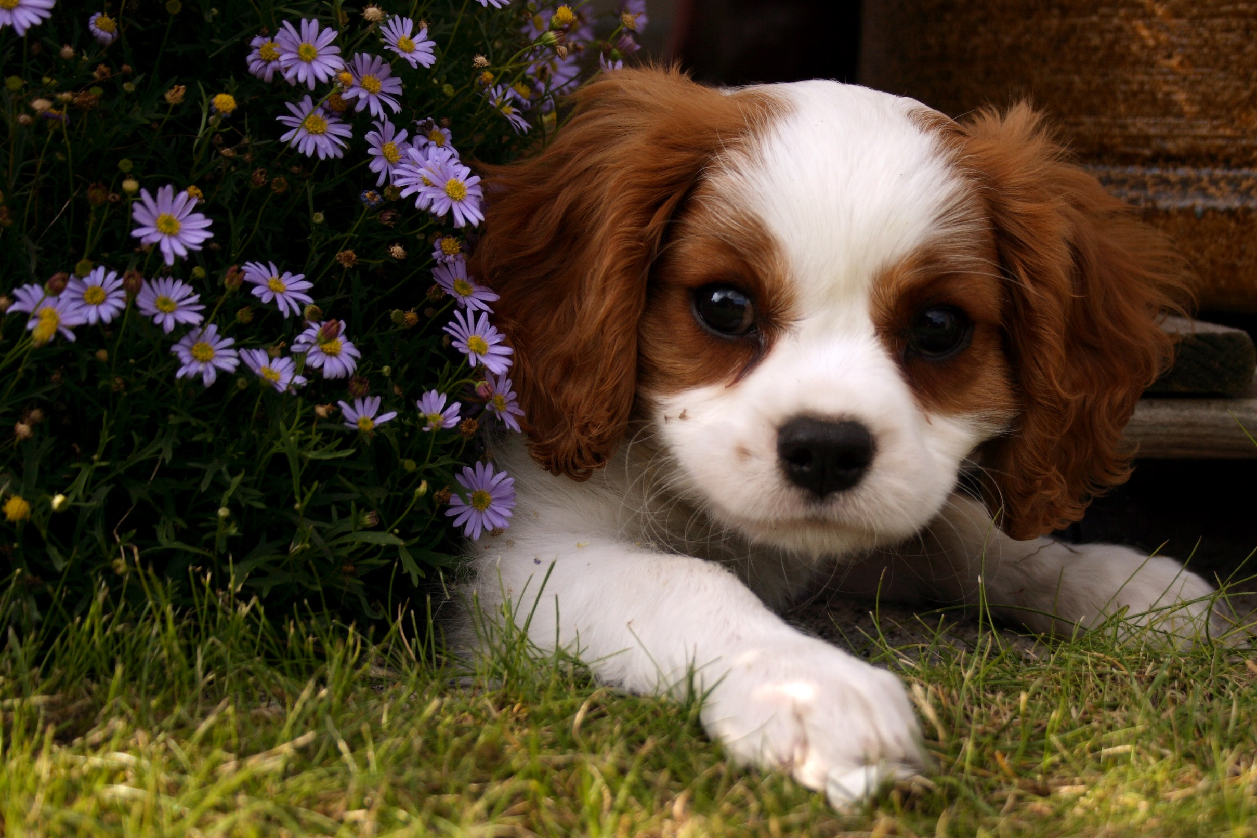
You run into cute puppies
What do you do
Attack it with a stik
Run away

Slide 4
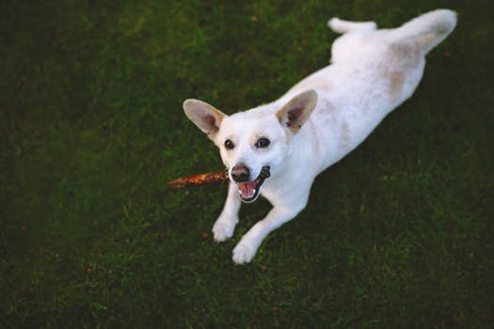
Attack it with a stick
The dog kills you

Slide 5
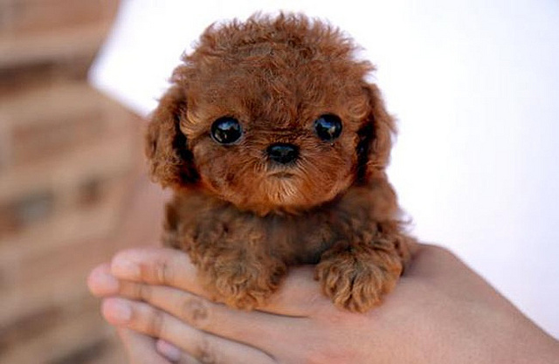
Run a way
Best friends

