Slide 1
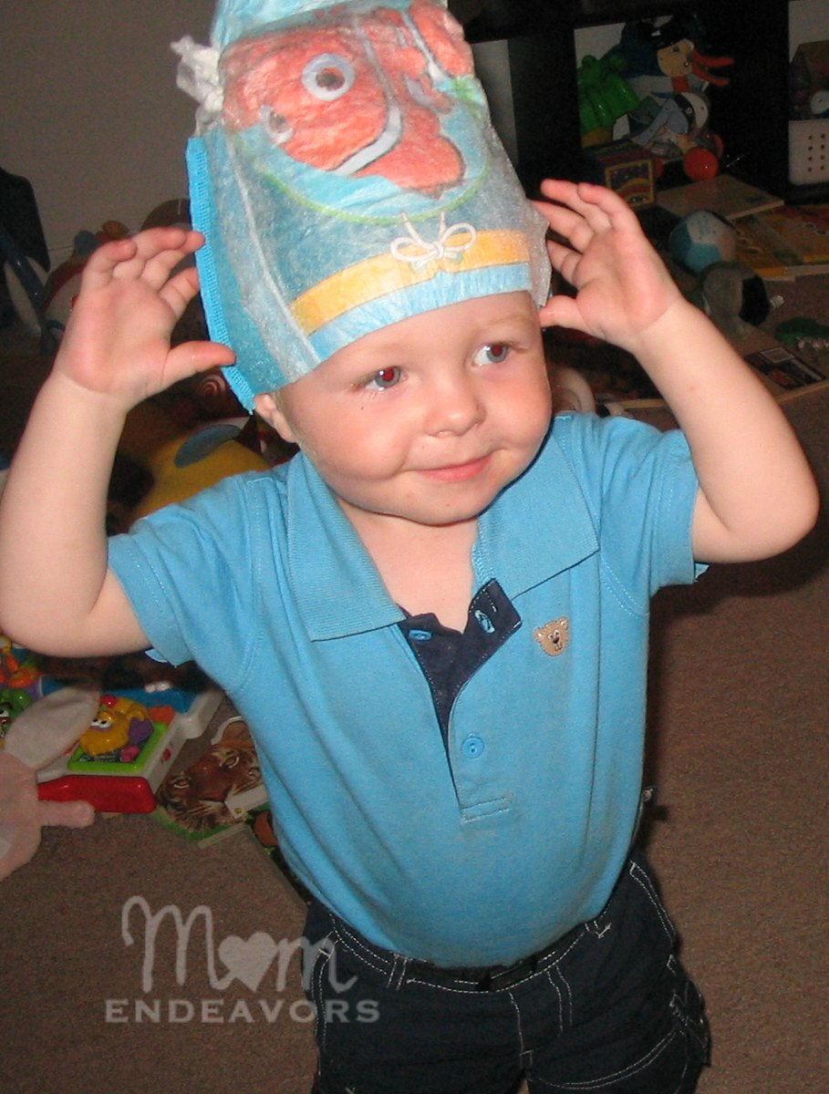
Layth l3

Slide 2
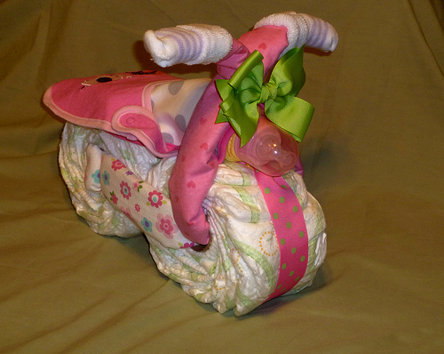
Who invented it?
marion

Slide 3
When was it invented?
1950

Slide 4
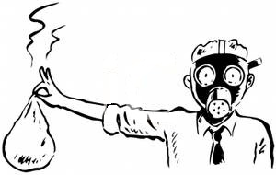
Fun facts
It smells

