Slide 1
Lucy w4
ZOMBIES ??????????

Slide 2
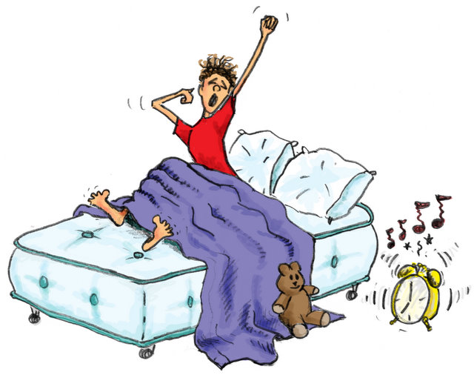
Morning
You finaly wake up but something is wrong…................
You check the time its about 4:30 am
You feel like something is wrong
check outside
Do nothing at all

Slide 3
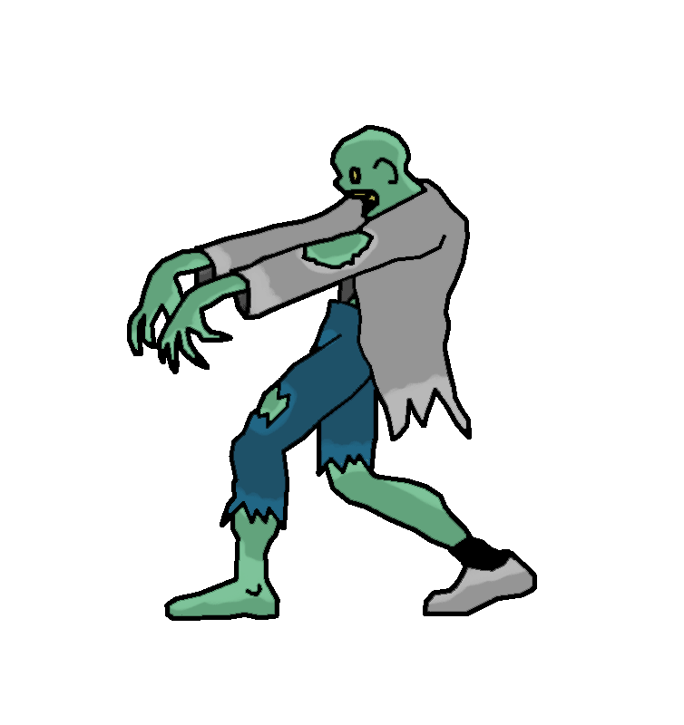
Check outside
You check ouside there is three zombies outside
You check to see if there is more zombies but all you see is other
Regular people outside the gate
Should you….
Go tell your parents
Attack by yourself

Slide 4
Tell parents
You tell your parents they already know
you …..
Attack your parents with knife
Attack zombies with family

Slide 5
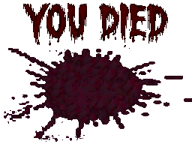
Do nothing at all
You do nothing at all you are very hungry
But since you do nothing you starve to death
Retry

Slide 6
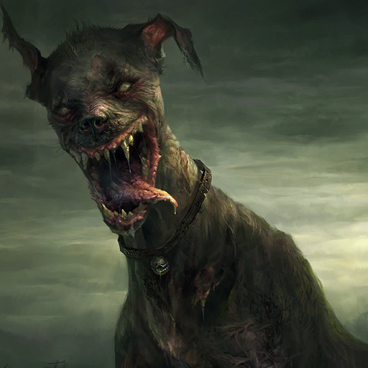
Attack by yourself
You attack by yourself
The zombies see you and attack
One of them bites you
You try to escape
They rip you into pieces and eat your brain
And you turn into a weak zombie
And a random dog kills you out of nowere
retry

Slide 7
YoU DIED retry

Slide 8
Attack parent with knife
You attack parents
They die but one parent stabs you before they die. You die mostly becase of sadness
10 years later the entire world is zombies or you would say zombie apacolips
retry

Slide 9
Fight zombies with parents
You fight the with your parents zombies and……….
YOU WINNNNNNNNNN!!!!!!!
Would you like to do more??????
Make more zombies

Slide 10
Make more zombies
You make more zombies to fight but this time
You see something shiny
Kill zombies first
Grab tresure

Slide 11
You kill they other zombies first
You kill the zombies first
Then you get the chest it has…
GOLD ANYTHING YOU EVER WANTED
DIMONDS

Slide 12
You die because you forgot about the zombies

