Slide 1
Maida r4
The haunted forest

Slide 2
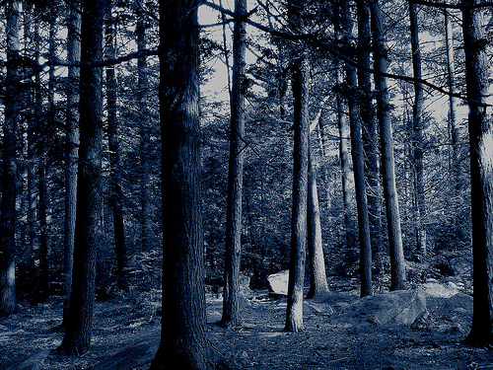
It was a beautiful morning
And jack and his family were going camping and there were almost there finaly they reached it then it was night time then jack went to use the bathroom but he did’t come back till morning .
do you…
look for him
Or wait

Slide 3
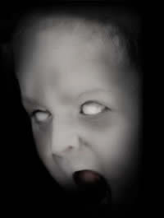
Look for him
You died from the ghost

Slide 4
wait
He comes back because he had a conversation with the wall because
when he was going poty there were these punching bags punching him while he was going poty.

