Slide 1
afan bakari
The attack of the giant snake

Slide 2
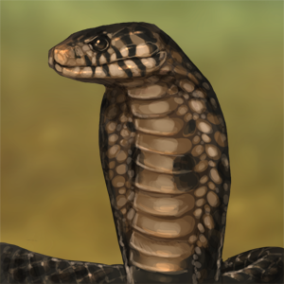
interdiction
Once upon a time. There was a evil snake in Pastaland. He ate
the pasta.Pastaland was losing the land.A stranger came and gave
Them 2 choices

Slide 3
Something happens…
you have 2 choices
Take advice
Don't accept

Slide 4
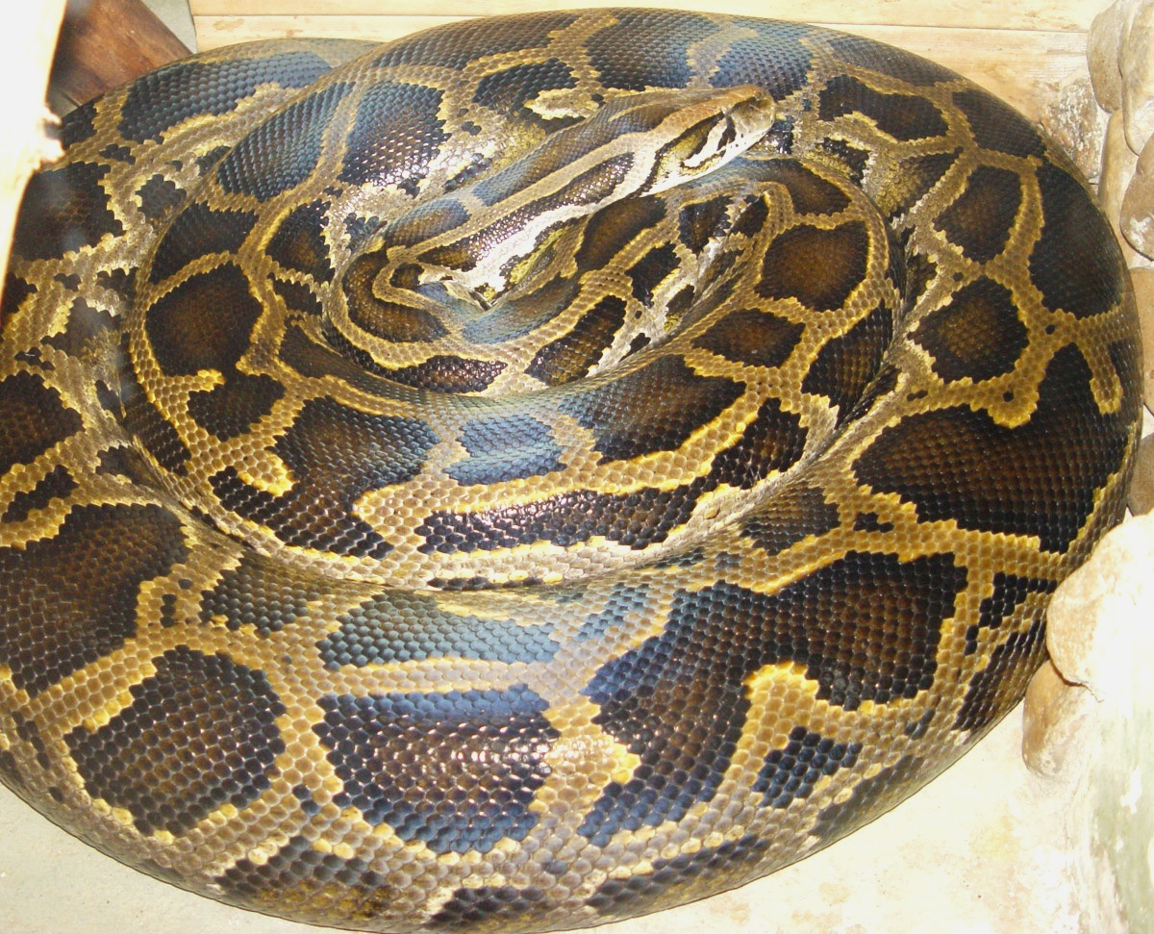
Choice 1
He tells you that he hates loud noices.Also he hates green and
Yellow.The snake comes back to pastaland.They did what the man
Told them he leaves the village. Then he comes back then he eats
The whole land
Try again
You lose TRY AGAIN

Slide 5
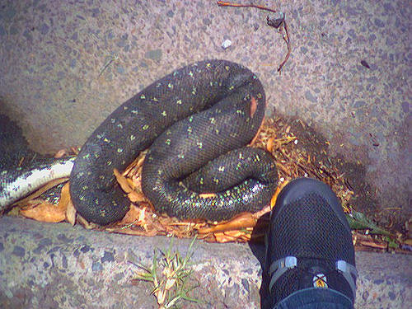
Choice 2
You don’t accept. You think of your own idea. You take spears and.
Then the snake comes and you hit him with your spear and he dies

Slide 6
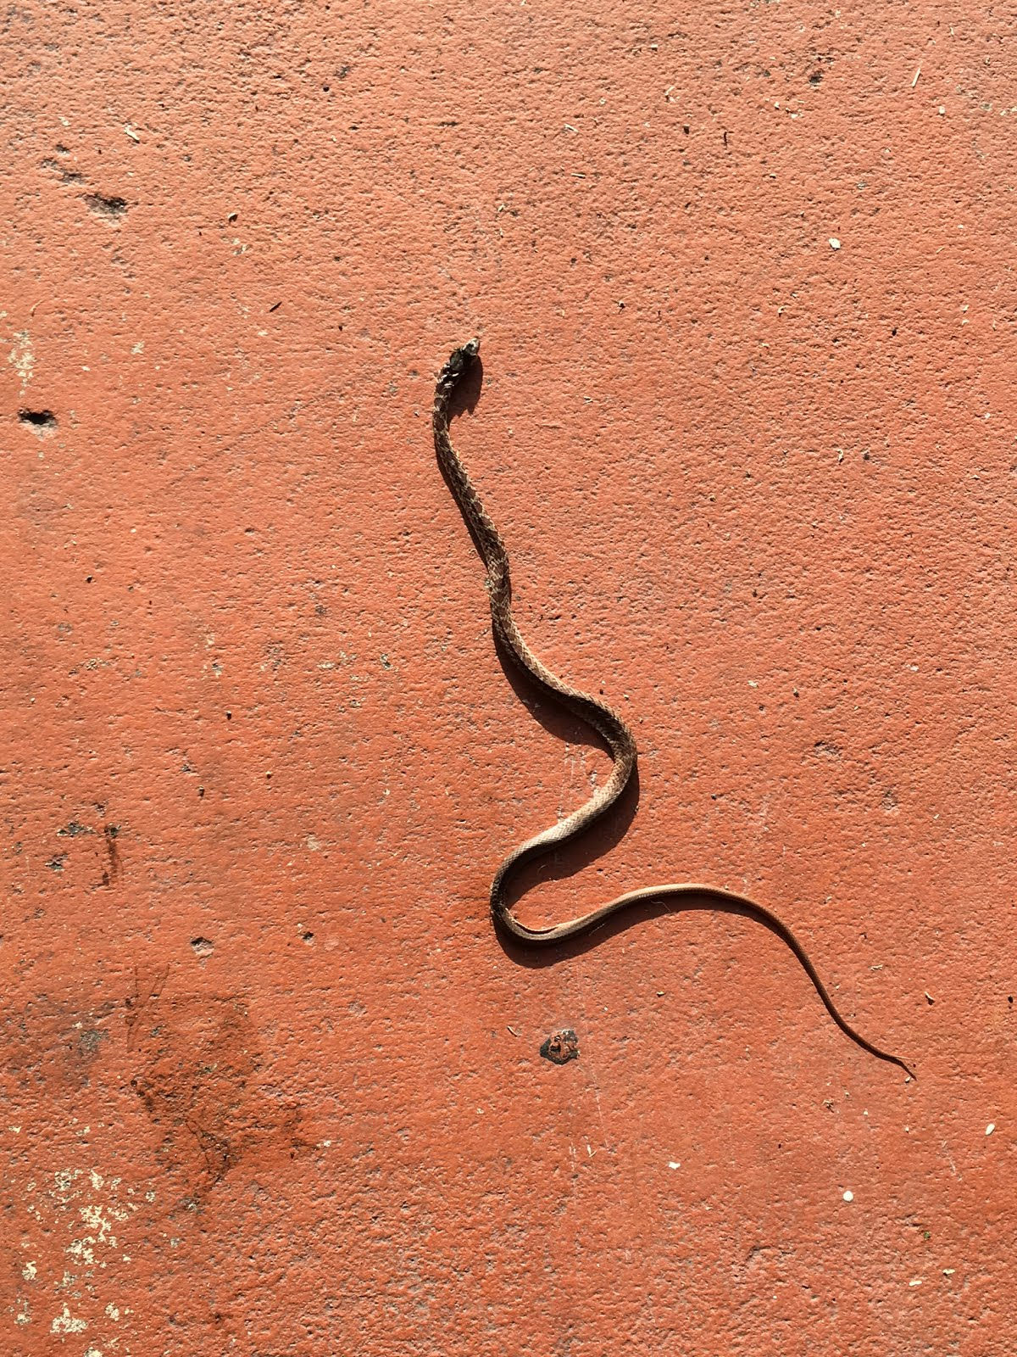
WHAT WILL HAPPEN
Then the babies come…
RUN AWAY
FIGHT BACK

Slide 7
CHOICE 1
You ran away. Then a different baby eats you
YOU LOSE TRY AGAIN

Slide 8
CHOICE 2
YOU fight back and hit the snakes with your spear and they die
You saved pastaland from snakes

Slide 9
Then a dragon comes…
Take your sword
Take your bow

Slide 10
CHOICE 1
YOU TAKE OUT YOUR SWORD AND THE DRAGON FLIES AND HE
SHOOTS A FIRE BALL AT YOU
YOU DIE TRY AGAIN

Slide 11
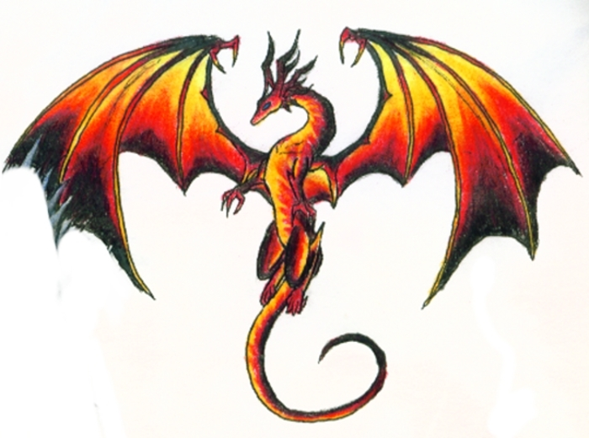
CHOICE 2
YOU take out your bow and shoot him and kill him
But then you see 50 more babies
Run away
Attack with bow

Slide 12
PATH 1
YOU run away and another one eats you
you lose try again

Slide 13
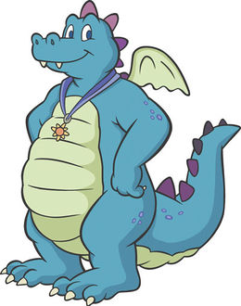
PATH 2
You kill them all with your bow
YOU WIN

