Slide 1
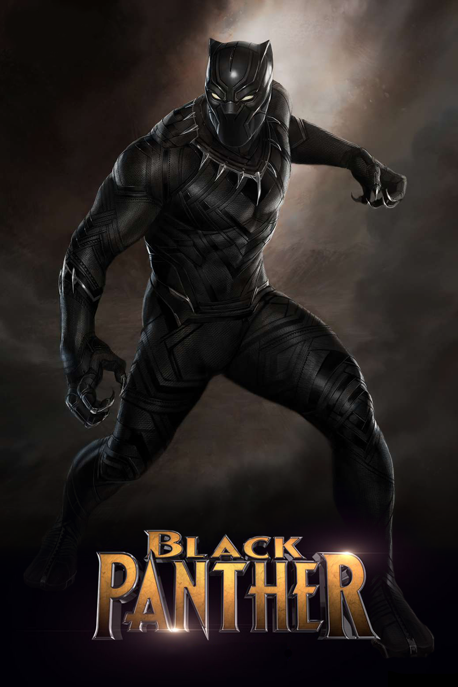
Mohamed

Slide 2
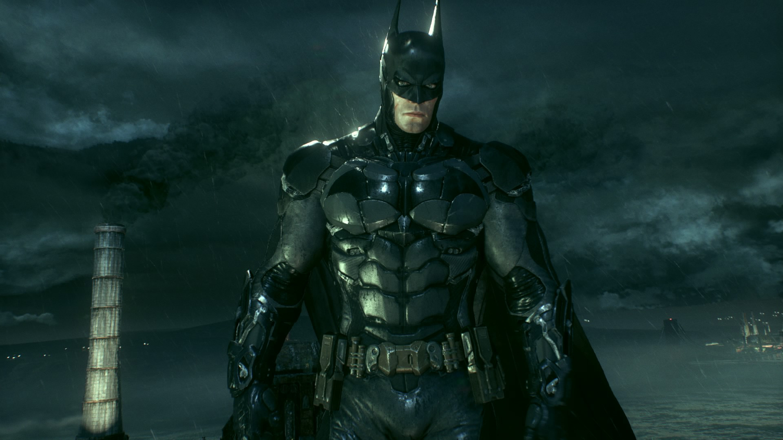
The adventure
Once upon a time there was an adventure and then a big monster came what should he do?
Call black panther or
Call bat man

Slide 3
You lose
You lose

Slide 4
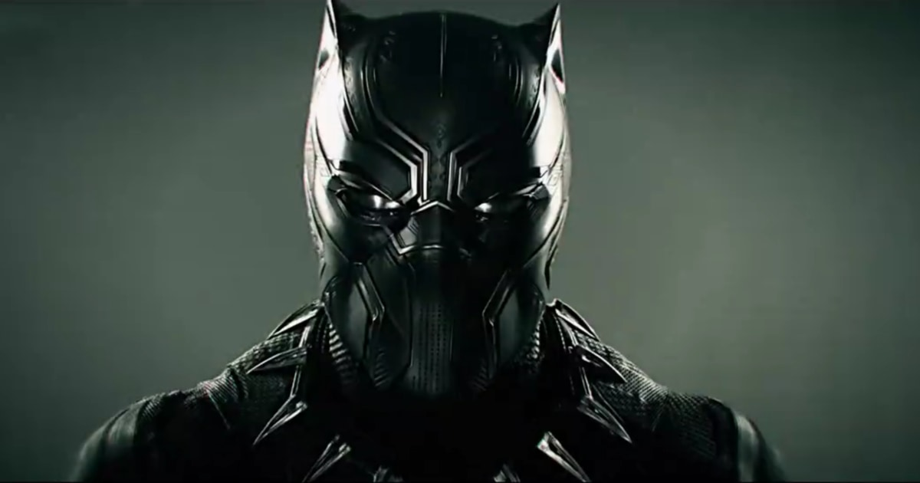
Black panther
Black panther killed the monster.

Slide 5
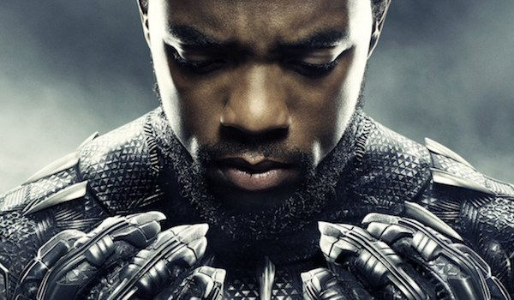
Bat man
Bat man fell a sleep.

Slide 6
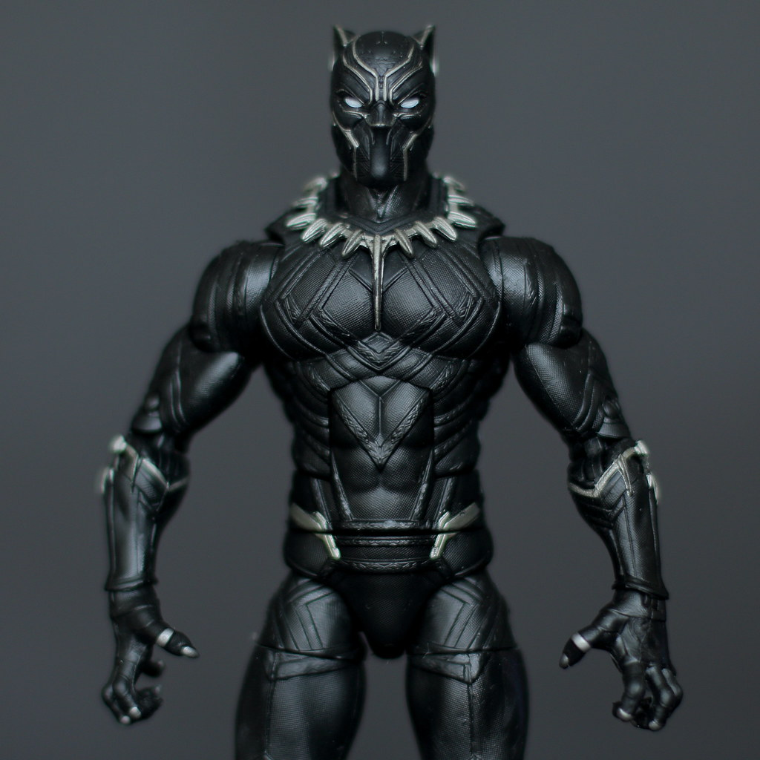
Bat man woke up
When bat man woke up he was confused he said what happened.

Slide 7
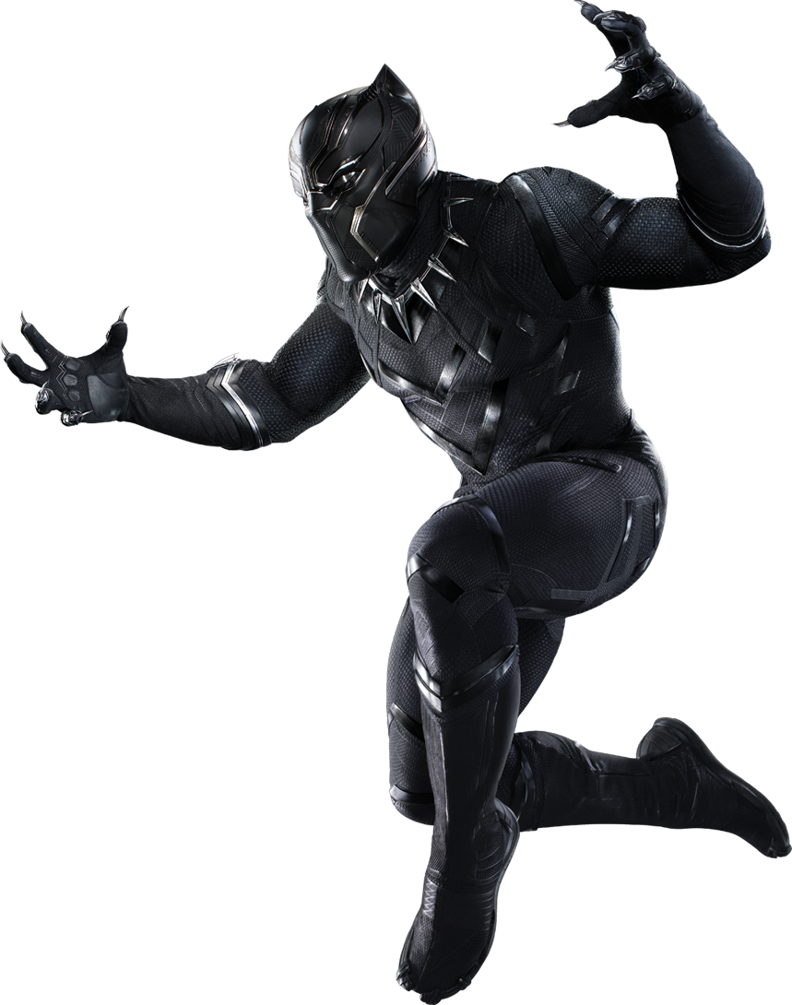
The monster woke up
What should he do
Get black panther
Get bat man

Slide 8
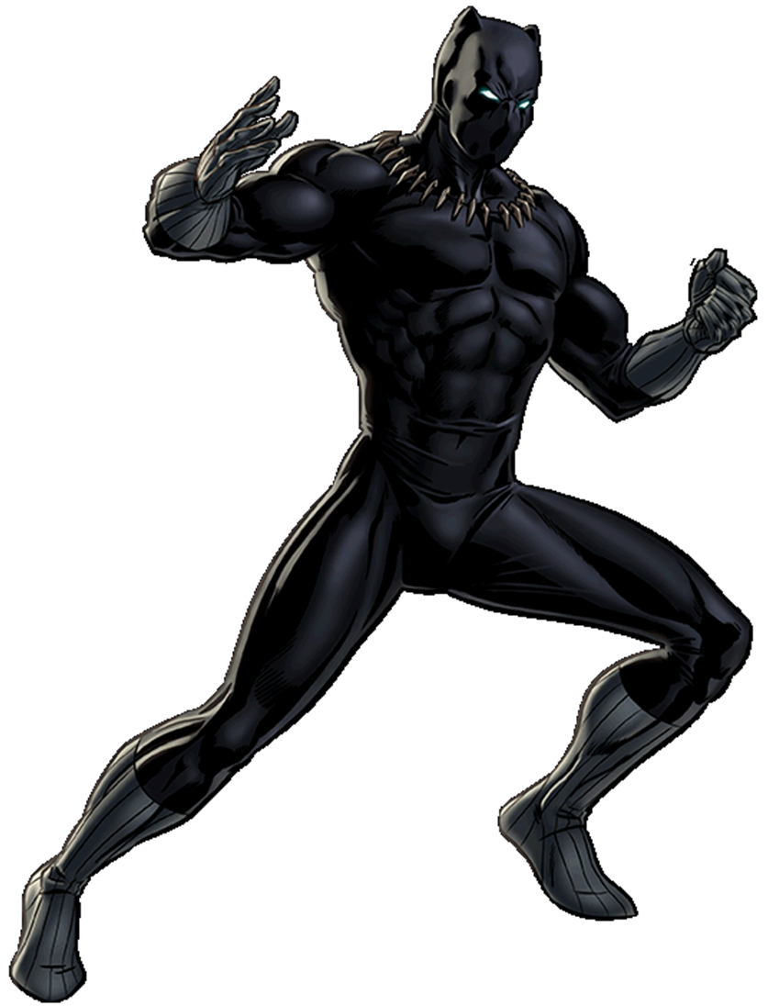
Who should I get
What should I do

Slide 9
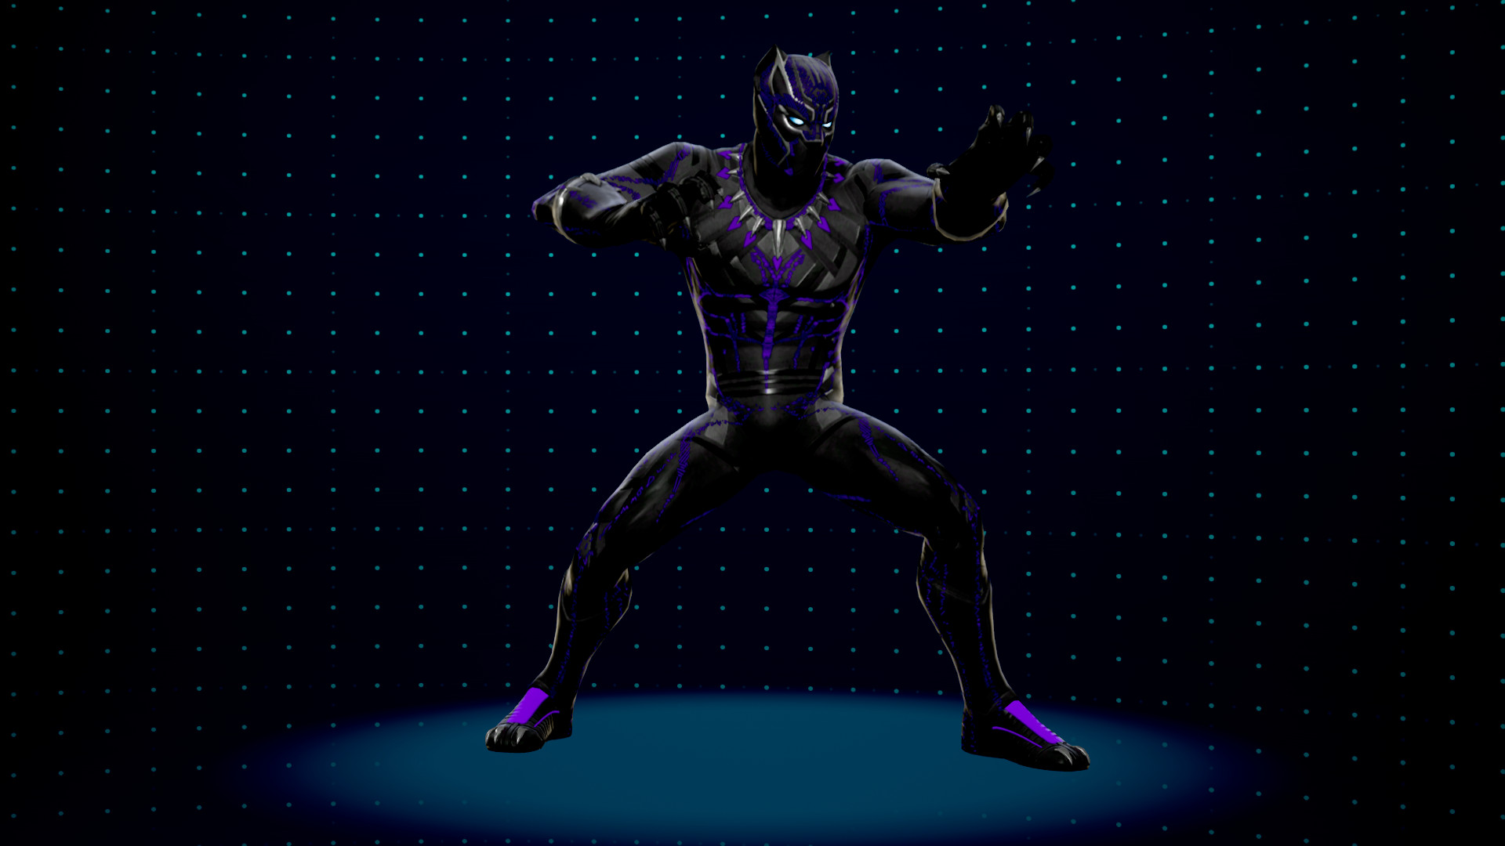
Get Black panther
They start to fight.

Slide 10
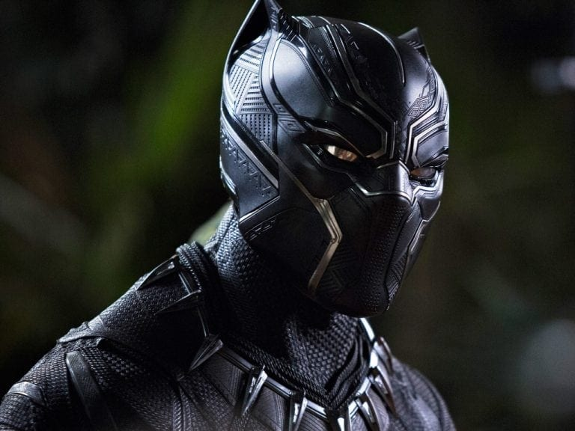
The end
He should get black panther because black panther killed him.
Play Again?

