Slide 1
Munaura r4
Labs and babs

Slide 2
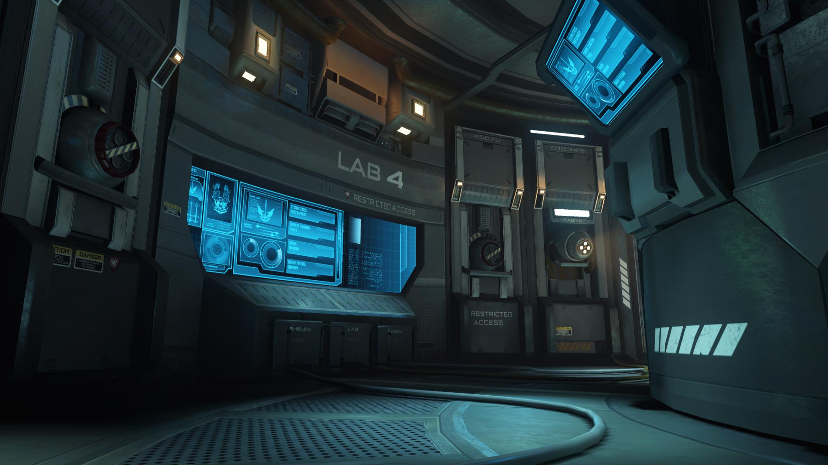
In the lab of…
It was meeting time in the lab of landen the lion. While the group was having there meeting keil the cub wanted to join in should he
sneak up on them
Leve them alone

Slide 3
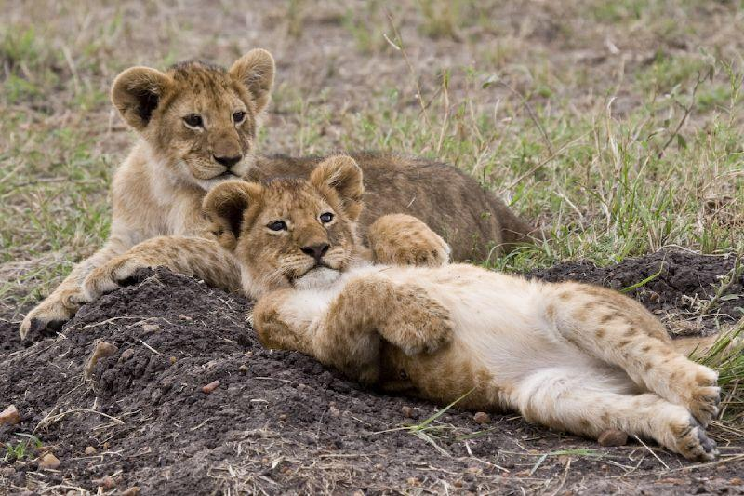
Sneak up on them
Kile the cub gets cot and grouned

Slide 4
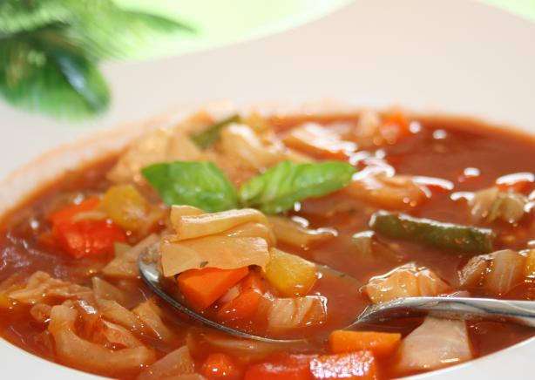
Leve them alone
Kile gets bored and his mom makes him souop

