Slide 1
Nafissa w4
Forest.

Slide 2
Their once was a girl…
Her name was Lilac…
She had a pet bunny named Forest…
But little did Lilac know.. That her.. Bunny.. Could protect her..
Few days later.. Her village got attacked.. But her bunny did something… amazing..

Slide 3
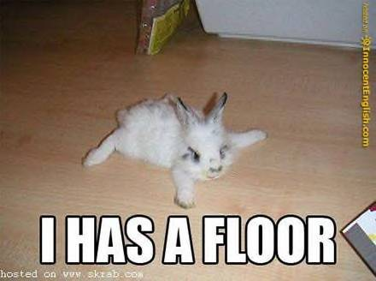
The bunny…
Gave Lilac powers.. But she couldn’t use them…
But just as she went to bed.. A monster attacked
What should Lilac do?
1: Run..
2: Fight back..

Slide 4
Run,
The monster does a freestyle dance
While chasing you
It soon got to you and teleported you to a pit of lava.
YOU DIED…

Slide 5
Fight Back..
You suddenly use your black hole…
You suck in the monster
Destroying it,
while the monster does a freestyle dance,
After that you and your bunny forest
Start laughing there brains out.

Slide 6
After that
You go to bed, your bunny sleeps on you.
The next day
Forest woke you up
To find that
Forest found a baby bunny!
what do you do?
Adopt it
Leave it to die

Slide 7
Adopt it!
You adopt it.
You realise forest and the adopted bunny both had powers!
Then you name the baby bunny..
Star!
A few minutes later
You get attacked.
What do you do?
Save The Universe!

Slide 8
Leave it to die…
You leave it to die,
Forest gets very angry
And kills you with a giant clock
YOU DIED!

Slide 9
Save the world!
You save the world!
YOU WON!

