Slide 1
Nick a4
A GIANT DOGE

Slide 2
ONCE UPON DOOG WORLD A GIANT DOGE WAS BREEDED
You were looking at dogs then a giant pupper came and destoyed anything in sight
do you…
Pet it
Run at it

Slide 3
Run at it… you cant beat him you lose he eat you

Slide 4
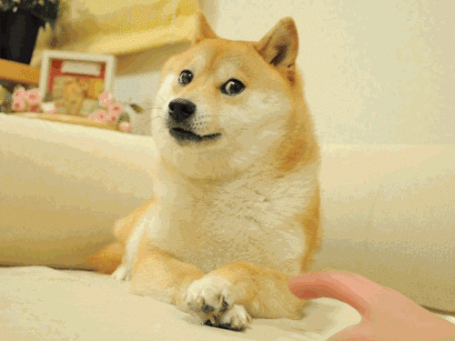
Pet it
You pet it and it throws you in the air and you land on him.
You win.

Slide 5
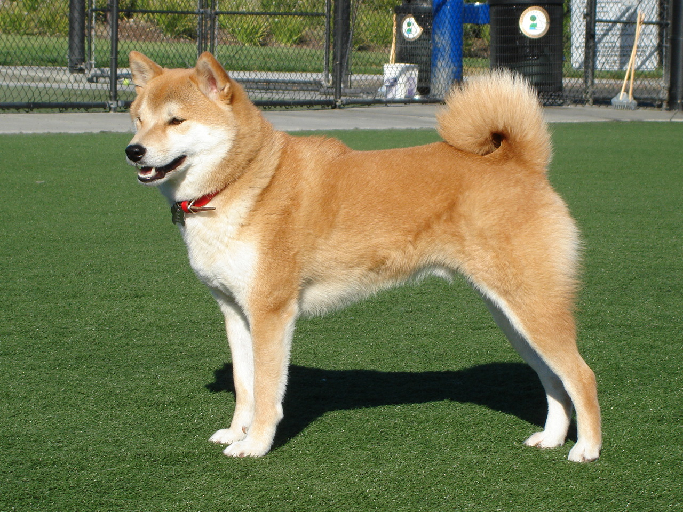
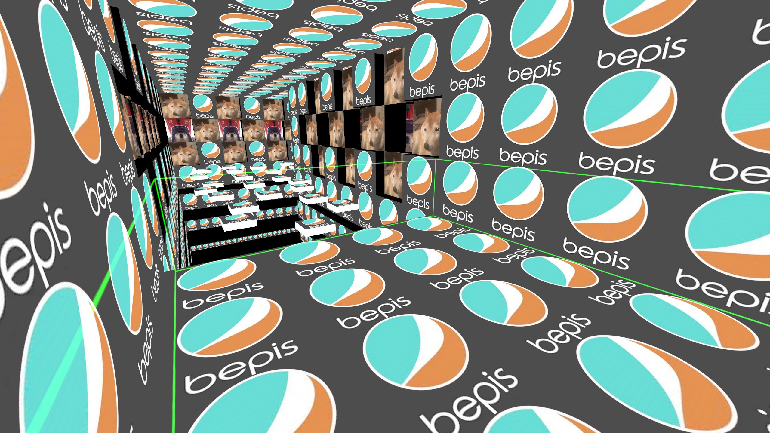
Bonus Slide
He bork at you because he has no bepis he need your help fren

Slide 6
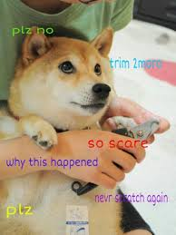
The adventure begins for doge fren for bepis
You are looking on the hills looking for bepis
But doge protect it so you cant get it do you…
Summon giant doge or
Do you run at it

Slide 7
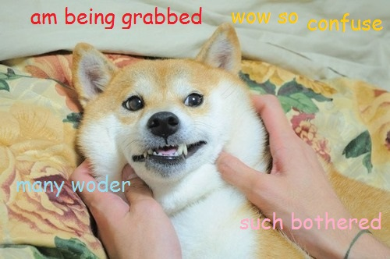
Run at it
You run and you jump over it grab bepis and run. You win.

Slide 8
Summon giant doge
Giant doge is summoned and they fight and bork. You lose giant doge has been defeated.

Slide 9
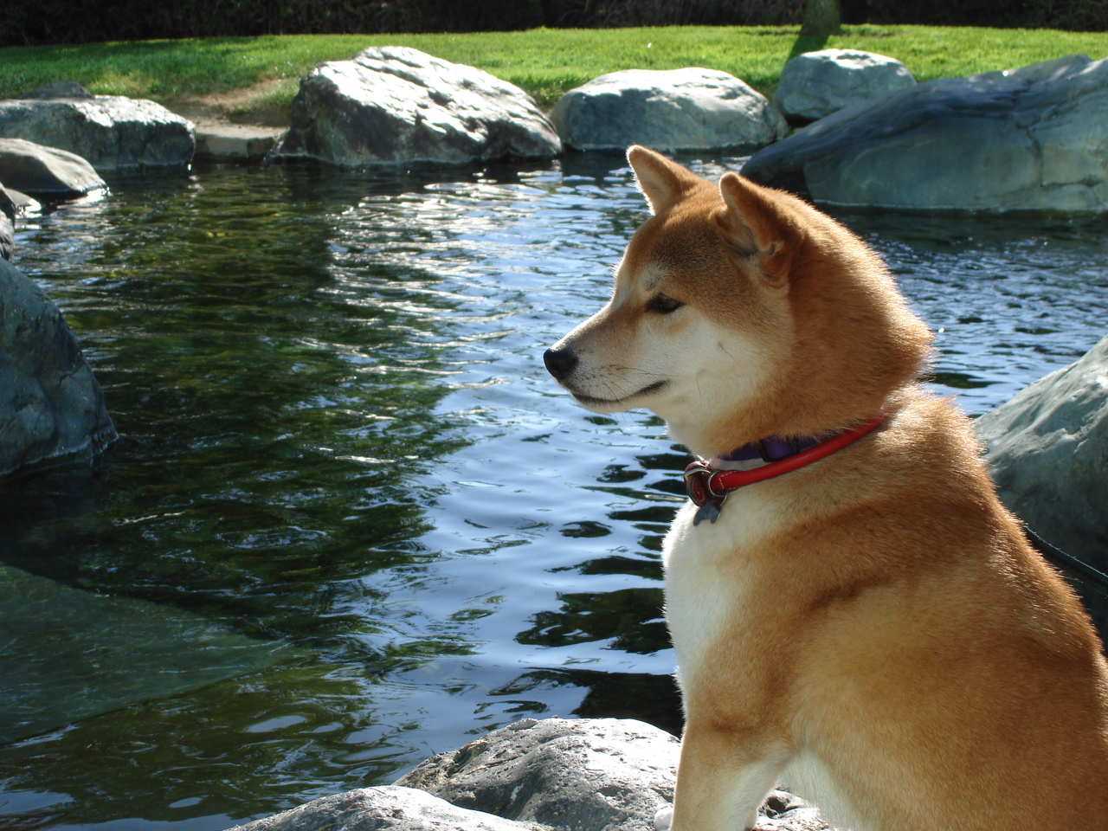
You need to pass parkour where mini doge helicopters shoot at you with lazers
Do you
Pull a tile a use it as shield or
Run and hide

Slide 10
Pull a tile you win

Slide 11
Run for it and hide you dead

