Slide 1
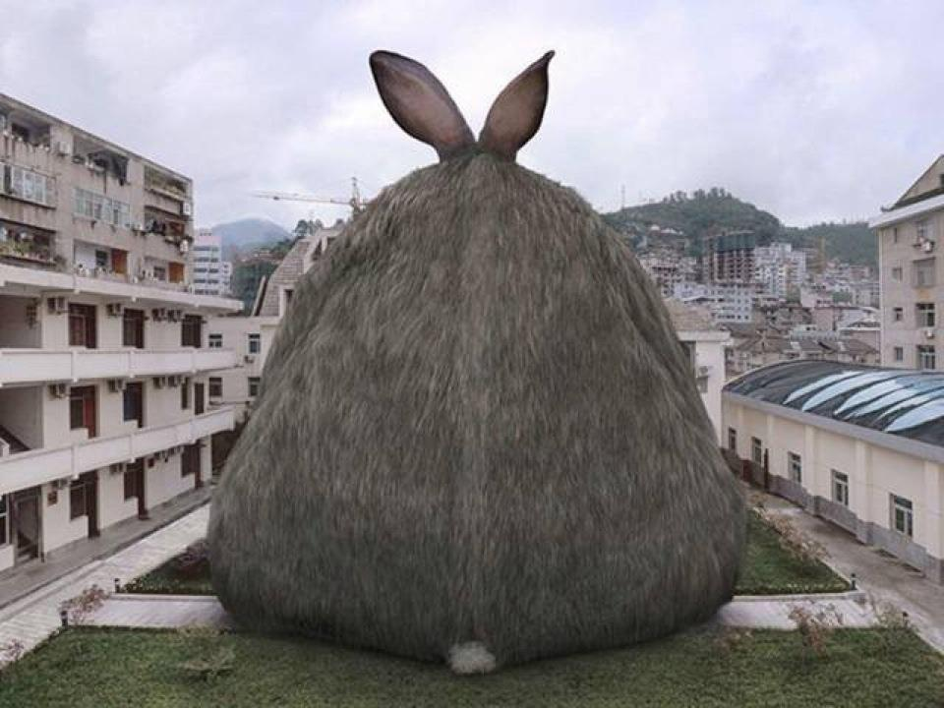
Nickw4
The attack of the giant bunnies

Slide 2
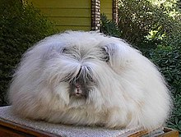
Once upon a time
There was a lovely village
You were at the top of a hill and a giant bunny attacked you
Run away
Fight it with a stick

Slide 3
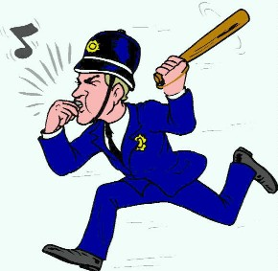
Fight it with a stick
You start running up the hill and the Fluff of the bunny overwhelms you the end.
Restart

Slide 4
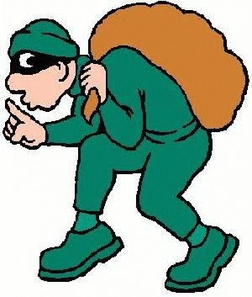
Run away
You run in to a forest and all of the sudden you get hit by an acorn you look up in the sky but you see nothing. And you find a chest of gold and you find a riddle if you take this treasure your life will end in a short time if you do not take this chest you will get a bigger reward.
Take the chest
Don’t take the chest

Slide 5
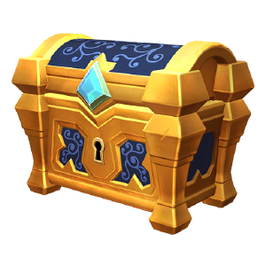
Take the chest
All of the sudden you get weaker and weaker and weaker and then you fall into a hole you die.
Restart

Slide 6
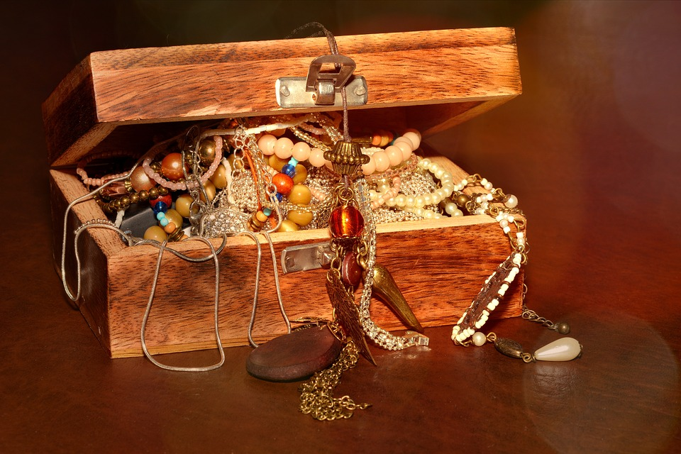
Don’t take the chest
You survive the attack you find something shinny you start digging it’s a chest. It has everything you want.
YOU WIN!!!!!!!!!!!!!!!!!!!!!!!!!!!!!!!!!!!!!!!!!!!!!

