Slide 1
Noah R4

Slide 2
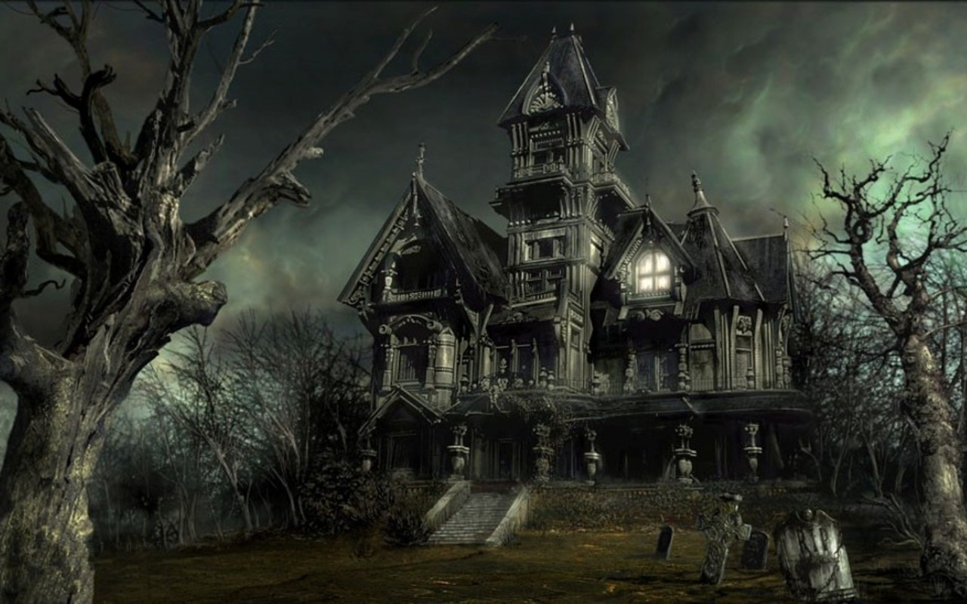
it was a dark and a stormy night
Then you walk by a house it was ugly and scary night

Slide 3
Go in
Run away

Slide 4
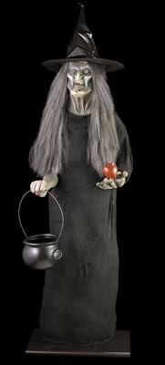
You get killed by a witch

