Slide 1
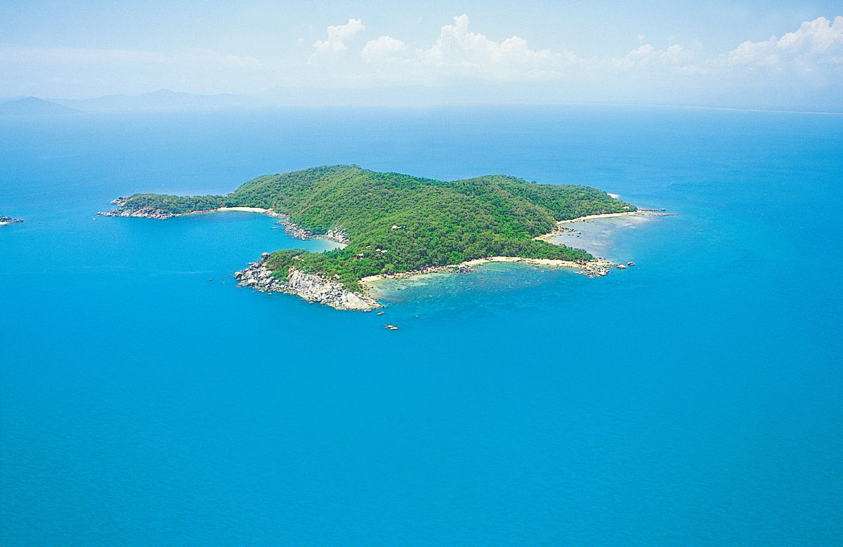
Oliver Castaneda
The lost island

Slide 2
A LOST ISLAND ?
A long time ago, there was a island called Atlantis. It was a beautiful island , but one day it sank.
Search for it.
Give up

Slide 3
Give up
GAME OVER !

Slide 4
Search for it
You chose to search for it. Do you
take A :
PLANE
or
BOAT

Slide 5
PLANE
Your plane crashes.
GAME OVER !

Slide 6
BOAT
The boat takes you to 2 portals
Right portal
Left portal

Slide 7
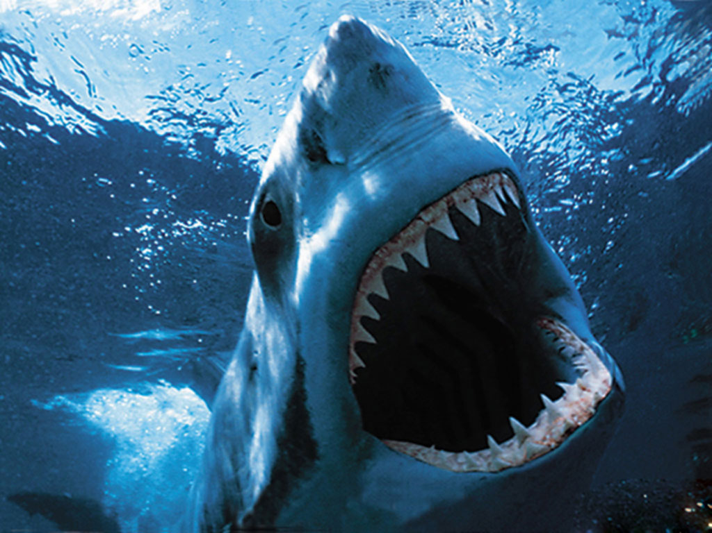
RIGHT PORTAL
A shark eats you.
YOU LOSE!!!!!!!!!!!!!!!!!!!!!!!!!!!!!!!!!!!!!!!!!!!!!!!!!!!!!!!!!!!!!!!!!!!!!!!!!!!!

Slide 8
LEFT PORTAL
You find Atlantis
YOU WIN!

