Slide 1
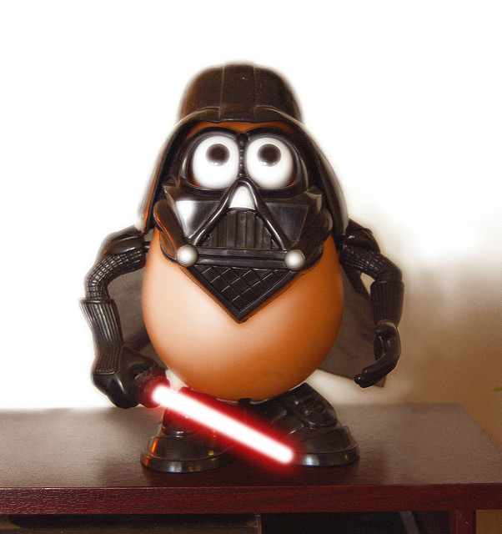
Potato attack

Slide 2
You wake up.your late to work!

Slide 3
First choices
Do you….
Take your time
rush

Slide 4
Thing 1
You slowly get your stuff. Suddently a darth vader potato hits you with his lightsaver!
You died!
Try again

Slide 5
Rush out the door
You run out the door and go to work.at the end of work do you
Go out the front door
Go out the back door

Slide 6
Path 1
You go out the front door.suddently gigatorchwood shoots you by accident.
again
You die!

Slide 7
Path 2
You go out the back door.do you
Run
Take your time

Slide 8
Path 1
You run home and go to sleep.in the morning do you
Go to work
Take the day off

Slide 9
Path 2
You take your time.when you go out the door darth vader potato kills you.
Try again
you lose

Slide 10
Path 1
You go to work.
Your work is destroyed!
Plants are attacking darth vader potato.
Do you
Help them
run

Slide 11
Take the day off
You take the day off
Suddenly storm trooper potatos attack.
again
You die!

Slide 12
Help them
You grab a lightsaver on the ground
Do you
Take a loop
charge

Slide 13
run
You run.
A laser hits you.
again
You die

Slide 14
Path 2
You take a loop.
You accidently get hit.
Do you
Continue
Stop
run

Slide 15
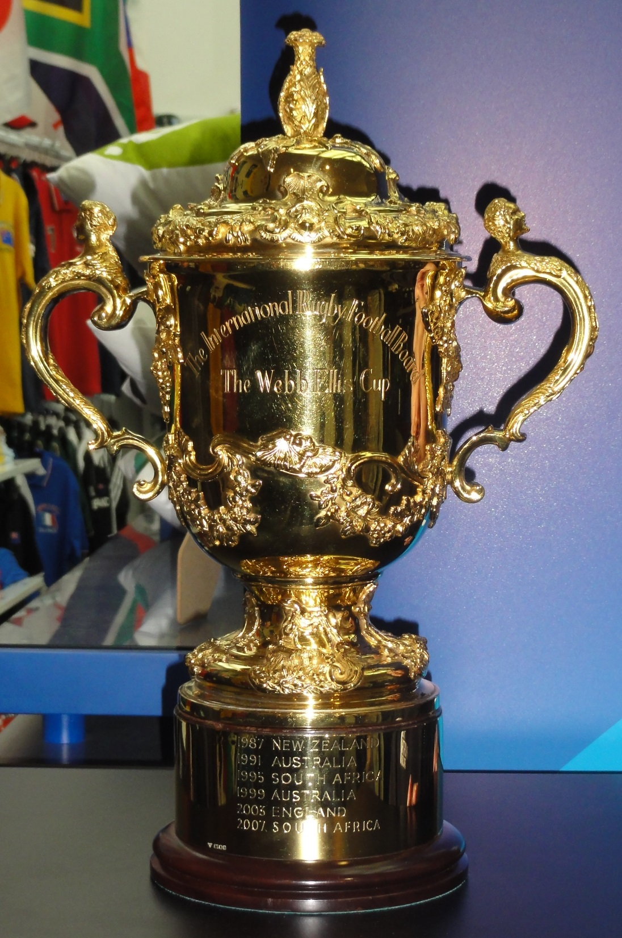
continue
You charge and kill darth vader!
You win!

Slide 16
stop
You stop and have death by a Stormtrooper potato.
Try again
Game over

Slide 17
You run
You run and fall into a lava pit
Try again
Game over

