Slide 1
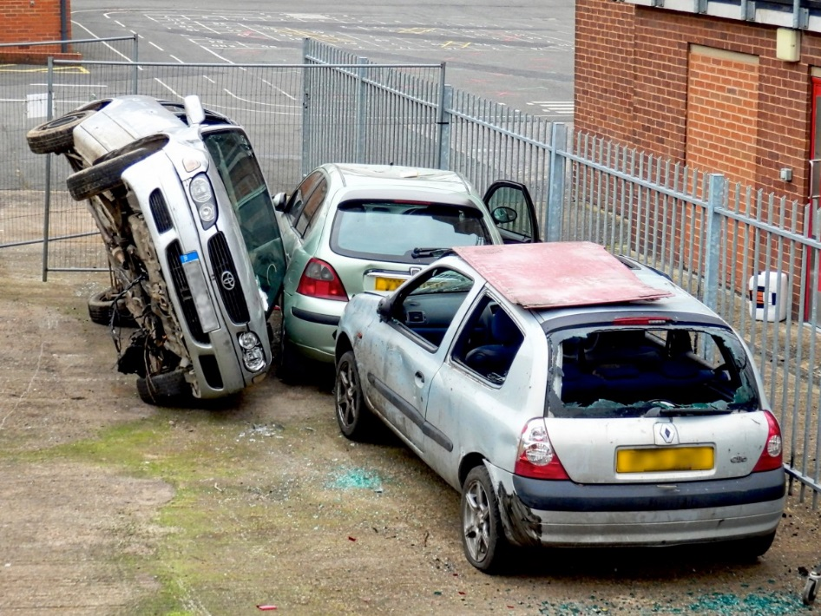
Riley r4
The car crash

Slide 2
You are driving when someone drives into you!!do you…
Try to get out
SACRIFICE!!!

Slide 3
SACRIFICE!!!
You sacrifice yourself and die! MUAHAHAHAHAHAHA!!!!!!!!!!! ☺☺☺

Slide 4
Try to get out
The fire almost got you!!
But you escaped!!!!
You get home and someone is robbing you!!!!!!!!!
Do you…
Fight him
Run away

Slide 5
Fight him
You try to punch him, but because you had guns in your house, he shot you!!!!! YOU DIE

Slide 6
Run away
You ran you are safe!!!! Good Job!!!!

