Slide 1
Roseline r4
Creepy dolls

Slide 2
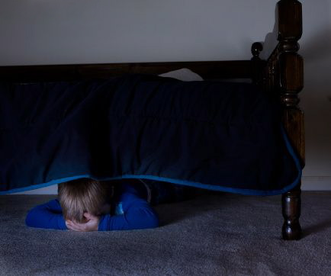
You wear walking and you saw a portal.
Do you…
Go in
Or go back to bed

Slide 3
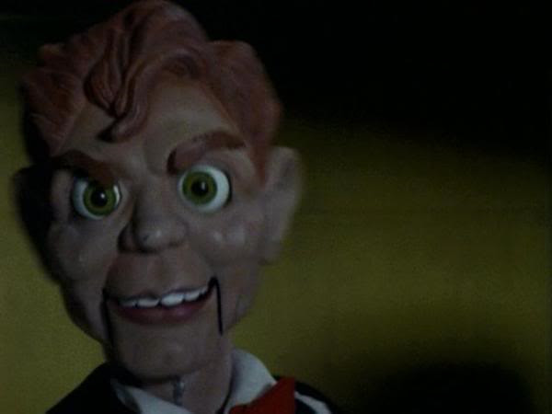
Go in …

Slide 4
Go to bed.
You go back to bed and you die in your nigt

