Slide 1
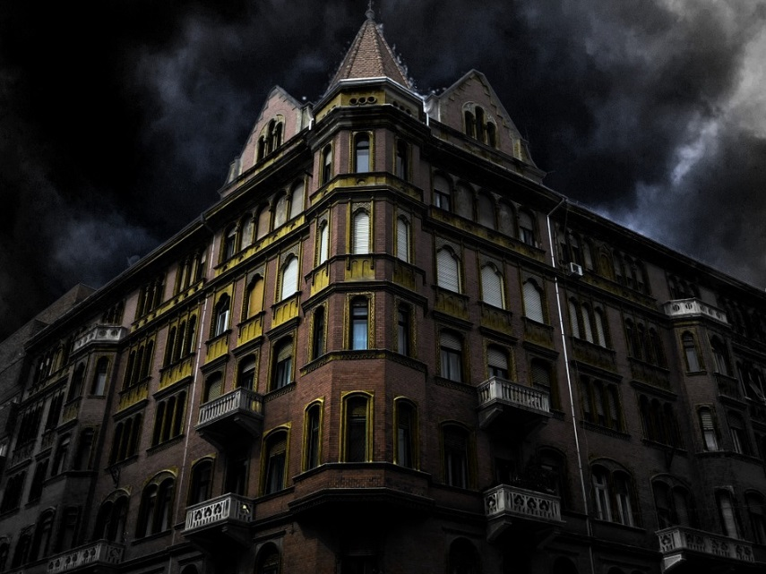
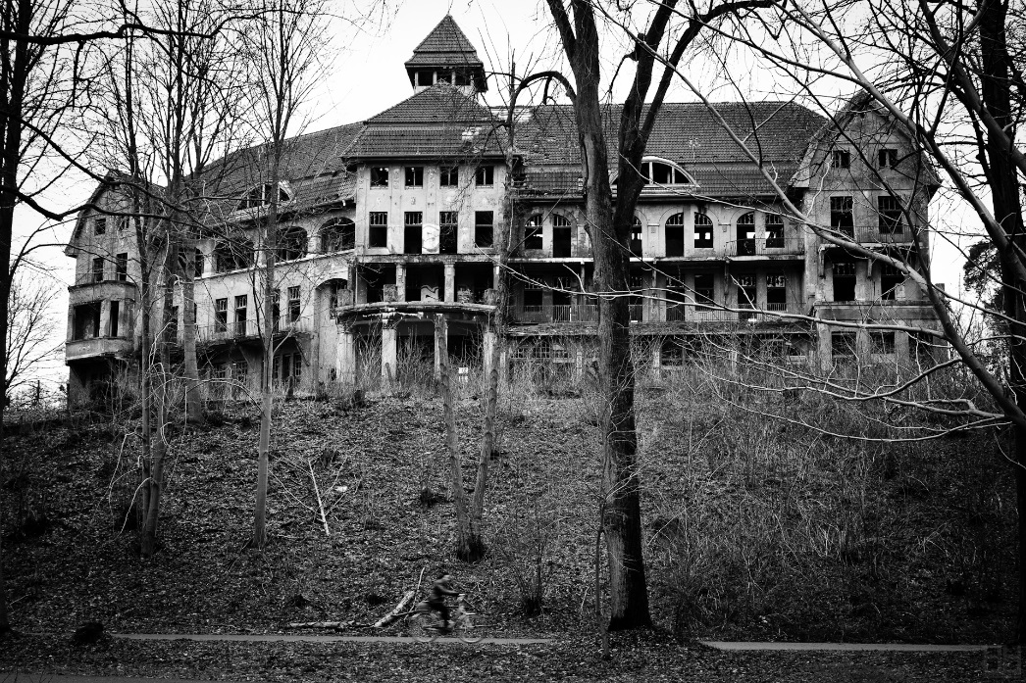
SatiannaR4
The haunted school

Slide 2
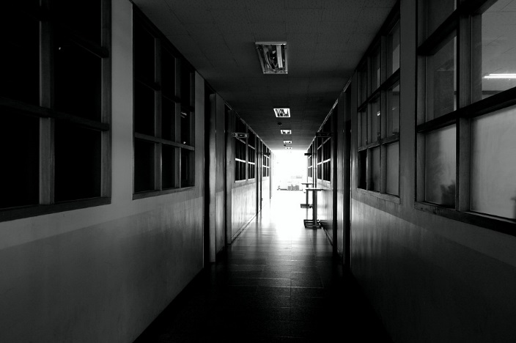
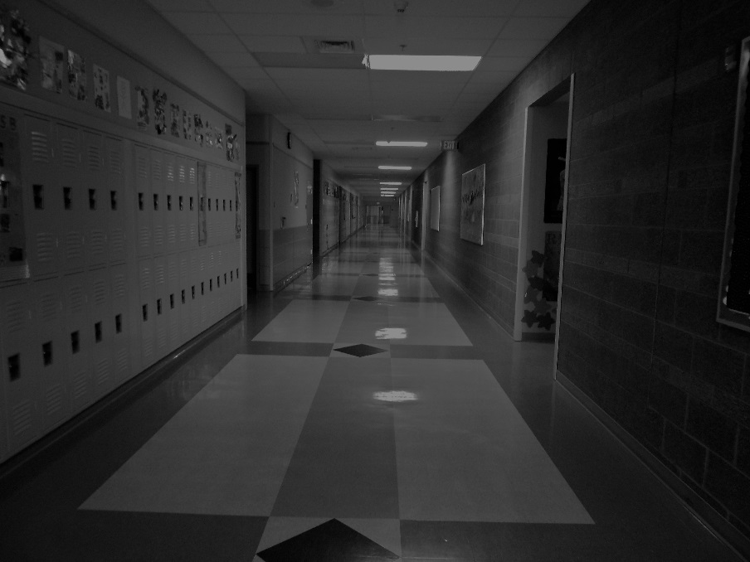
One stormy day you went to school and there was no one there
What do you do
Walk around
Run all the way home

Slide 3
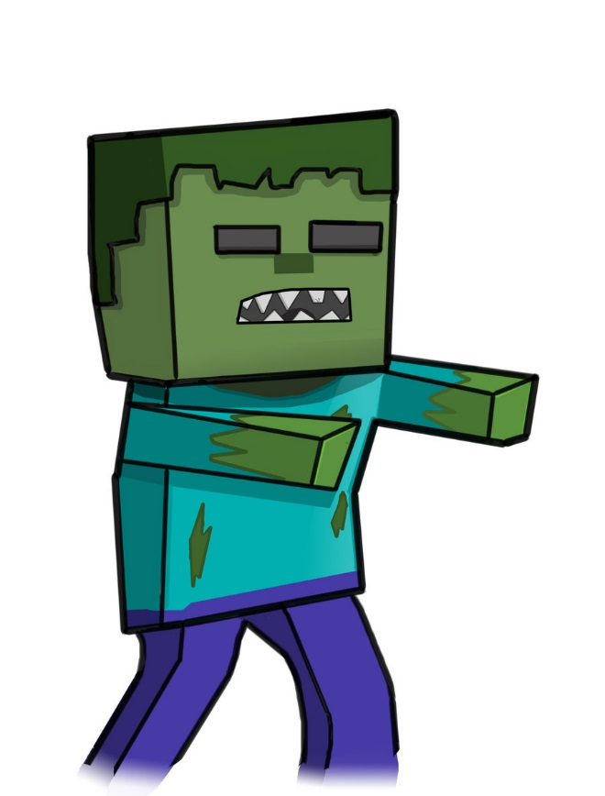
You walk around
There is a zombie going to attack you!
What do you do
Run
Attack back

Slide 4
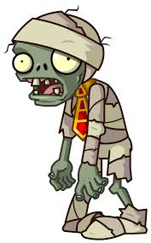
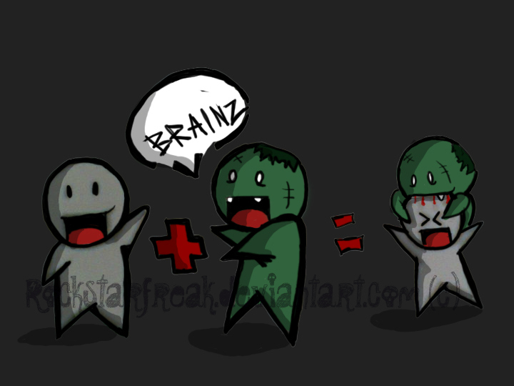
You attack
You get hurt

Slide 5
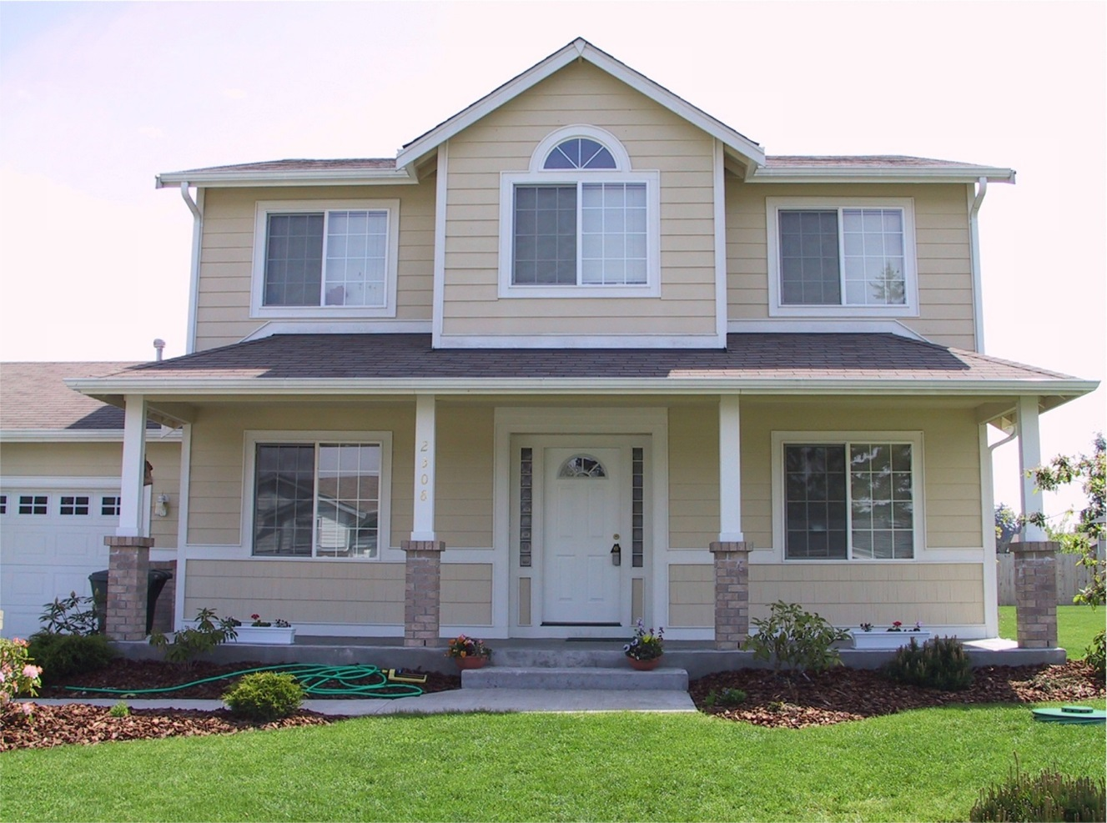
You run home
Do you tell your parents
Or pretend it never happend

Slide 6
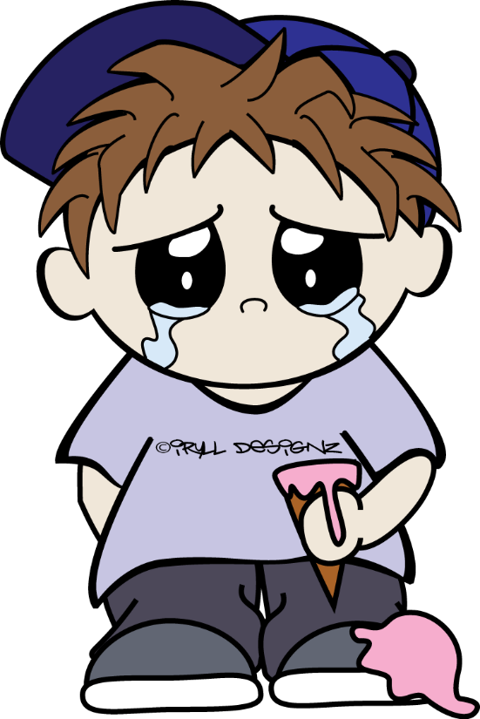
You tell your parents
Your grounded for the rest of your life

Slide 7
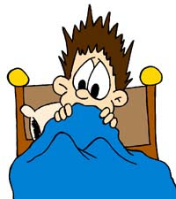
You pretend it never happened
You never go to school again

