Slide 1
shaadiyaA4
The mysterious sea creature

Slide 2
One upon a time it was a dark and scary night…
You were swimming in the when you suddenly saw a black shadow
What do you do
Run away and tell you friends
Scream and run at it

Slide 3
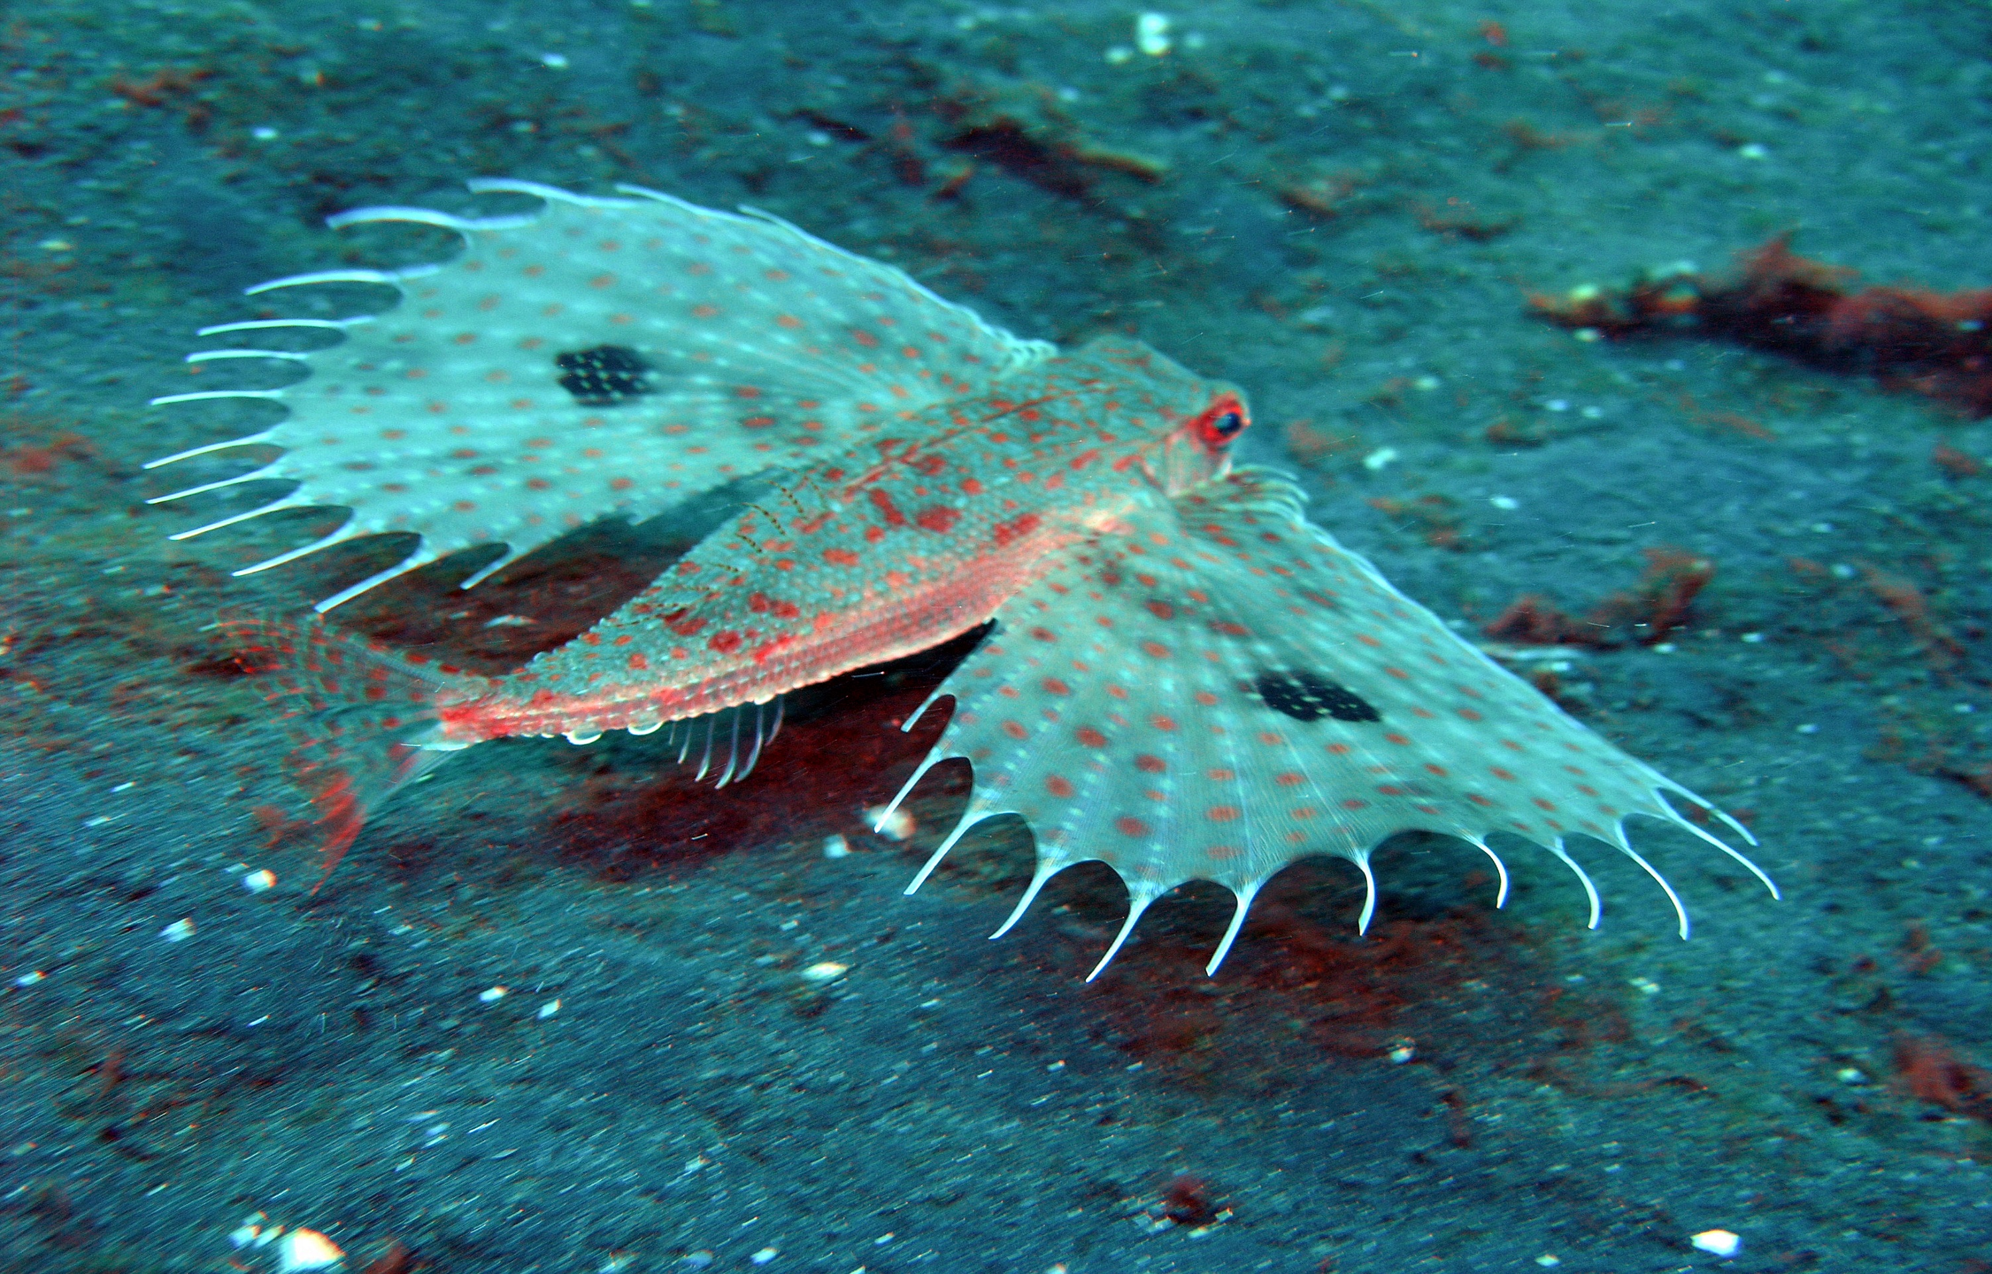
Tell you firends
Then it runs after you then it eats you alive

Slide 4
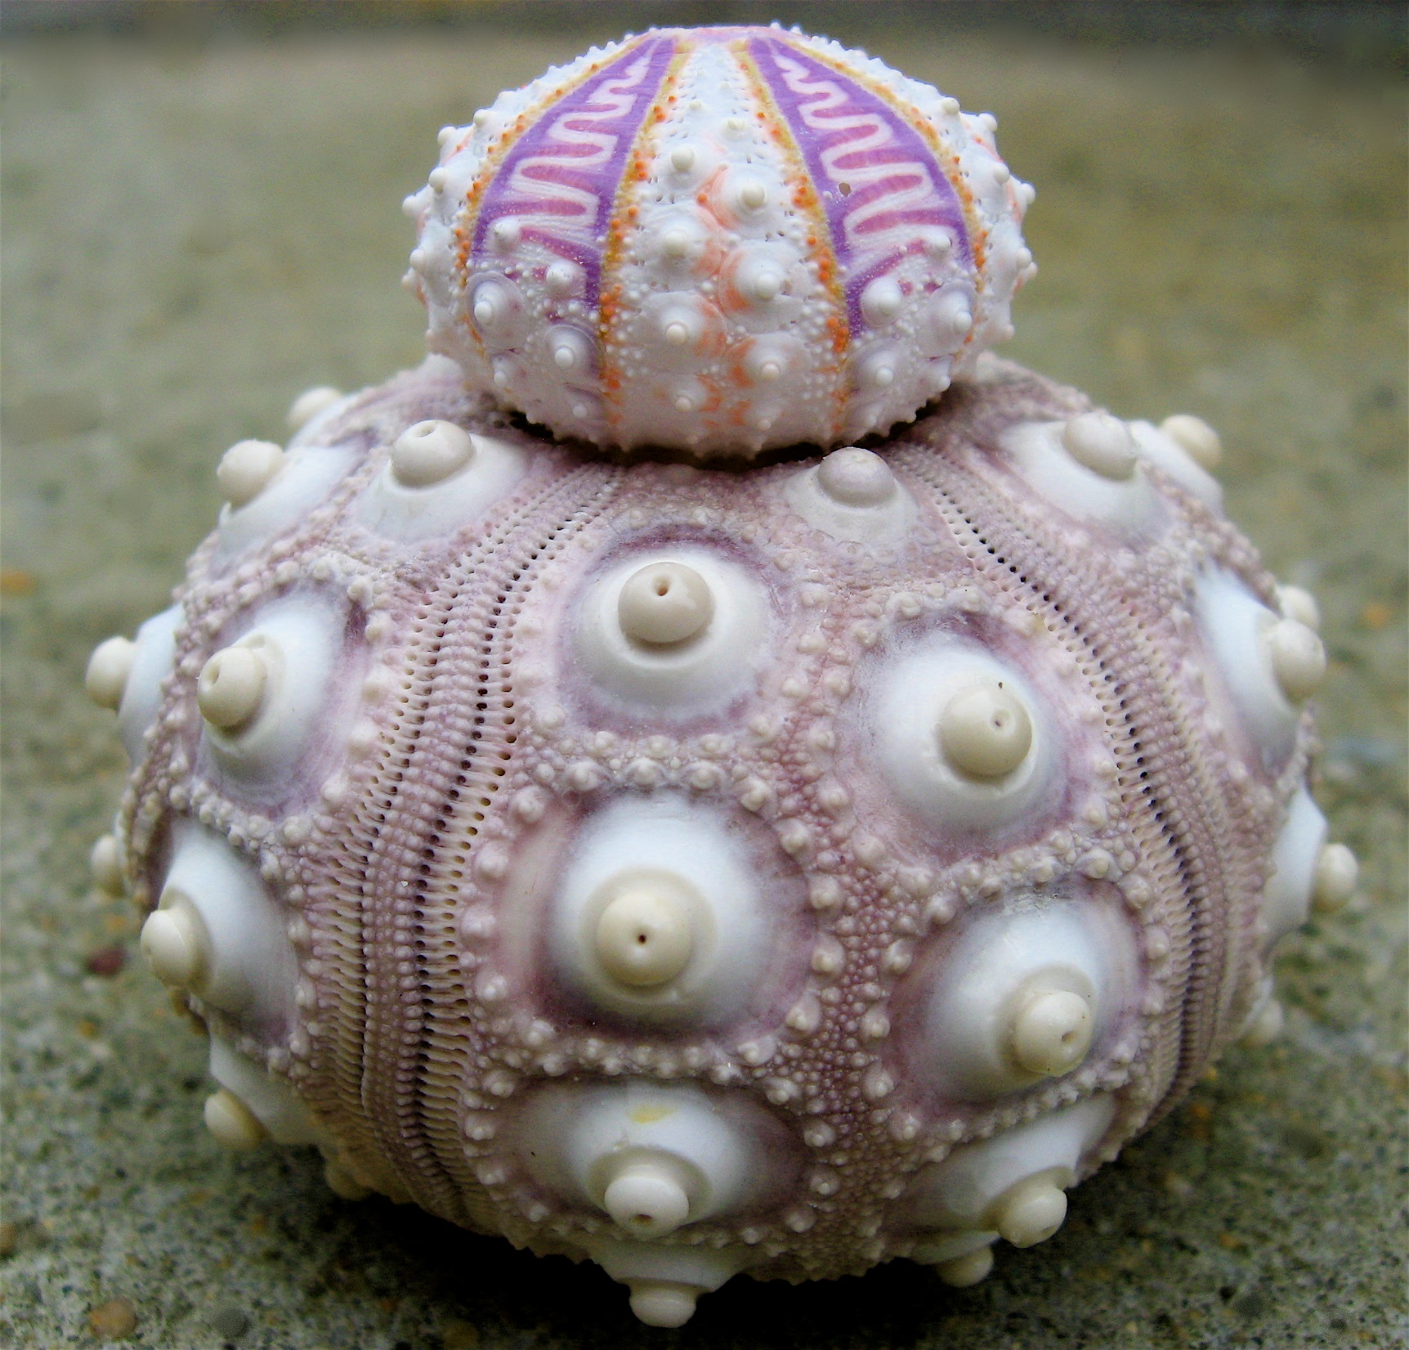
You scream and run at it
Then it goes back in the sea

Slide 5
go home and tell your friends
And then they did not believe you so you go back to the mysterious sea creature

Slide 6
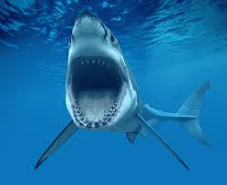
It eats you alive
GAME OVER…!

