Slide 1
Shane a4
Five nights at freddys

Slide 2
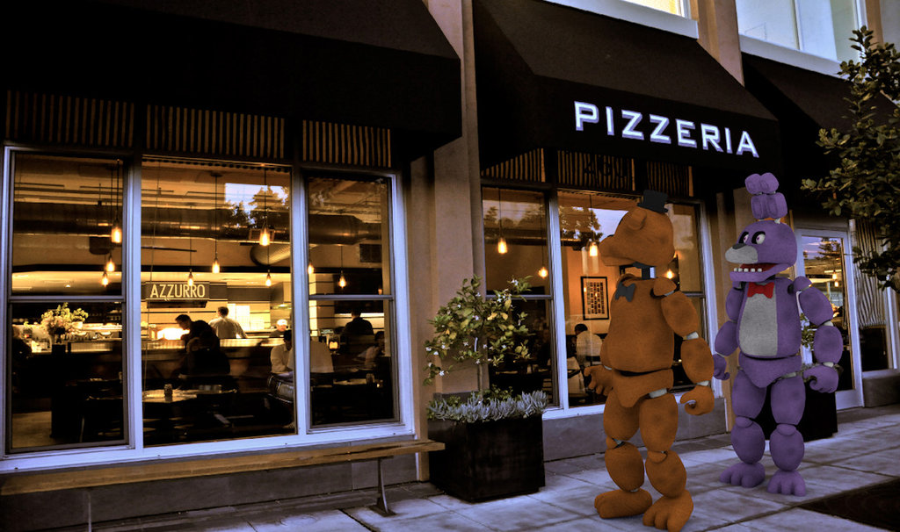
The pizza zone
It was 12:am he had to work at his night shift

Slide 3
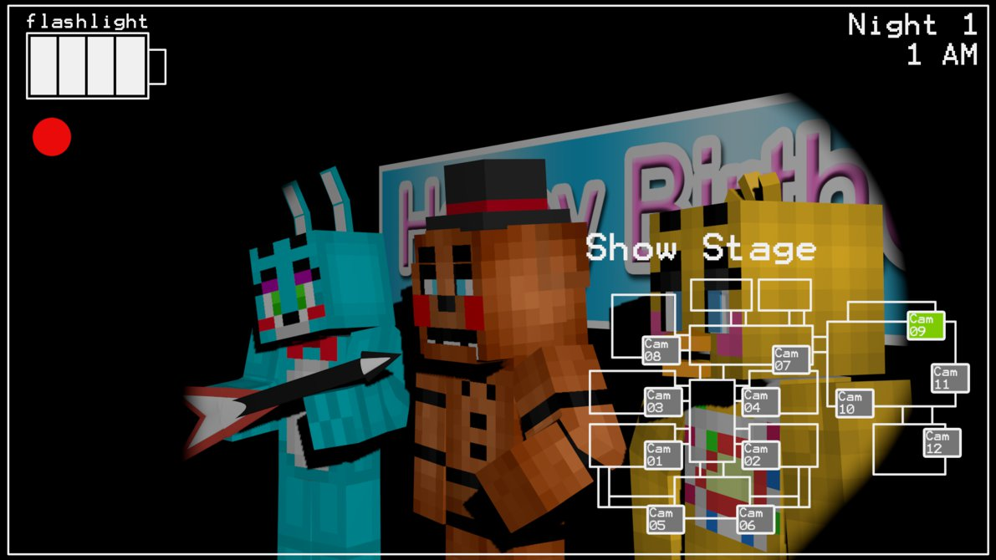
He went in his office and got on a camera
He had to make sure a robber did not steal anything

Slide 4
Then he herd something
Should you
Go out side the office
Or
Stay in your office

Slide 5
Go outside the office
You went out side and there was a black figure
Do you
Go back inside the office
Or
Run to the black figuare

Slide 6
Stay in office
You stay in the office then the powers out
Do you go to the genurater
Or you close the door

Slide 7
Close door
You close the door but you forgot that the powers out the dude chokes you to death
Game over

Slide 8
Go back INSIDE THE OFFICE
You go back to the office and the power is out
do you go to the generater
Or stay in office

Slide 9
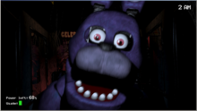
RUN TO THE BLACK FIGUARE
YOU RUN THE BLACK FIGUARE
THEN
HE CHOKES YOU

Slide 10
Go to generater
You go to the generater and turn it back on you you go back to the office but
You see 4 people but they Just stay there its 6 am so you go to the exeit
You win

Slide 11
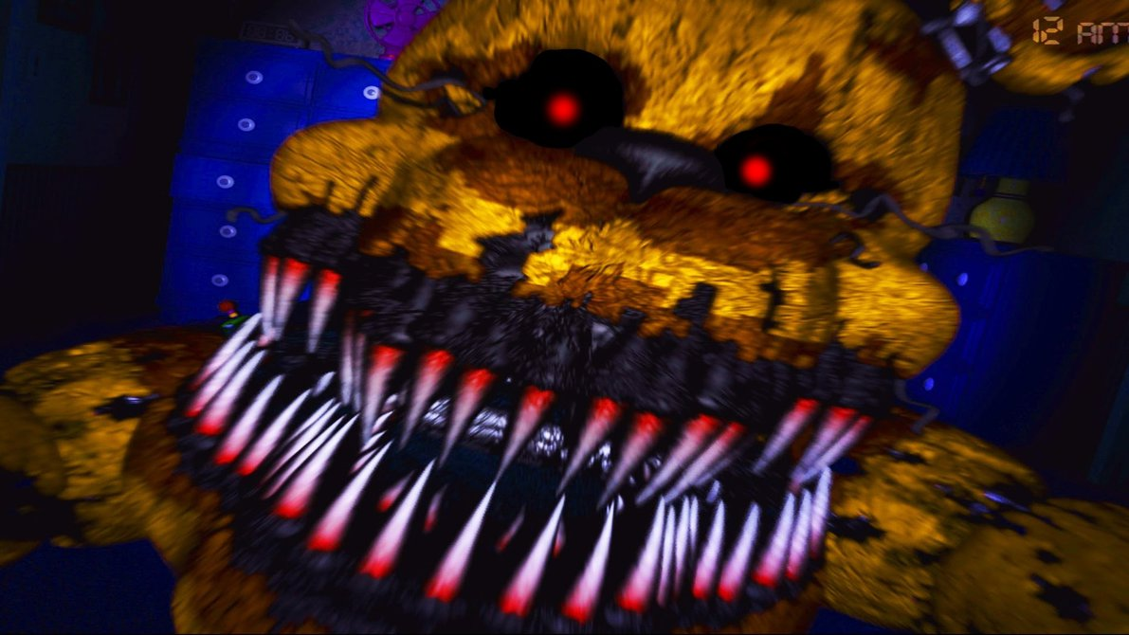
Stay in office 2
You stay in office but you see eyes you stay at your seat but the person punches you until you die
Game over

