Slide 1
shoukhanA4
Theirs a monster under your bed!!!

Slide 2
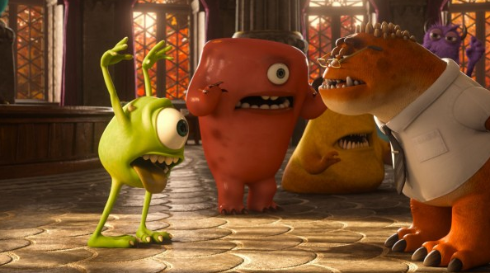
Once upon a time it was a dark night...
You were sleeping then suddenly you woke up because their was a noise under your bed…
Do you…
Look under your bed
Do you go running to your parents

Slide 3
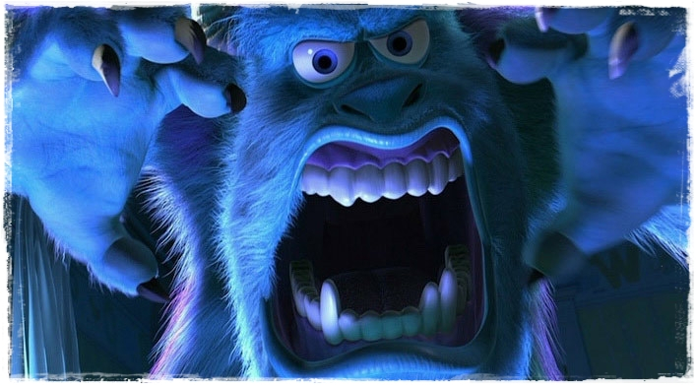
Look under your bed!!!
So you’ve seen the monster and you start screaming like crazy. The monster gobbles you up and…
Game Over….

Slide 4
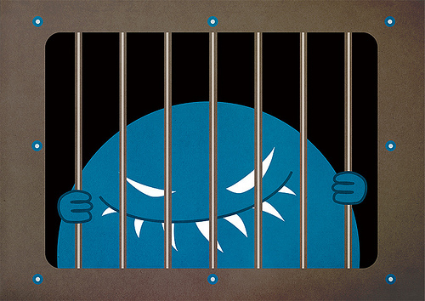
Run to your Parents
You run screaming to your parents and they come to your room they call the cops and the cops take the monster to jail. The monster escapes does it go to
Florida
Turkey

Slide 5
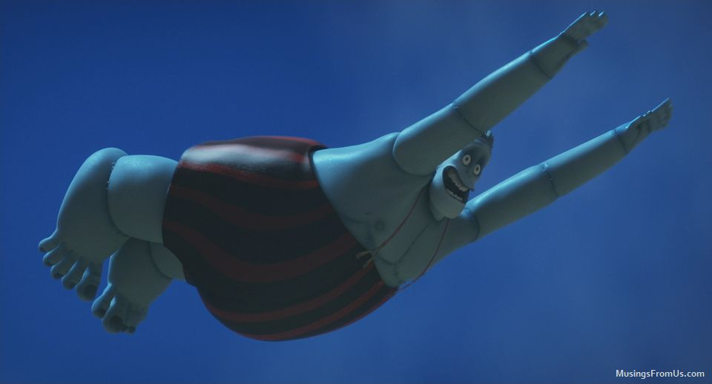
Go to Florida
You win. the monster went on vacation and it lived happily ever after.
You Win…

Slide 6
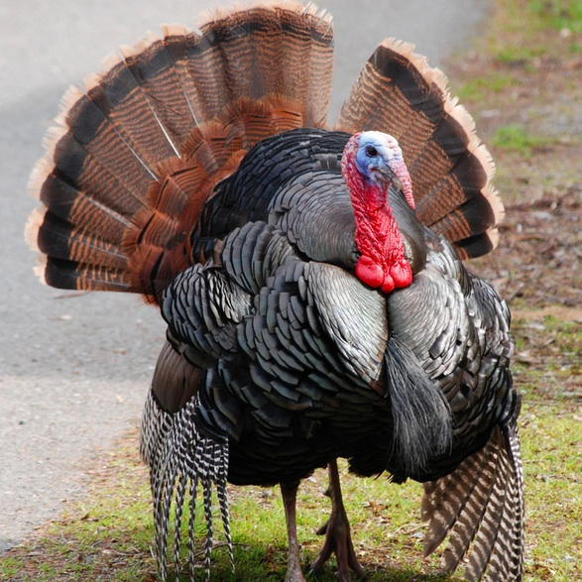
It goes to Turkey
It goes to Turkey and it gets swallowed by a Turkey in Turkey and it’s
Game over for you….

