Slide 1
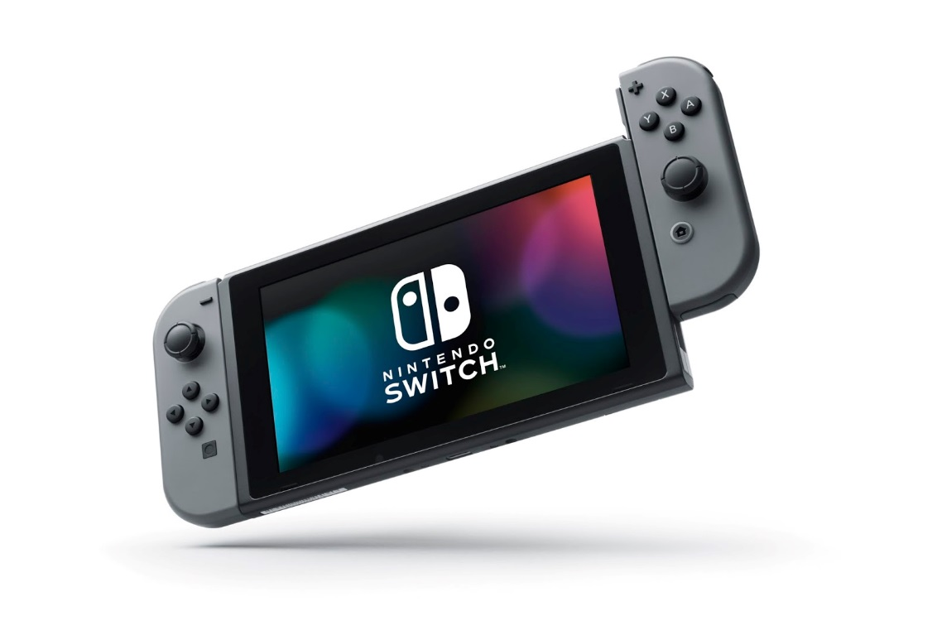
Tate N. L3
Video games.

Slide 2
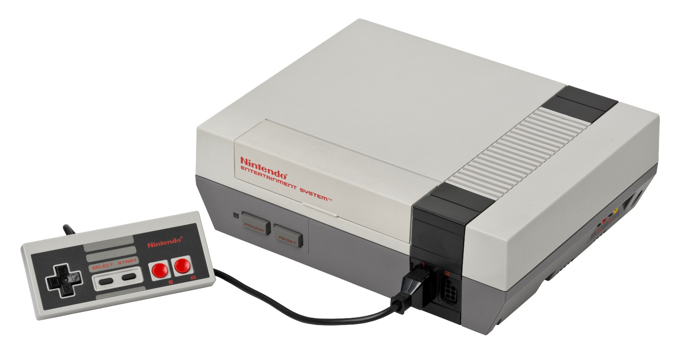
When and who made it?
In 1972, video games were invented by Nolan Bushnell to give intractable entertainment to people around the world!
consoles like the NES (Nintendo entertainment system) were created to have all ages be entertained.

Slide 3
Fun facts
I love Nintendo as well as Sega and epic games too!

