Slide 1
The War Arises
By Aaron Loveless

Slide 2
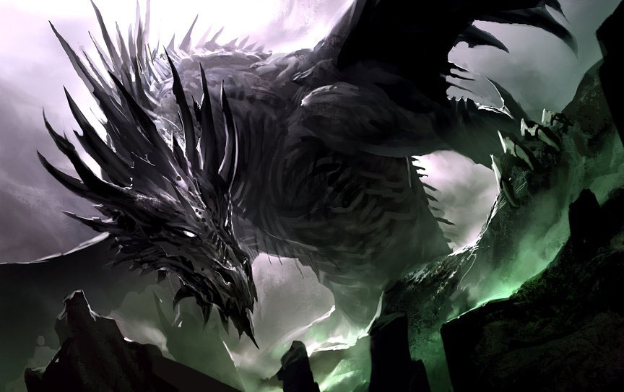
introdution
The dragons are battling a war . They need your help…

Slide 3
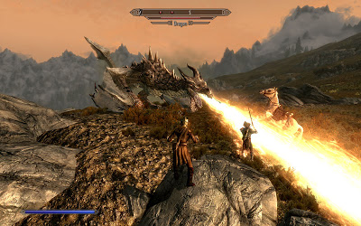
THE BATTLE STARTS
You have 2 choices.
Ride in and attack.
Ride Away

Slide 4
Ride Away
You ride away. The other dragons see you. What do you do?
Attack
faster

Slide 5
Attack
You attack. The dragon kills you.
YOU DIED
Try again?

Slide 6
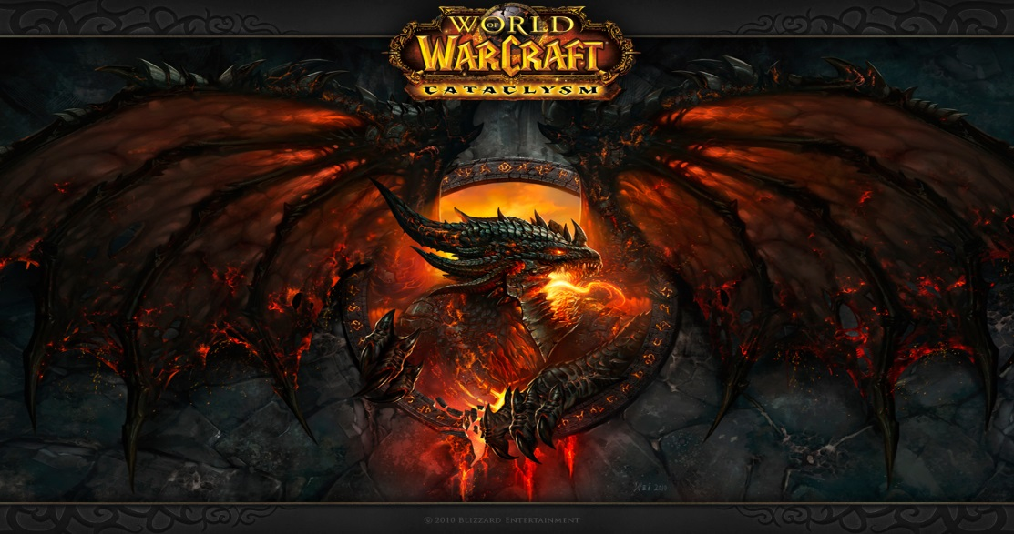
You attack
You attack . What do you do?
Attack the boss?
Call your friends?

Slide 7
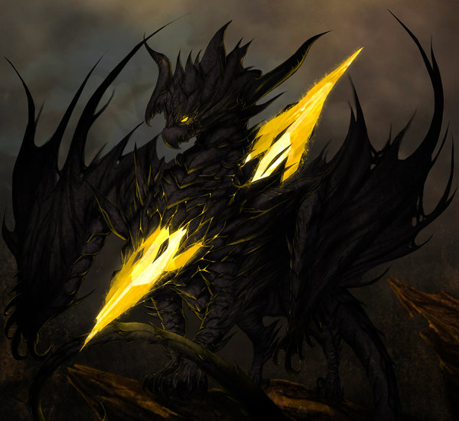
FASTER
You go faster. You escape!
\ you won!

Slide 8
Call friends
You call your friends. You finish of the army, now the boss.
Stick him in the back?
Far range?

Slide 9
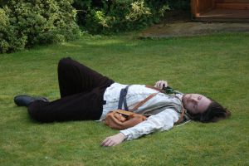
Attack the boss
You attack the boss. It kills you.
YOUDIED!
try again

Slide 10
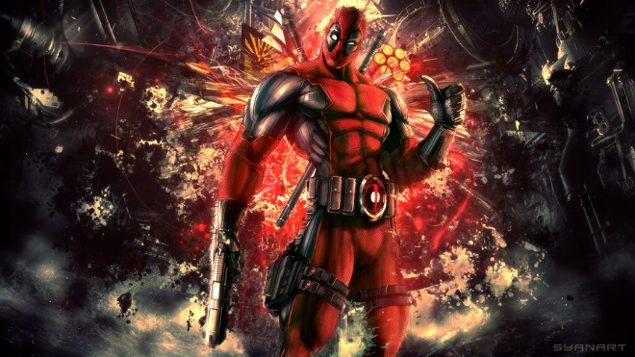
Stick in the back
You stick him in the back. You Won!

Slide 11
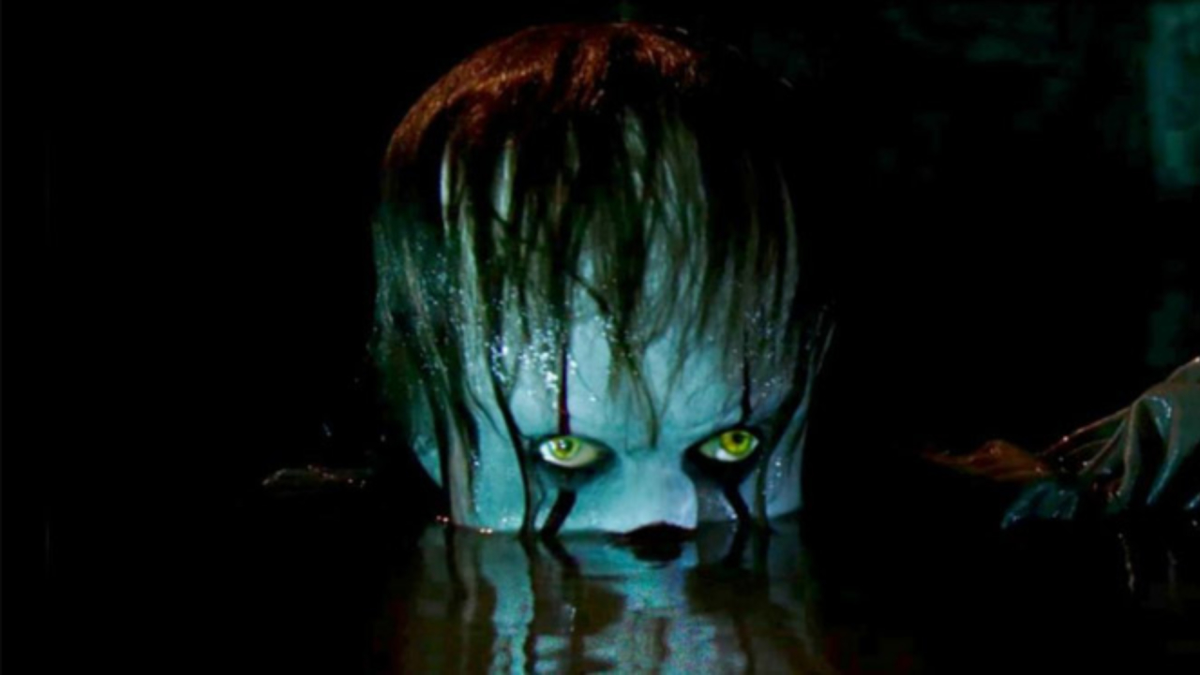
Far range
You far range. The dragon calls pennywise and he kills you.
you die!
Try again?

Slide 12
Poo poop! poooooop!

