Slide 1
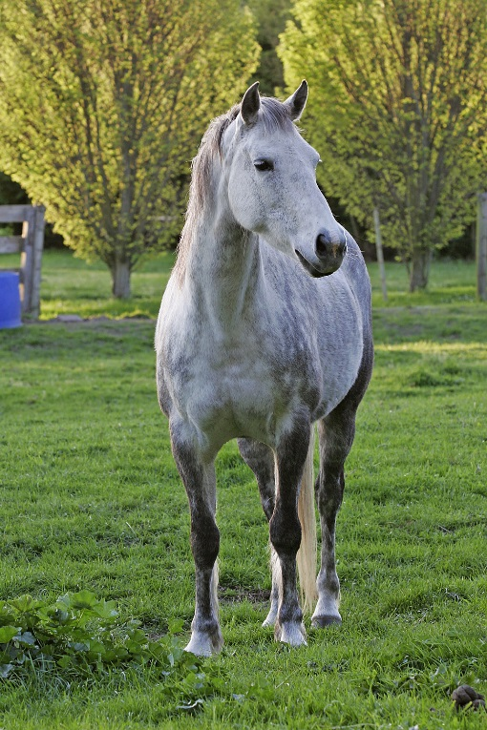
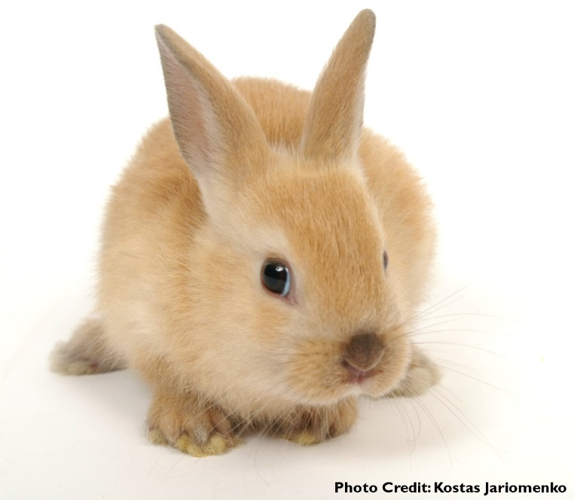
Vivianna R4
Bunny and horse

Slide 2
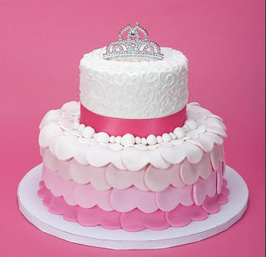
Bunny and horse are best friends they love food but they loved chocolate cake with pink frosting
They found a found a chocolate cake with pink frosting in the grassy fields
Should they
Eat it
Or
Save it for later

Slide 3
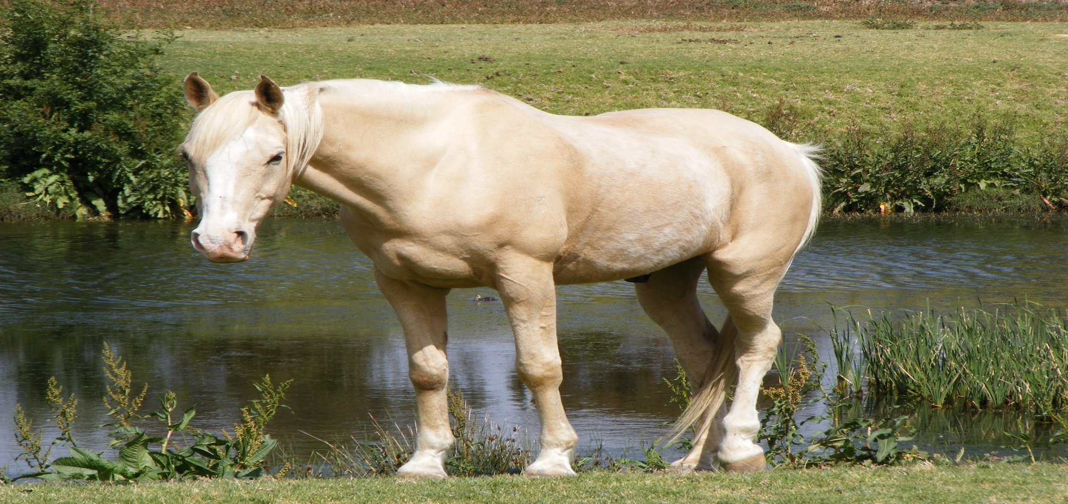
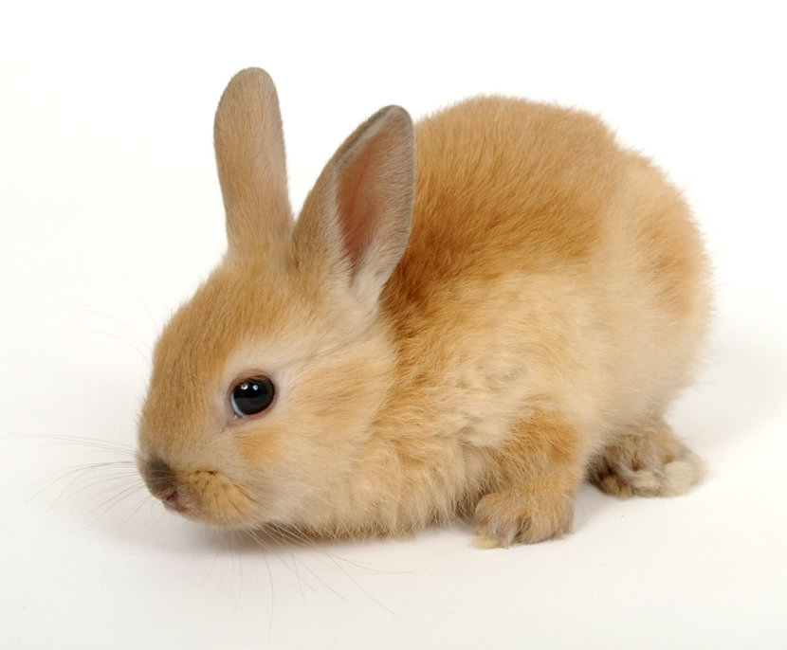
You eat the cake and you get hyper and throw up rambows and carots
Then you go home and sleep

Slide 4
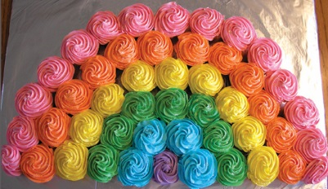
You did not get sick

