Slide 1
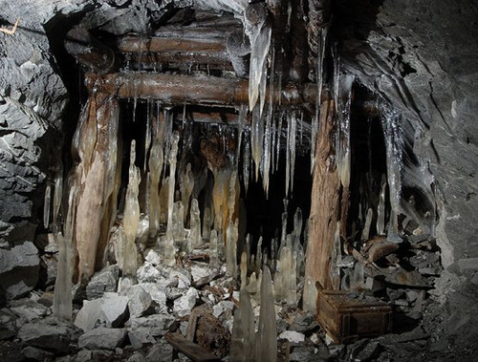
Yuki R4
The Haunted Mine

Slide 2
It was the afternoon almost sunset
You were taking a walk. You found this mine in the distents. Once you got closer you…
Went inside
Or run away in the woods

Slide 3
You went inside the mine
The mine was dark…
Then you hear a noise
It was a zombie!
Try Again

Slide 4
You run away
You look behind you…
It was a zombie!
Do you… Run into the woods
Or attack the zombie

Slide 5
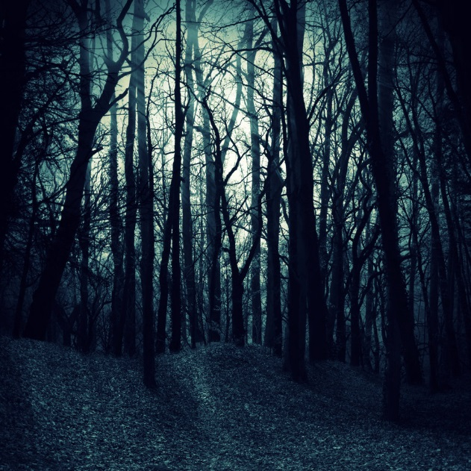
You run into the woods
While you run into the woods, you hear more noises
There was more zombies!
Try Again

Slide 6
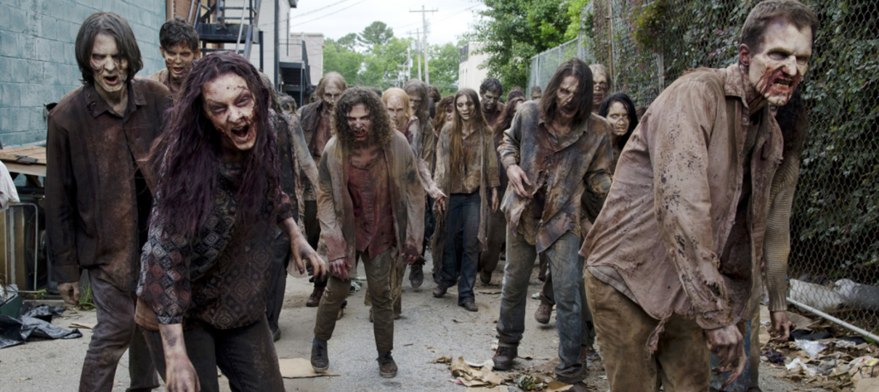
You attack
You find a stick
You choose the fight with a stick
They were all defeated
Do you…
Go back home
Or find out what is in the mine

Slide 7
You went back to the mine
Once you went back to the mine you…
Died by more zombies
Try Again

Slide 8
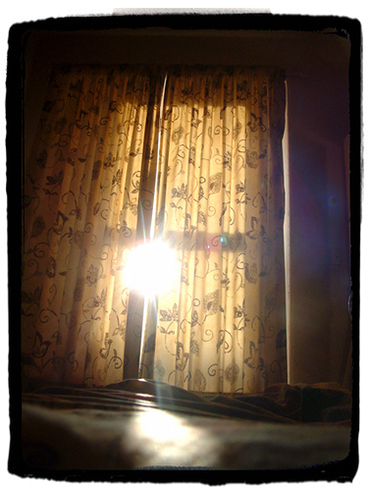
You go home
Once you got home you heard an alarm…
It was a dream!
The End

