Slide 1
Slithering
Choose Your Own Adventure

Slide 2
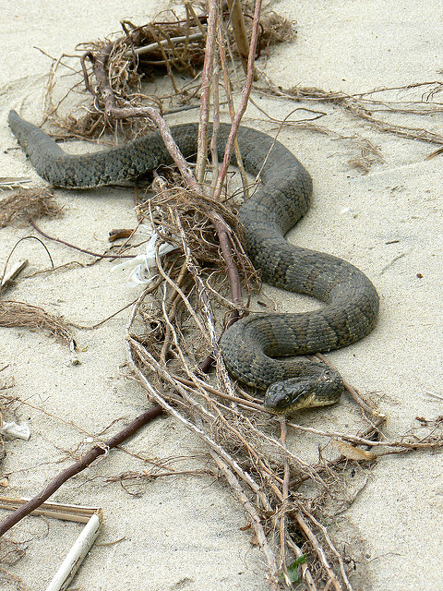
Our hero, Carey, awoke to a fading noise. Within seconds it was not even there. I must have been dreaming, thought Carey.
But there it was again. What should she do?
Run
Go back to sleep

Slide 3
Run
Carey ran out of the house, not looking where she was going. She ran right into a police officer. “Where do you live?” shouts the police. What should she do?
Confess
Run

Slide 4
Go Back To Sleep
You go back to sleep, and your mom catches you awake. “Why are you awake in the middle of the night?” she demands. What should she do?
Run
Confess

Slide 5
Tell the Police where you live
I live on the fifty third house on seventy second street. Confessed Carey. “Humph!” he growls, taking out of his belt something that Carey didn’t notice before. A spear.
YOU HAVE LOST AND DIED.

Slide 6
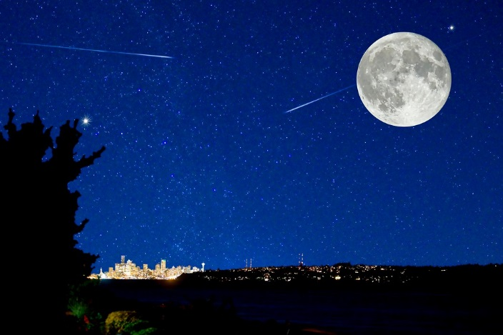
Run
You run and run and run, your chest heaving in and out. You need food and water! You can’t go and further without them. You take one more step and collapse . You simply cannot go any further than that.
YOU HAVE LOST. THE POLICE WAS ARMED.

Slide 7
Run Away From Your Mom
You run and run and run, right into the evil neighbor’s yard. Unluckily for you, he’s standing at the gate. He takes off his cloak and throws it to the ground. You stare in horror. Your evil neighbor, Mr. Stinkeysock, is actually an evil wizard! He throws a spell at you to make you disappear.
YOU HAVE LOST!

Slide 8
Confess To Your Mother
You tell your mom everything. She’s very understanding. She wraps her arms around you and tells you that she isn’t mad. She tells you that she was worried.
YOU HAVE WON.

