Slide 1
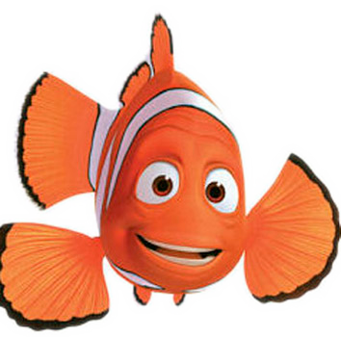
Fins
By safa

Slide 2
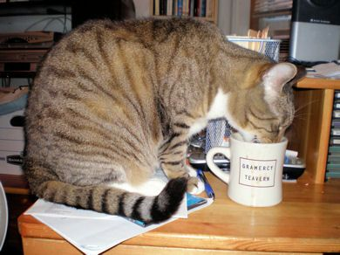
The story begins
It all begins on a sunny warm morning. Our hero is drinking coffee. when she hears a loud bam on the door .
Open the door
Sleep

Slide 3
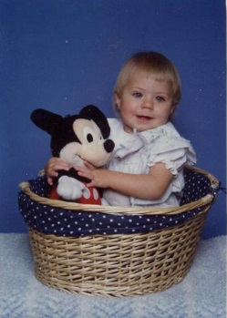
Open that door
A baby is in front of the door.
Cry
Bite it

Slide 4
cry
You cry so much that you forgot to do your homework . The baby brakes your house and eats you for lunch
you lose

Slide 5
Bite it
You bite the baby and he dies
You win

