Slide 1
The Girl At The Park At Night
By Sarah

Slide 2
One night…
There was this girl who was at the park
It was the afternoon and her mom needed to use the restroom and it turned night..
What should the girl do?
Choice 1 knock on the bathroom door for her mom
Choice 2 wait for her mom

Slide 3
She knocked but..
There was no answer the girl was sad and upset
She tried to knock again but there was no noise

Slide 4
She waited but..
She waited but none came out
But she saw baby..
She wanted to name the baby Denis.

Slide 5
After a few hours..
Her mom didn't come out
So Denis told her to poke a tree

Slide 6
It was weird..
It was weird because she poked the tree but
Someone was behind it so she looked and saw Jeff ((Warning you’ll see something scary on the next slide))

Slide 7
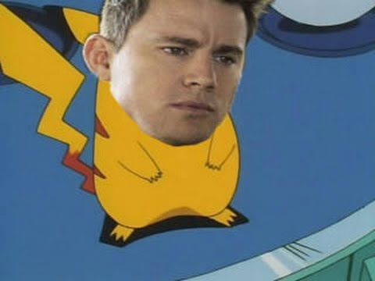
She was so so scared
She was scared but she realized that it was just a..
Pokémon with a face..

Slide 8
What should the girl and Denis do?
1.Give it dirt
2.Run!

Slide 9
They ran away but..
Pikachu was catching up with them they ran like Sanic but then Pikachu was to lazy to catch up so..
YOU WIN :D
yOuR tOo SlOw!11

Slide 10
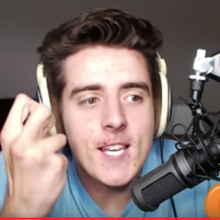
She gave it dirt and Pikachu was mad..
He/she was really mad so Pikachu attacked them!
YOU DIED

