Slide 1
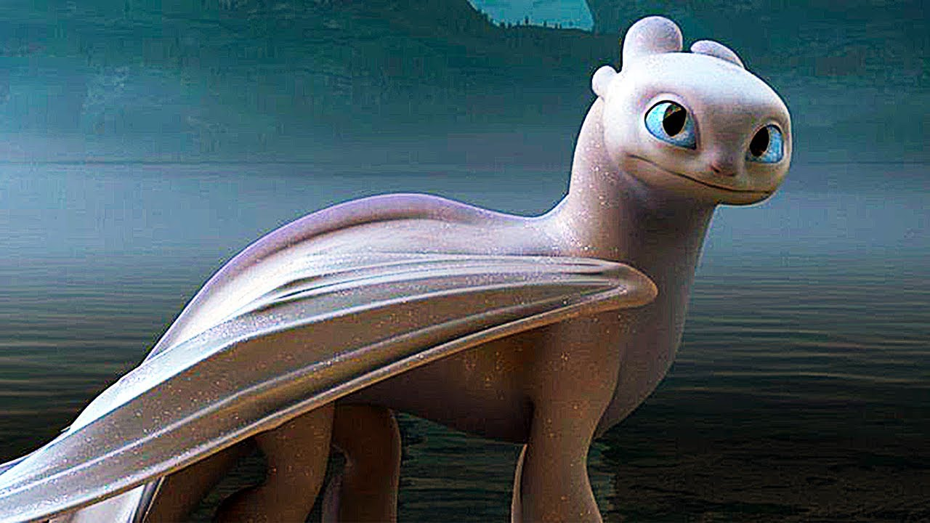
The legendary dragon realm
By Sarah hobaish

Slide 2
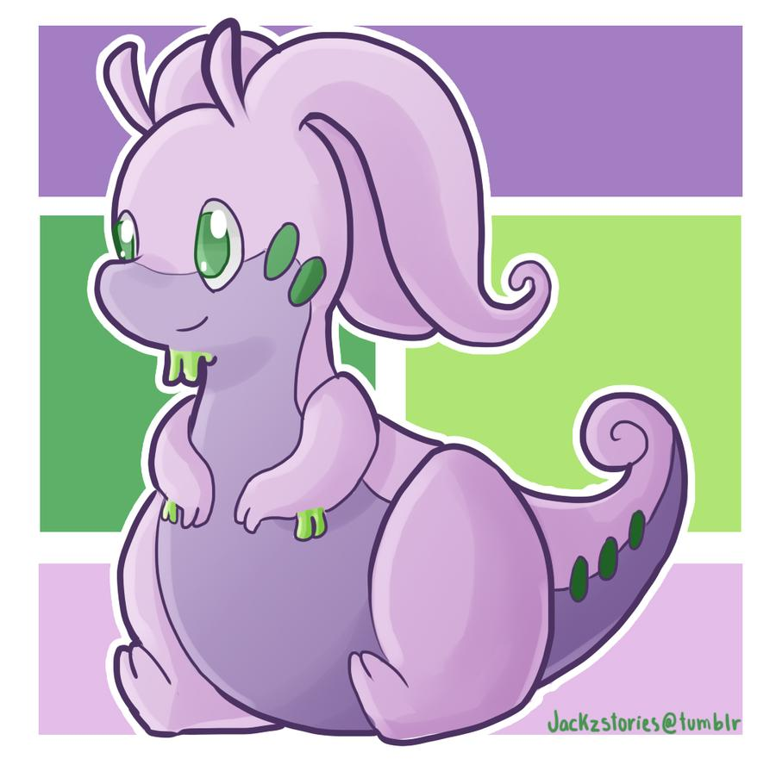
There was a girl named sarah hobaish who wanted to go to the fabled and forgotten legendary dragon realm. but nobody knew how to get there. What should she do?
Find a map
OR…
Search endlessly

Slide 3
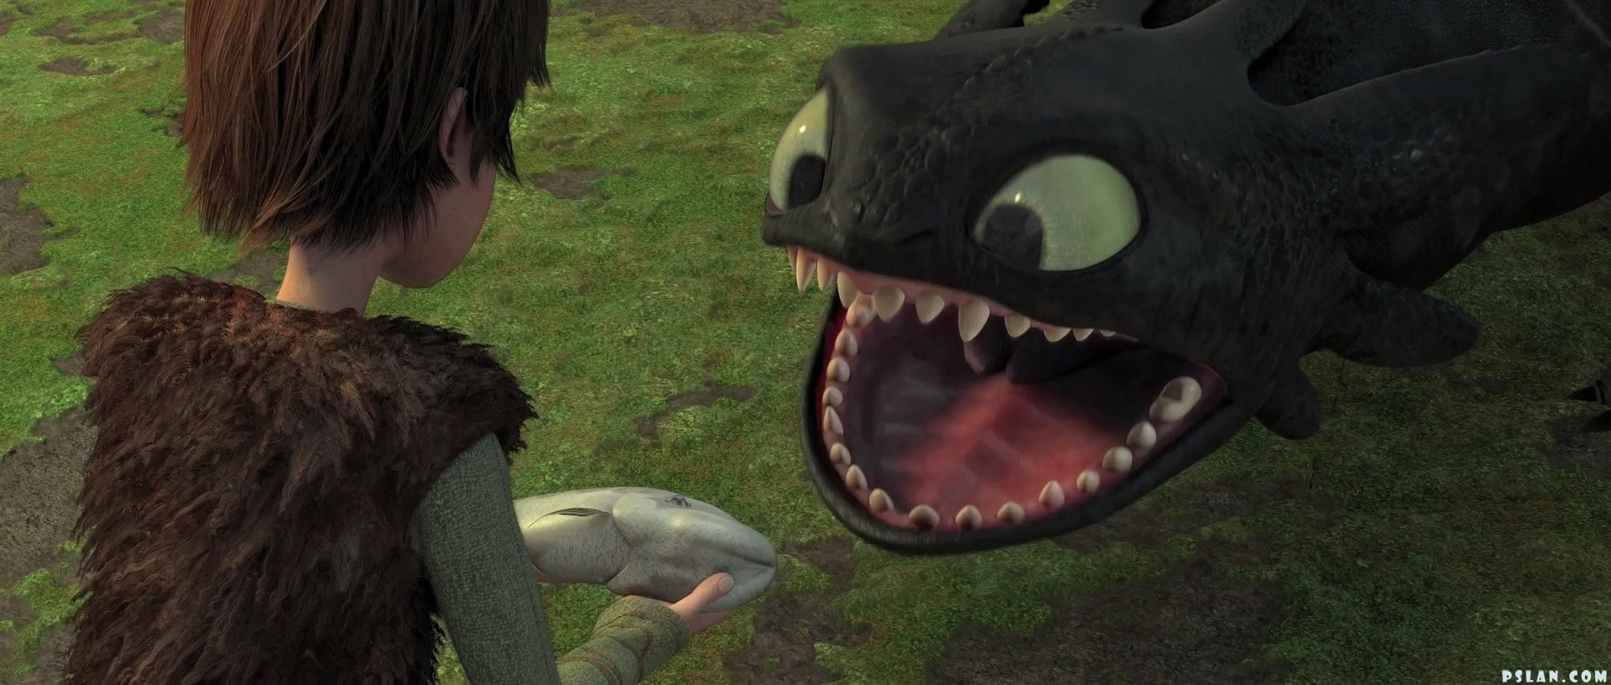
Find a map
She decided to find a map. She found one and searched for the dragon realm.
She came across a big boulder blocking the way, hey the map
does not say anything about this huge boulder! She thought. What should she do????
Break it
Or
Find another route

Slide 4
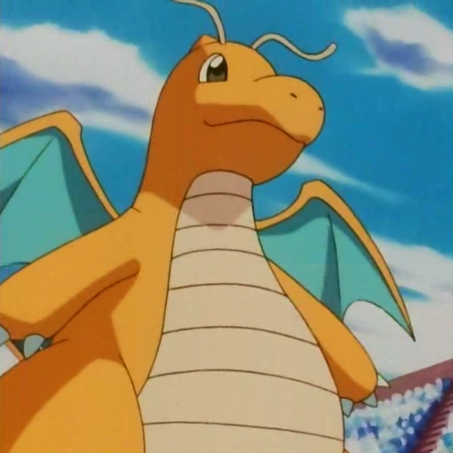
Break the boulder
She tried to break the boulder. A dragon from the dragon realm picked her up and flew away. She was never saw again
YOU LOSE
The end

Slide 5
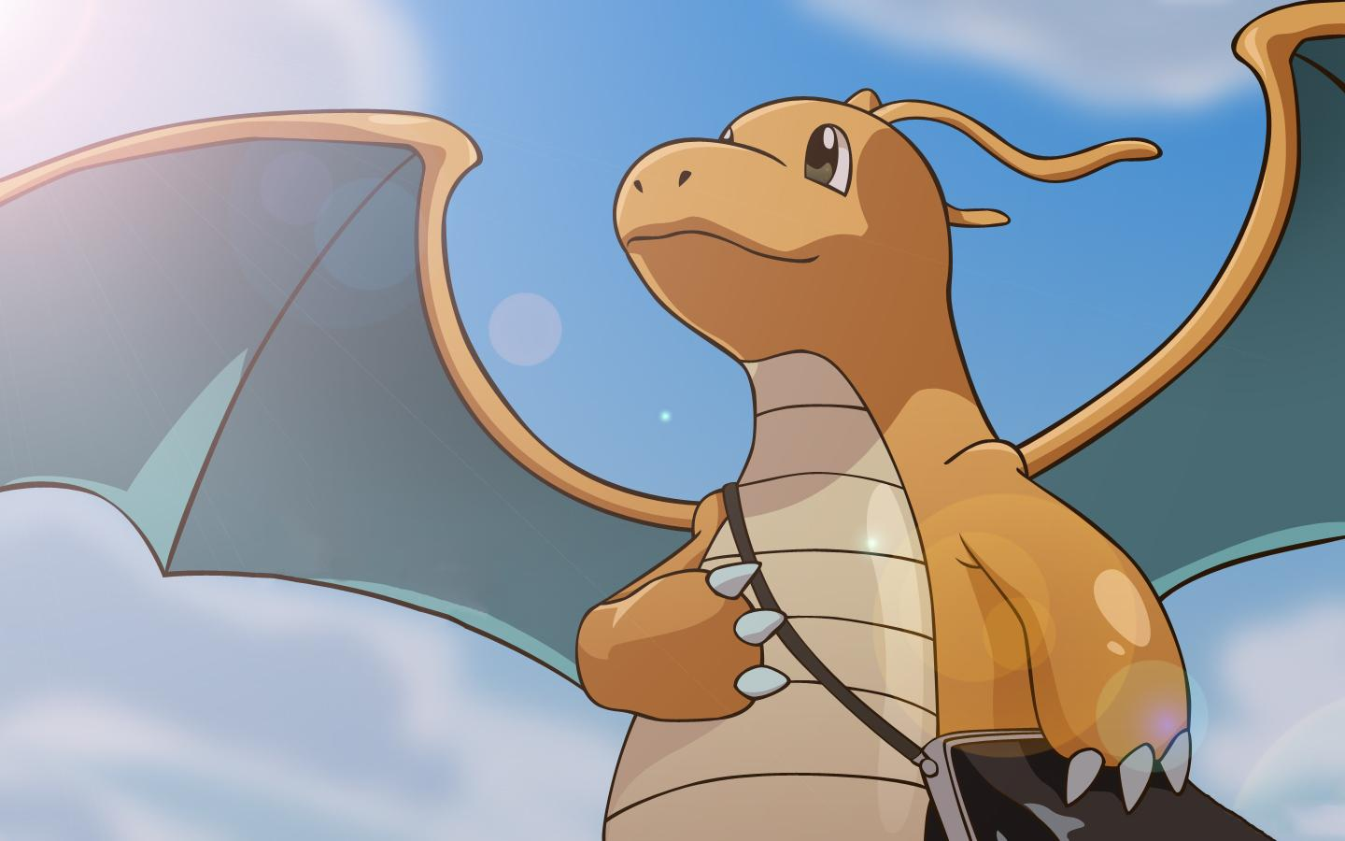
Find another route
She found another route and she was going in circles so she gave up.
Instead she made a garden and a special someone liked to visit the garden.
His name is Winston. He is a flamescale, a type of dragon.

Slide 6
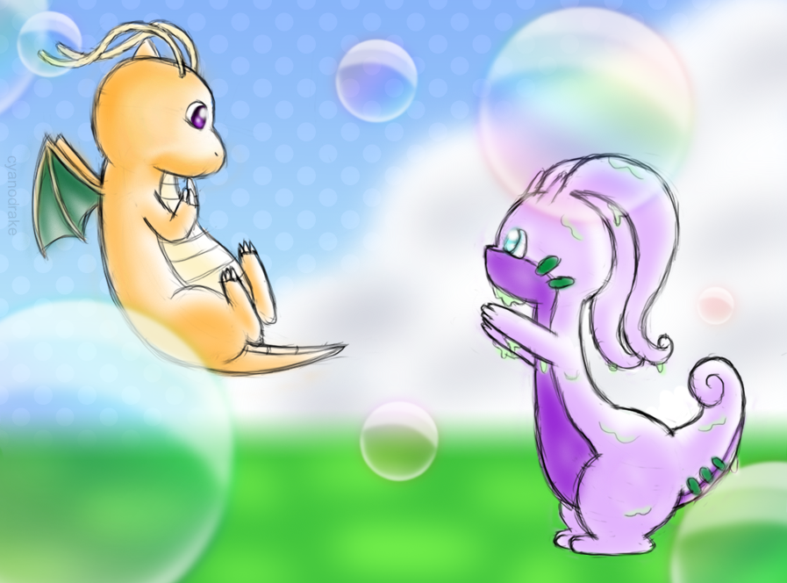
Search endlessly
She searched for a hour and then she finally found the legendary dragon realm! She built a house there and lived there happily ever after.
The end
YOU WIN

Slide 7
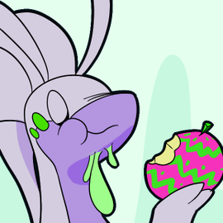
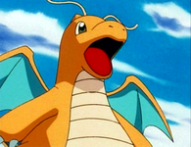
Celebrate!
Celebrate this moment

