Slide 1
Shamsr4

Slide 2
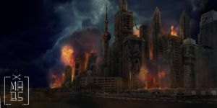
The last kids on earth
We are the last kids on earth
Our homes are destroyed
A stranger comes up to us and demands us to give him all our money
Do we run away
Fight back

