Slide 1
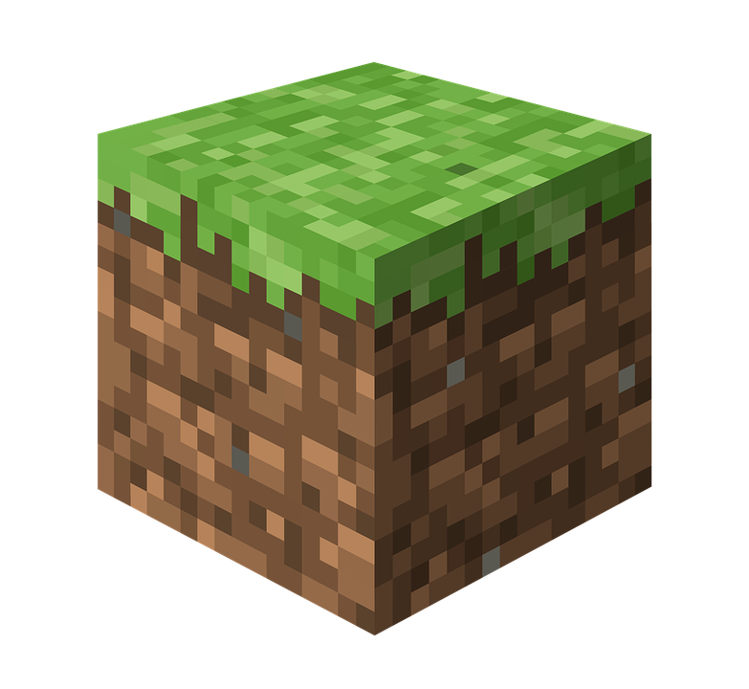
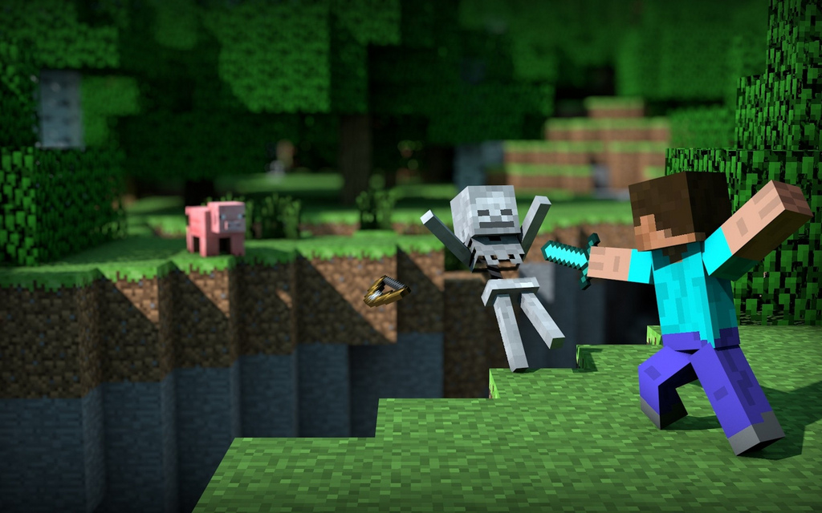
New world!
By stephanie

Slide 2
Your world
Once upon a time there was you and this happened to you. One day you said “I want to play minecraft” so you bought it for your x-box one.
You insert the game and you get to the title screen and you hit “make new world”. You name your world “first time playing” and hit “create”. But suddenly you get sucked in. You see a chest with a book and a map. You decide that you want to go exploring. Do you,
Go left
Go right

Slide 3
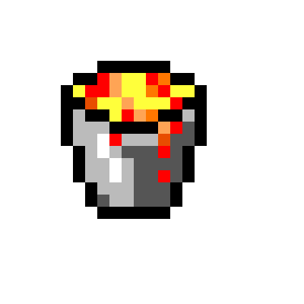
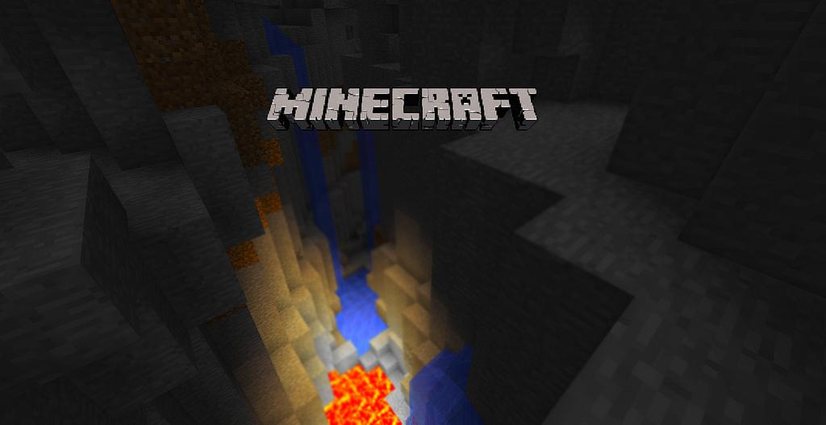
Go left
You run left hoping to find a forest. But all of a sudden see a ravine. You try to stop, but you can’t. You see (*gulp*) lava! You fall in and burn to death!
Respawn

Slide 4
Go right
Yay! You find a forest! But it's getting dark, and you don't know if you should:
Get wood
Mine dirt and build small shelter

Slide 5
Dirt plan
The sun has gone down and the moon has gone up you mine away, but it is to late! Zombies and creepers surround you. You accidentally look at one of the creepers. It flashes then explodes.
Respawn

Slide 6
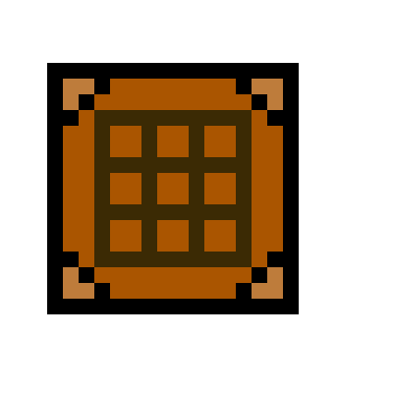
Get wood
You go to get some wood. It just so happens that you are under some leaves that are 3 blocks high! The sun has gone up, and you want to do more exploring. But you need some more materials.
Do you,
Make a crafting table
Just run right

Slide 7
Just run
You sprint right but after the day has ended, you can't run anymore. You forgot one thing that really matters, your hunger. You start to take damage, then die of hunger.
Respawn

Slide 8
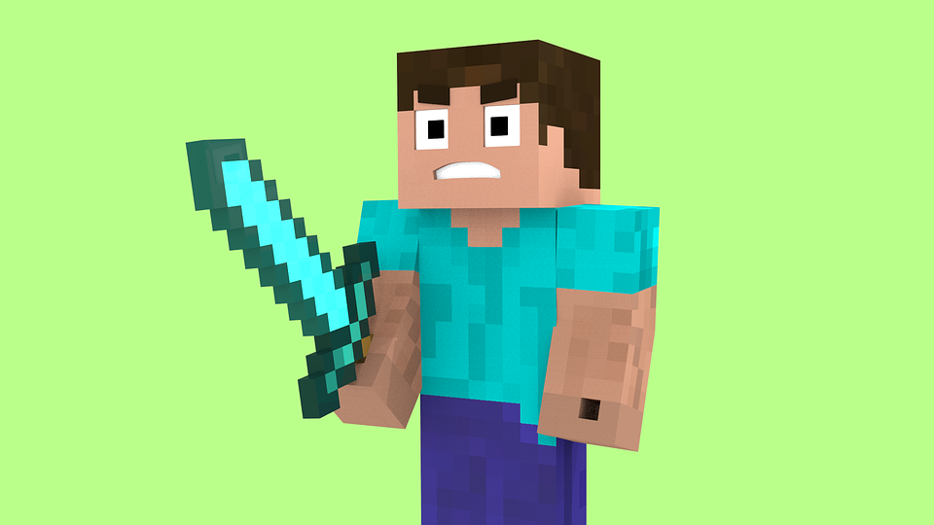
Crafting
You quickly make a crafting table, and then you see a chest on the top of a tree. You use the dirt you collected (in case of emergencies) and built your way to the chest. You open it and see two diamonds!!! With your crafting table,you make a diamond sword. Now you are ready for anything! But you need to find shelter. Do you,
Use your wood you collected
Head right YAY!!!!!!!!

Slide 9
Run right
You run but the sun sets fast. You see light up ahead, but that light is lava! You try to go around it but it is like a river of lava. You try to jump to the other side, but you miss.
You have burned to death
Respawn

Slide 10
Shelter!
You build your shelter then wait until day. When you see the sun rise again, you go out of your fort and head right. You see houses and you found village! You are now safe! You start to make a few trades with a villager when suddenly the villager you traded with sparkles and fireworks explode from his head. You see that he has one more trade. If you give him one stack (64) of wood planks, he will give you a PORTAL HOME!!!!!! You immediately give him the stack of wood you have and get the portal and find a place to put a place to put it down when you realize it says “only work if stone button placed on”. But you used up all your stone. Do you,
Go get some wood
Look at the chests in the village
Just settle down and live here until you are ready

Slide 11
Going to get wood
You go get wood but its night. You make your way to a tree,mine it, and head back to the village you go inside a house and craft a button. You then go to sleep on a bed you crafted earlier. The next day you wake up and place down the portal and put down the button. You push the button and the portal sparks then opens. You jump in but you start to wither away. Why? BECAUSE YOU NEEDED A STONE BUTTON, THAT’S WHY!
Respawn

Slide 12
Chest exploring
You go to the blacksmith and open the chest and find a stone button. You pick it up and go to put the portal. You place it down, put on the button, push it, and jump in. Yay! You are home.
Yay! You beat the game if you liked it, please say so in the comment box below
*Please make each comment a different color*
THAT WAS AWESOME!!!! Your adventure story was Excellent. I loved the Minecraft screenshots for the background. The story was descriptive, fun to read, and play!!! -Mr. K

Slide 13
Live here in the village
Yay! You have survived! You just settle down and live with the villagers!
YAY YOU WIN!!!!!!!!!
If you liked this, please say so below! ;)
*Please make comments nice and in different colors*

