Slide 1
The evil fat water melen
By Maya smith

Slide 2
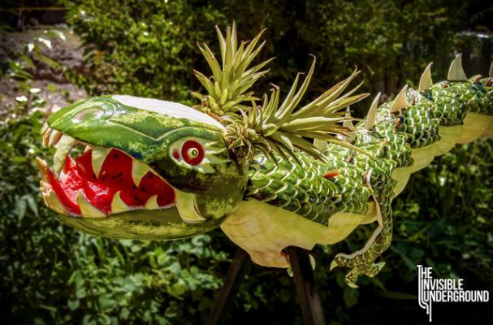
introduction
Once upon a time there was an evil fat watermelen and evre year he would attack everebody even eat som people e om..ee

Slide 3
Dunt dunt duuuuuuuuuuuuuuuuuuuuuuuuun
You have two choices.
Listen to the stranger
Attack with a stick

Slide 4
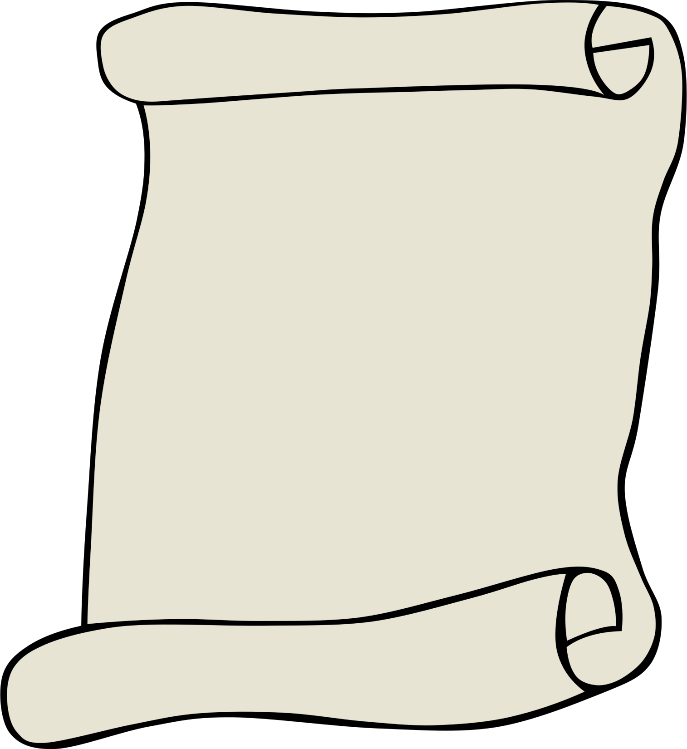
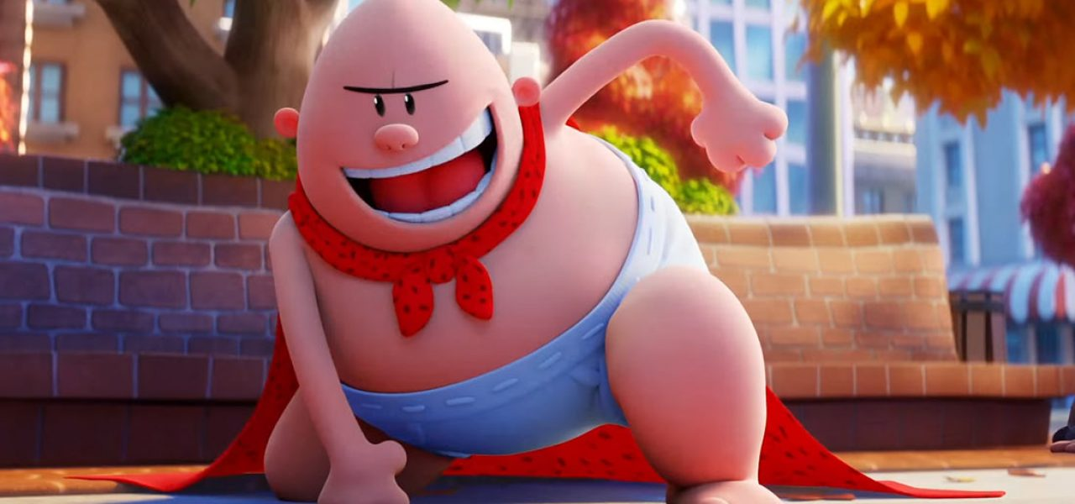
Listen to the stranger
You lisen to the strarger the stranger is
Captain Underpants! He punches you and
you face-plant and die on the cement!!!

Slide 5
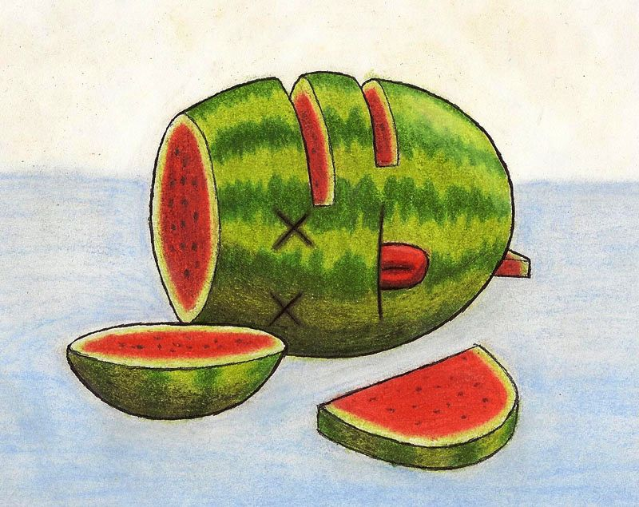
Attack with a stick
You attack the watermelon with your stick.
The watermelon it turns out was a real watermelon, and its head falls off and you win!!!

