Slide 1
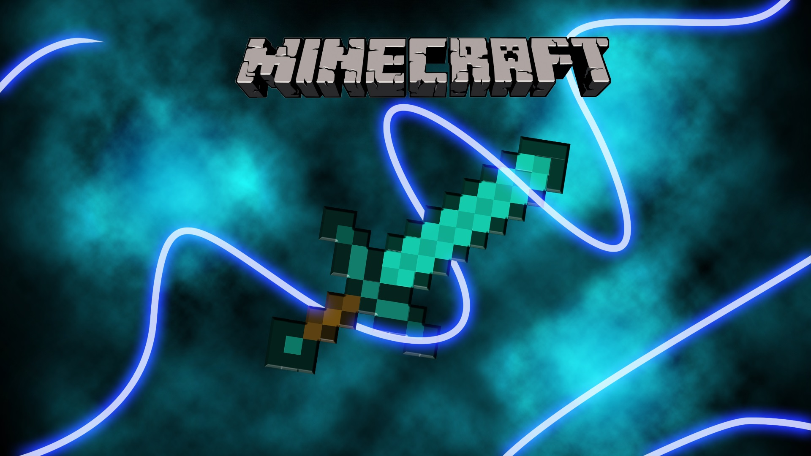
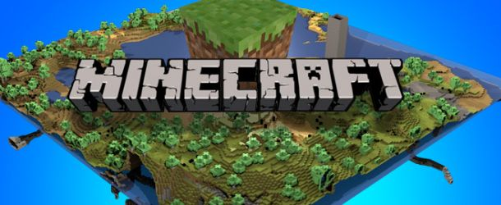

Slide 2
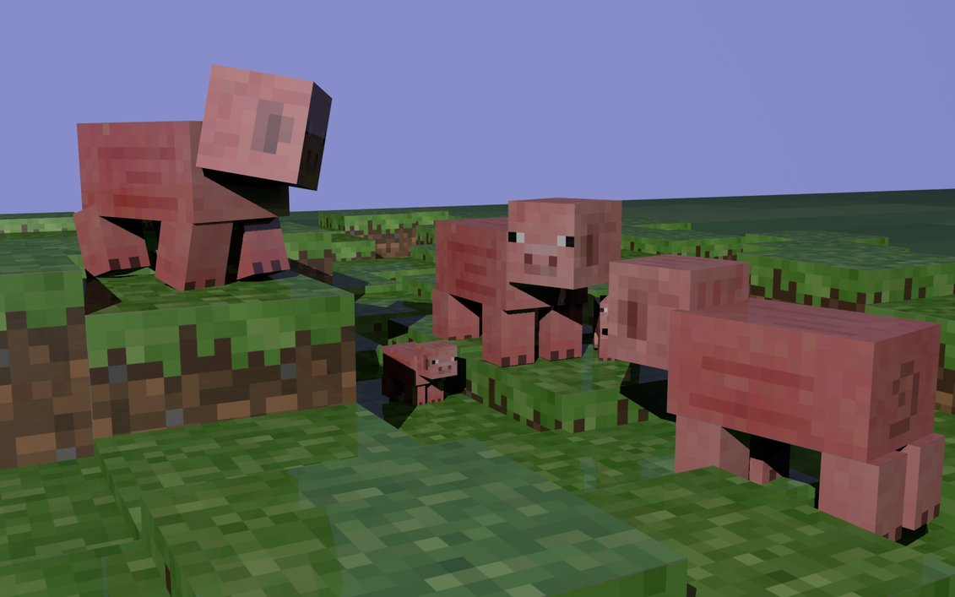
It is your first day in minecraft

Slide 3
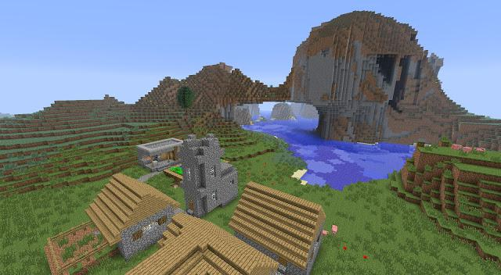
You have two choices.
You can build a house.
You can go excploring..

Slide 4
1
You win!

Slide 5
2
You were ecspioring and a cow starts toattak you.
You attak back.
You runuway.

Slide 6
2
You runuway but it gets you game over!

Slide 7
1
You chas it but runsuway youcan not fiynd it
You ceep ecsploreen.
You go home.

Slide 8
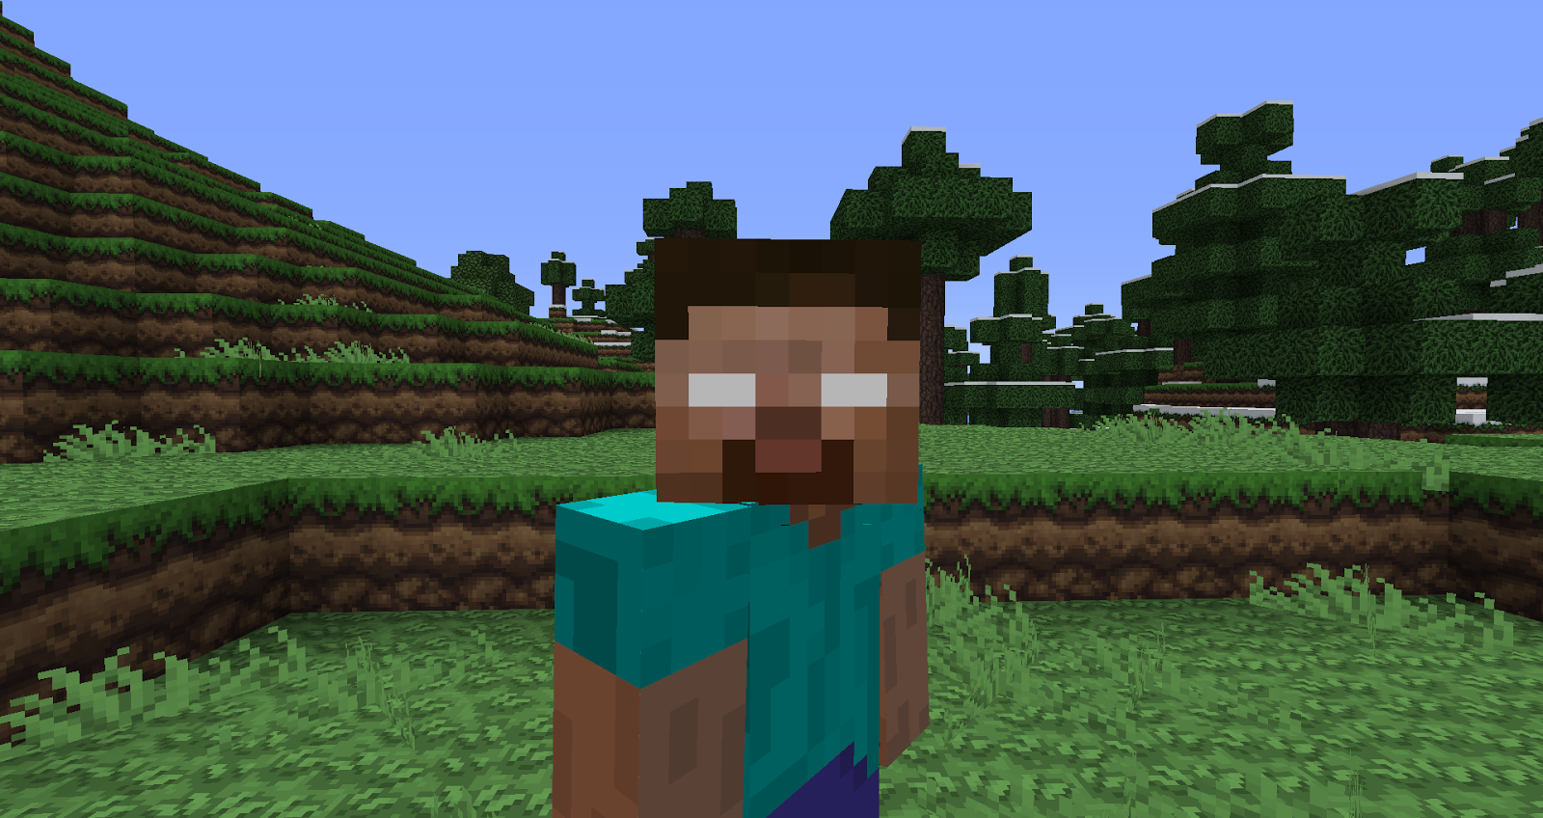
1
You ceep ecsploreen then heerobrin attacs game over!

Slide 9
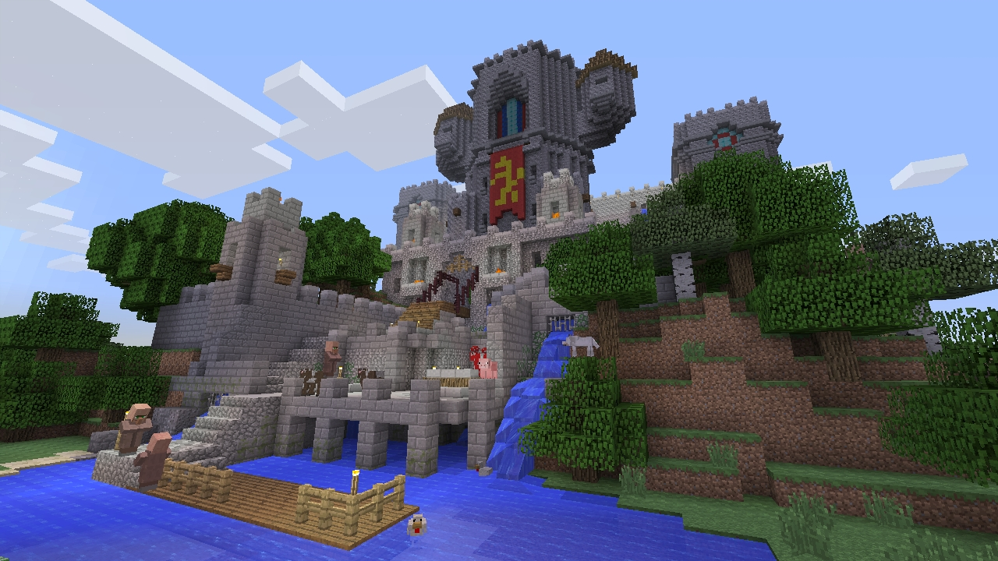
2
You go home youwin!

Slide 10
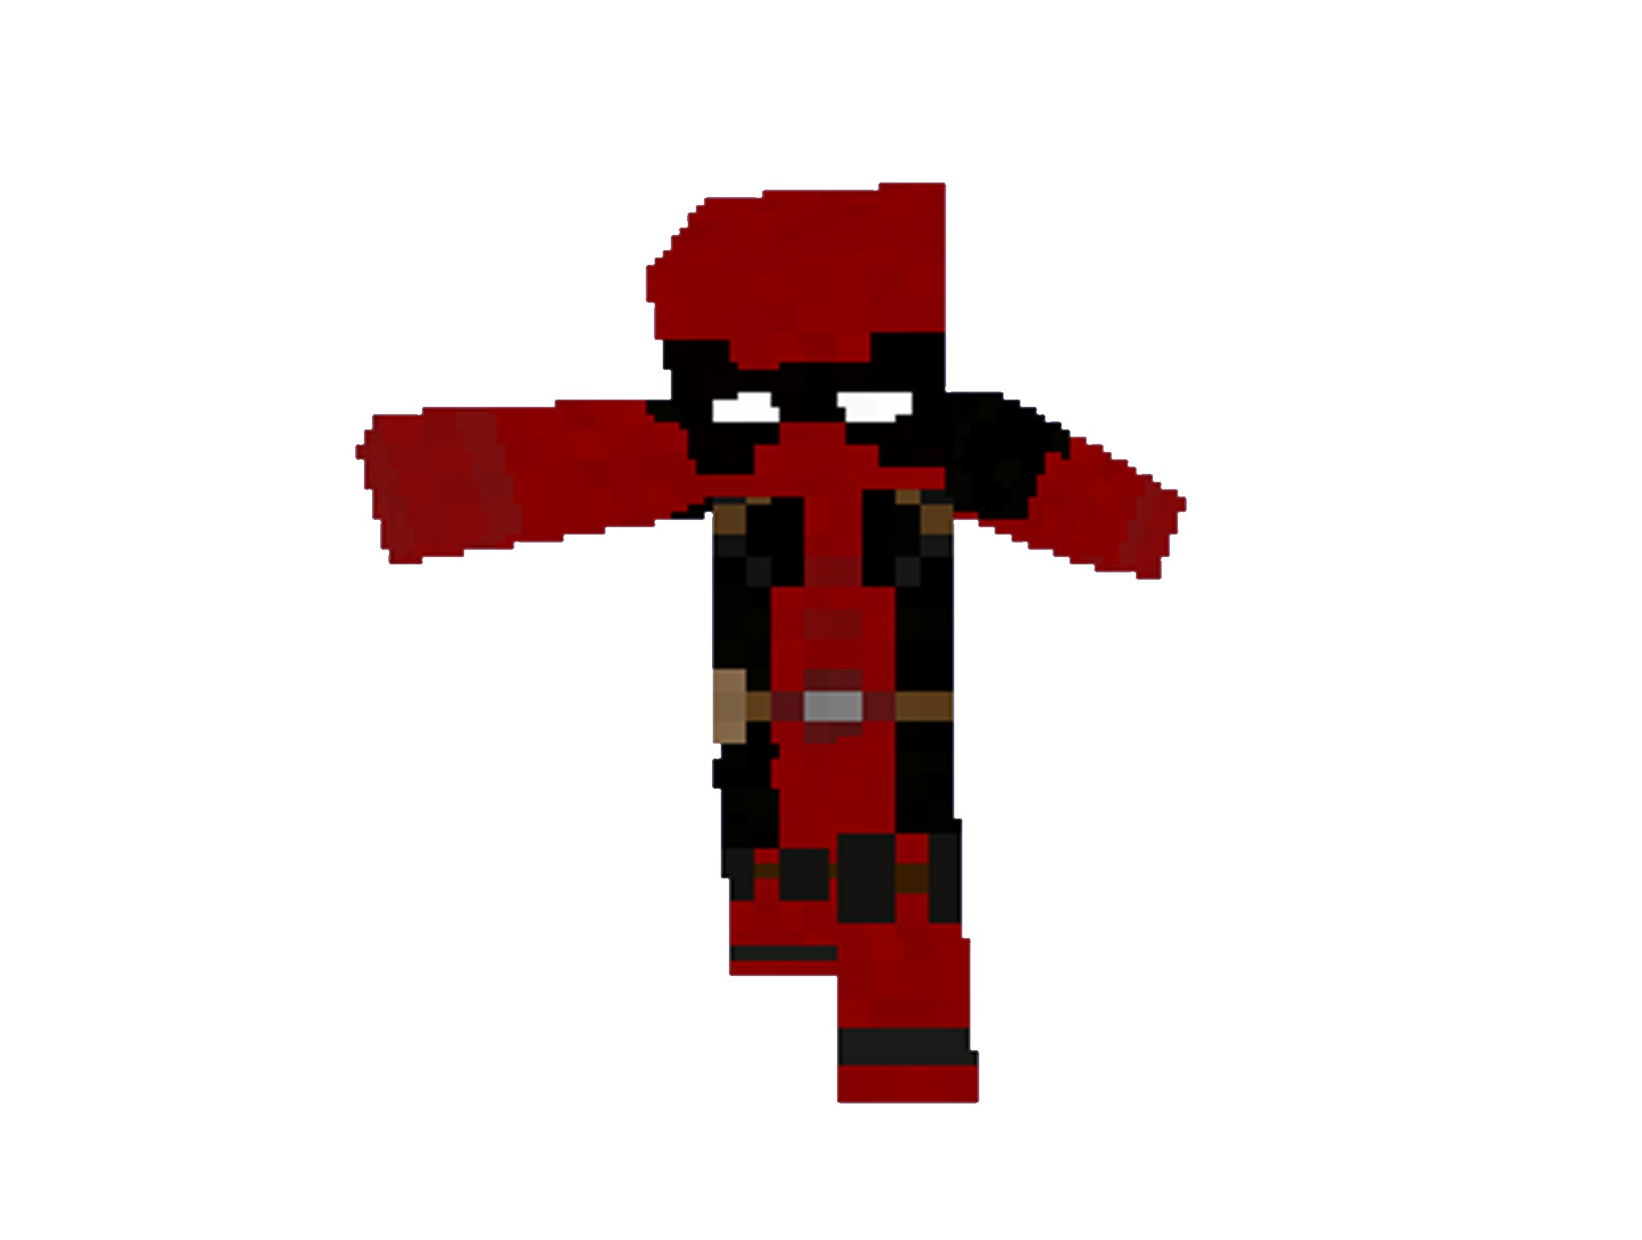
Good job!

