Slide 1
The Gang
By yousef

Slide 2
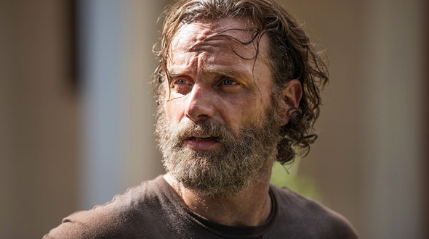
Once a guy named jeff got caught in a gang fight
Then he was instantly targeted
1 run away
2 fight back

Slide 3
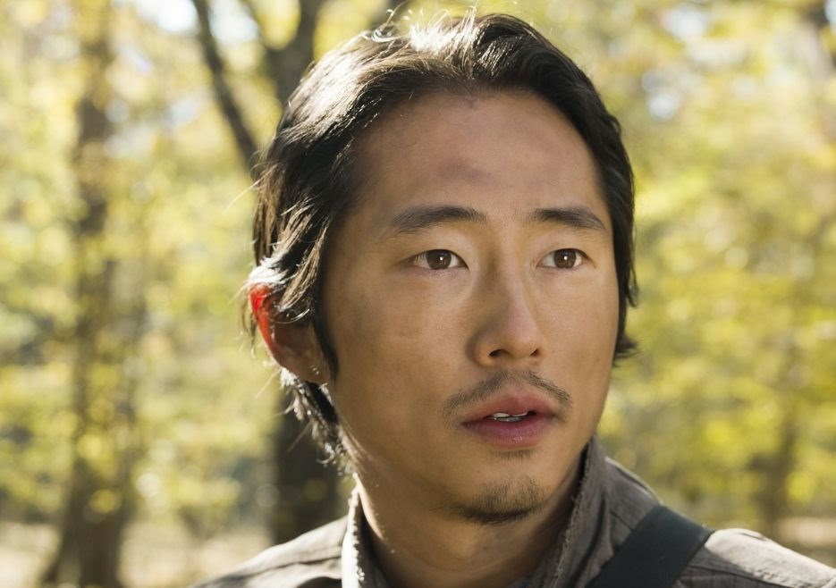
Path 1
He runs away but then he gets arrested by the police for being in the gang
Choice 1 escape
Choice 2 wait 20 year sentence or slight chance of death

Slide 4
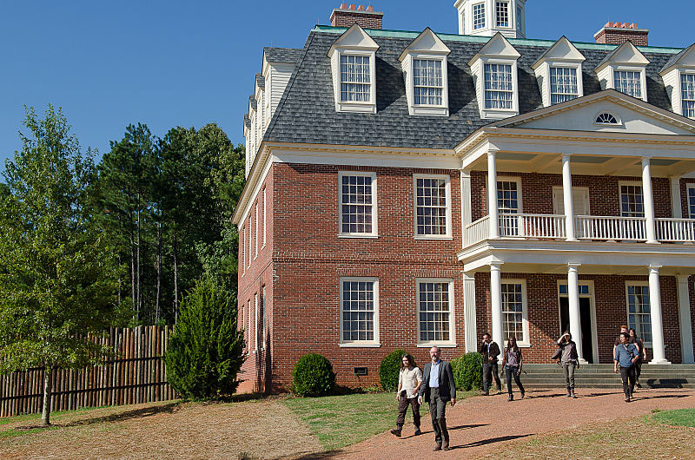
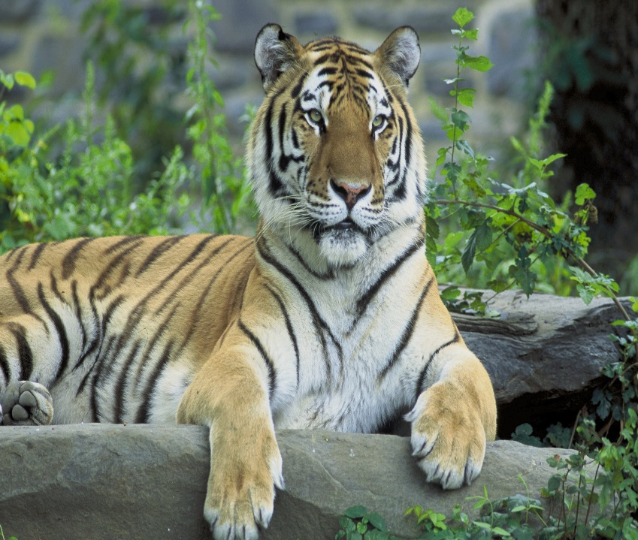
Path 2
You wait 20 years and live but get caught in another gang situation but they had a tiger
call the police
Do nothing

Slide 5
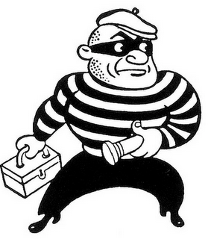
Path 1
You call the police and they arrest the gang for weapon possession and attempt of murder
You win

Slide 6
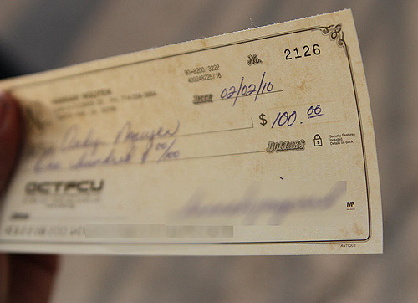
SYKE
You run to your house due to cashing in 200000000 in 1 paycheck if you don’t run you get arrested and get a death sentence.
RUN
Get arrested

Slide 7
Path 1
You run away and see a fight between steve jobs and bill gates you decide to punch because you own an apple phone and a Microsoft account
Punch steve jobs
Punch bill gates

Slide 8
Path 2
You punch bill gates and get free apple products every time they make a new product, and the police get offered free iphone 7 if you don’t get arrested.
You win

Slide 9
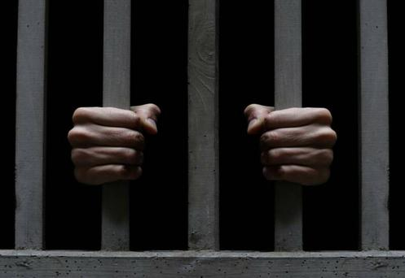
Path 2
You grab a metal baseball bat and fight back and you survive but you get arrested by the police for murderer and a death sentence
You fail

Slide 10
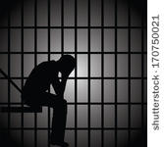
Path 2
You get arrested and you die
You fail.

Slide 11
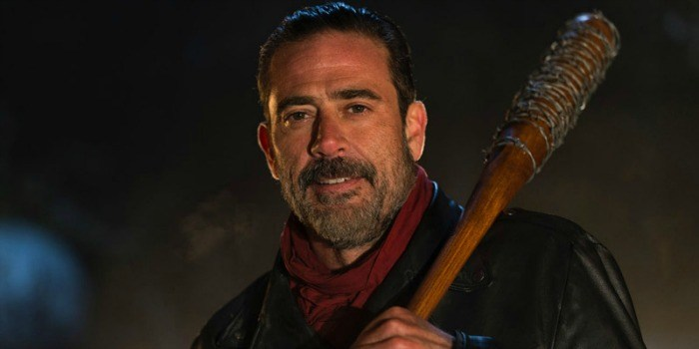
Path 2
You get killed by a baseball bat with barbed wire named luceal
You lose

Slide 12
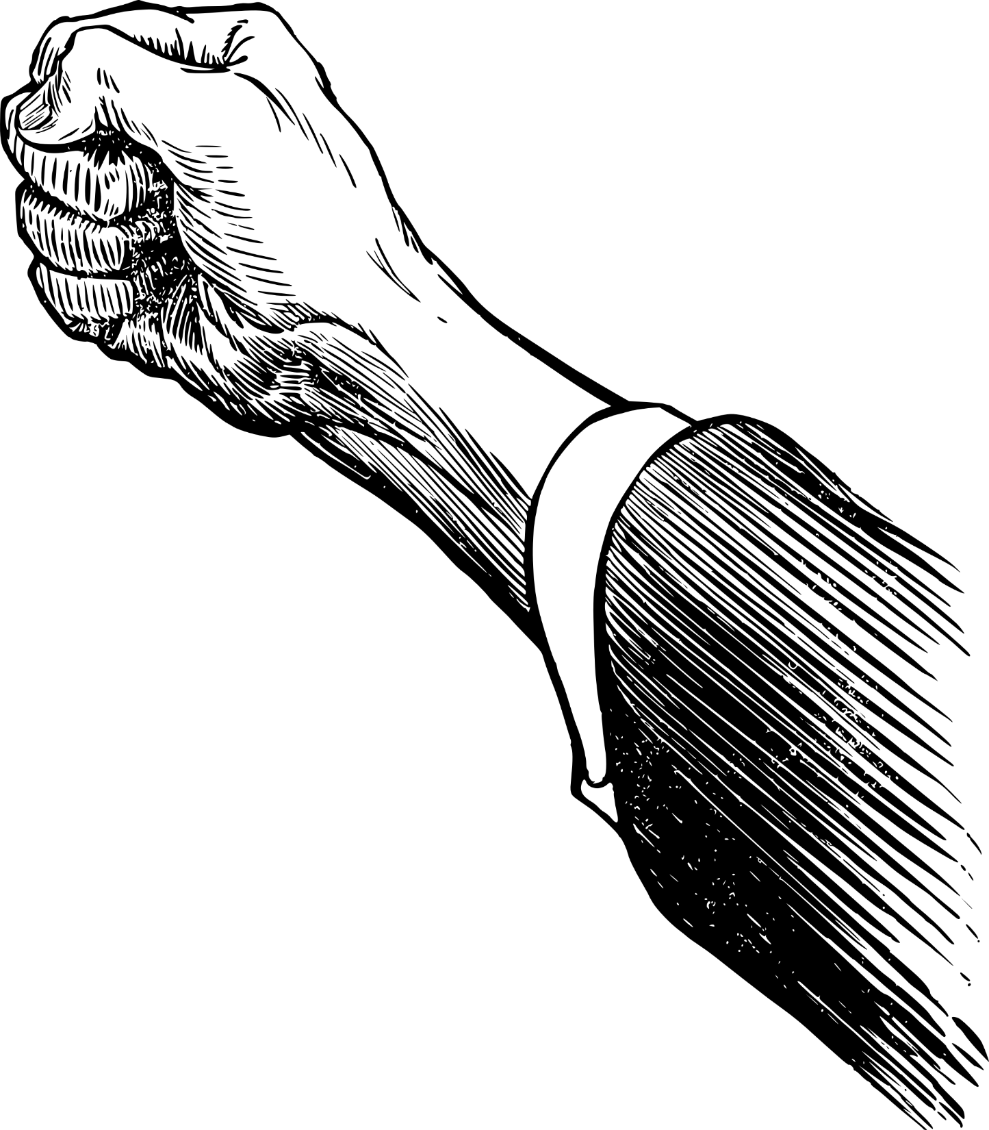
Path 1
You punch steve jobs and get arrested for assault
You fail

Slide 13
Path 1
You escaped and never get caught and hide from the gang who later get arrested
You win gg no re

Slide 14
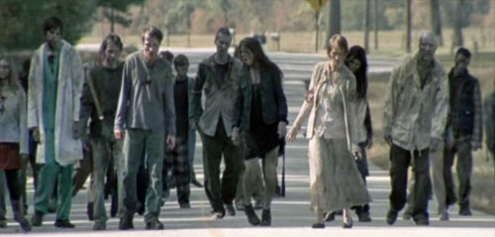
Once again syke
You run into a zombie apocylypse in the city
RUN
Go through

Slide 15
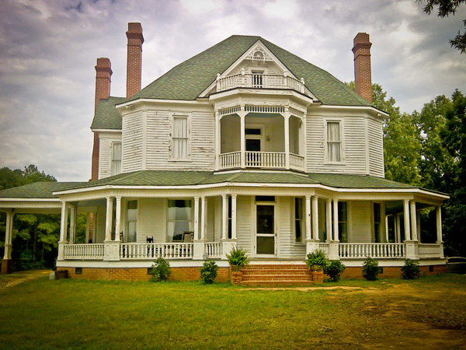
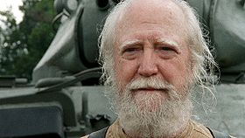
Path 1
You run and escape to a farm owned by a guy named Hershel and you survive
Click me!

Slide 16
Path 2
You get eaten alive and die
You fail

Slide 17
You win
You win and survive
Yay

Slide 18
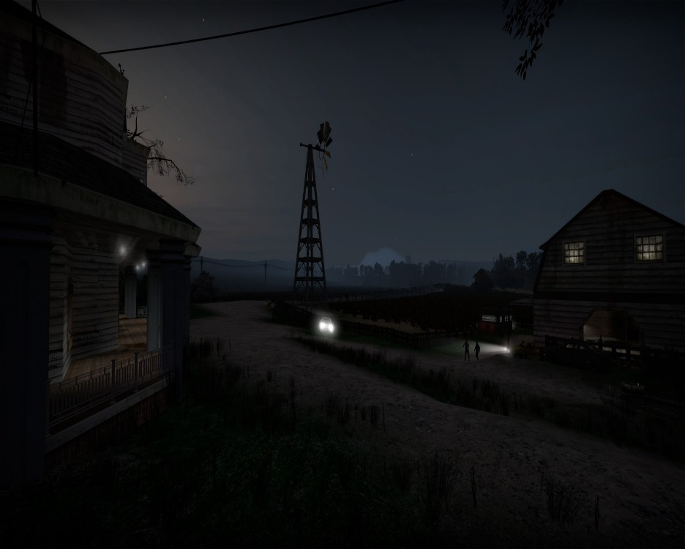
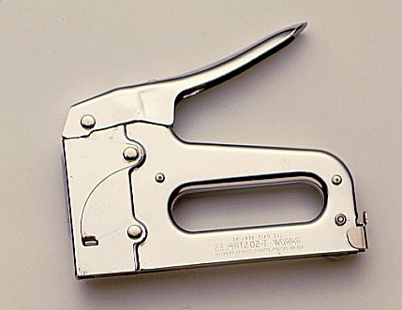
Suddenly zombies
Hershel’s farm gets overrun by zombies led by a helicopter so Hershel starts attacking the zombies with a stapler that he rigged into a staple gun
Join Hershel
Leave Hershel alone

Slide 19
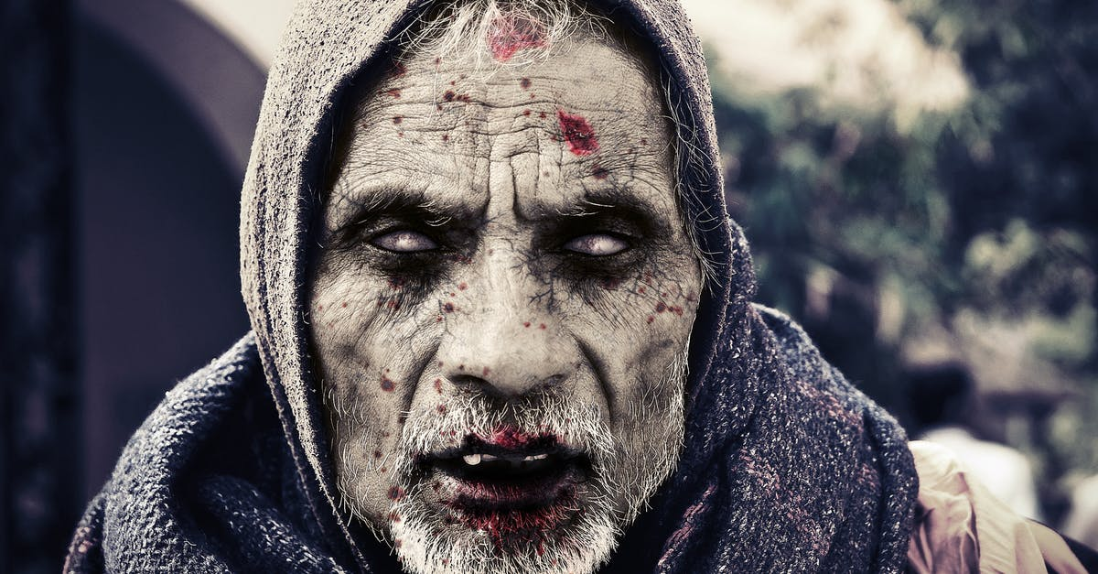
Path 1
You join Hershel but you don’t know how to fire it so you get stapled to the wall and eaten alive

Slide 20
Path 2
You leave Hershel alone and he kills every zombie and pins them to the wall to scare off other survivors
You win

