Slide 1
An a adventure story
by:zirian

Slide 2
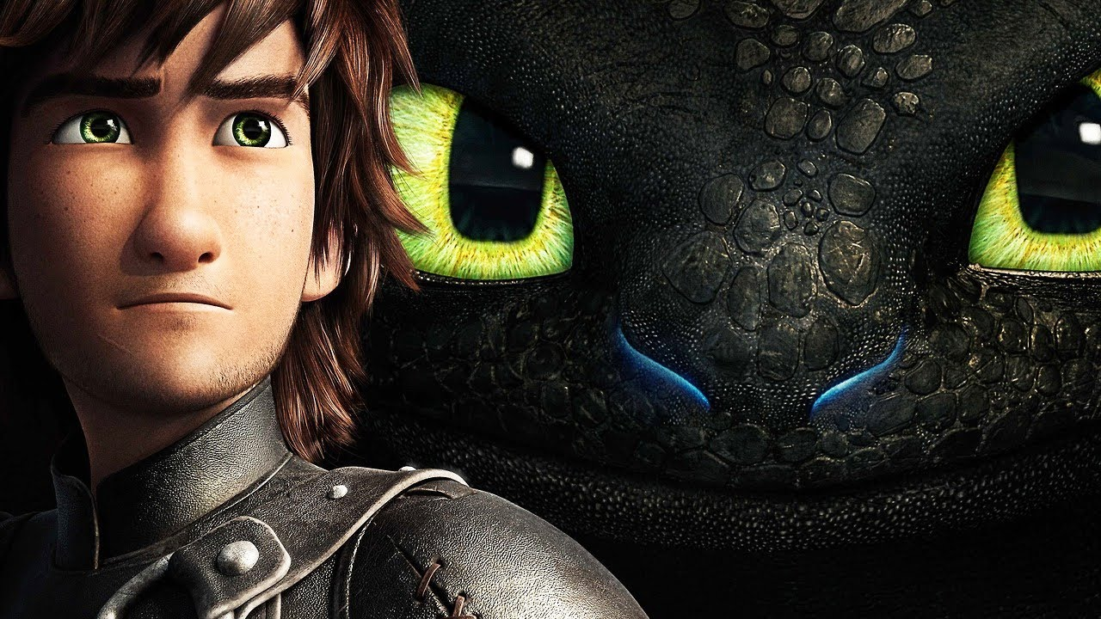
Ones a pone a time
A little Viking named toby cut a dragon tail. So he tamed it with fish. The dragon name is footless because it took toby leg.

Slide 3
Huckfang
Do you fight
Or run

Slide 4
You win
YOU KILLED STARTLOUD YOU WIN

Slide 5
YOU LOST
YOU RAN AND GOT KILL

