Slide 1
The beach house

Slide 2
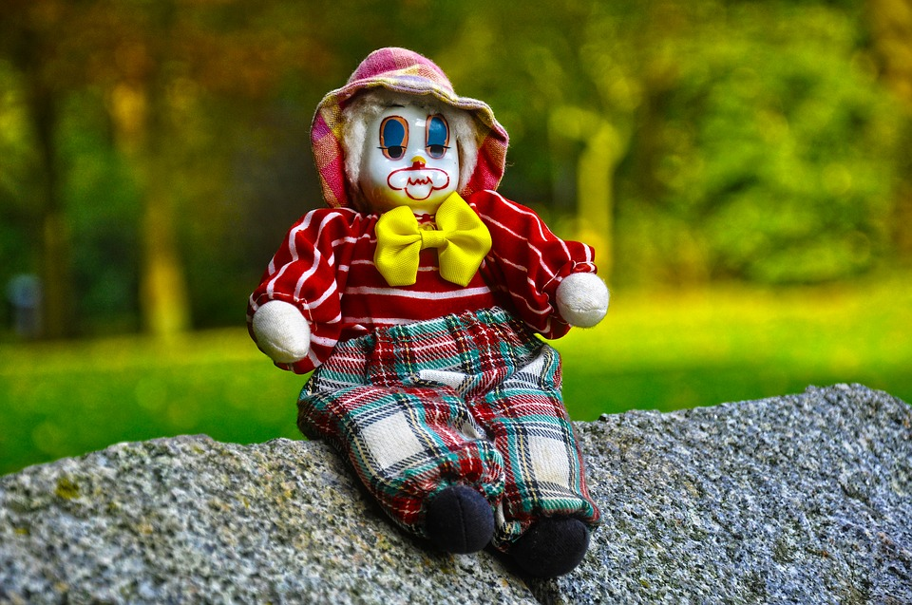
One day me my brothers my mom and couzins were sleeping at a beach house with a creepy noam in the house. That night me my cousin were awake and the noam moved from its spot that we saw it last.

