Slide 1
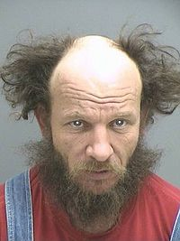
Deadly doom of a man by abdullahi
Once there was a man it was late night he woke up he went to the city then this ugly man came he was almost died then he stared walking to me. Want will you do 1. run away.2 fight 3. call 911

Slide 2
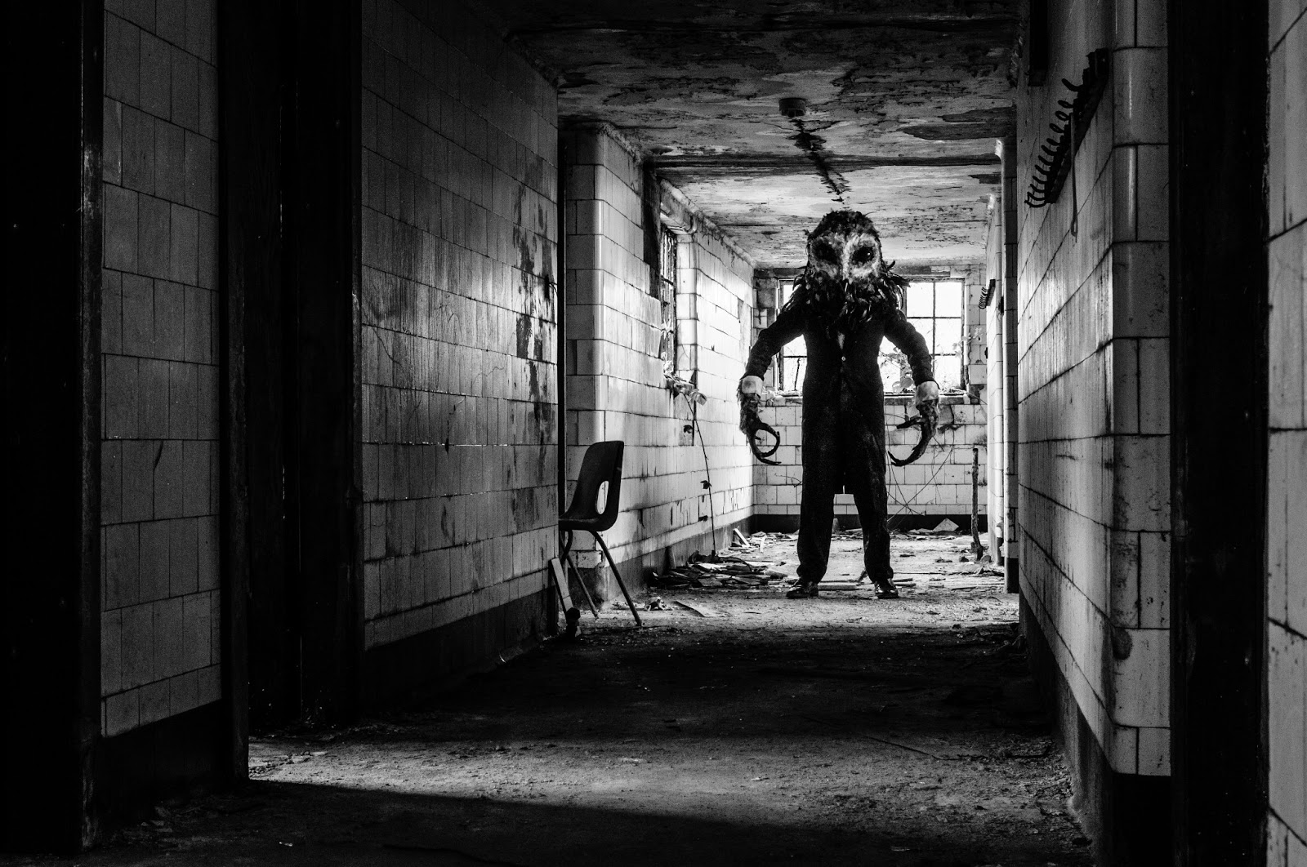
Run away now you are in this sewers this monster is here want do you do.1hide.2run.3 look at him

Slide 3
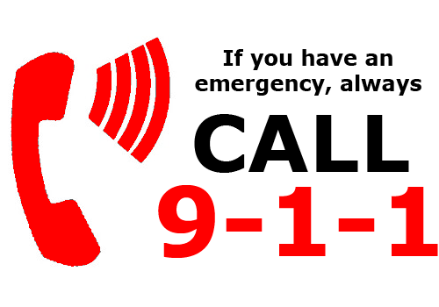
911
If you call 911 it would take long and the man would kill you

Slide 4
Fight
If you fight you will lose because he is strong ……………… game over

Slide 5
Look at him
He walk towards you than he kills you

Slide 6
Run away
If you run and the man you met he was looking at you and he has a knife so he kills you

Slide 7
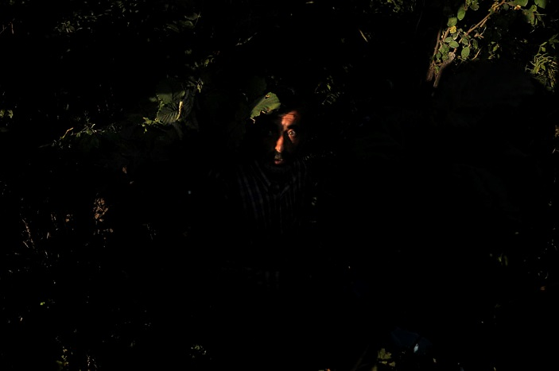
Hide. If you hide you will survive

