Slide 1
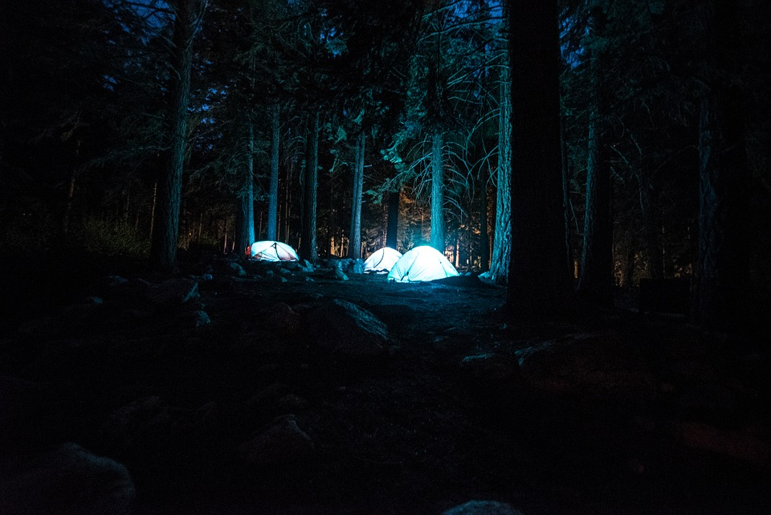
A Camp Adventure
By Addy

Slide 2
The adventure begins…
You arrive at camp and you are so exited you are going with your best friend. The camp director seems really nice. BUT YOU AND YOUR BEST FRIEND ARE IN DIFFERENT CABINS. You either…
Get really mad
Be fine with it and stay you will still be friends

Slide 3
Option 1
You get really mad and you get sent to the camp directors office and she gets really mad.
You apologize
You get really mad

Slide 4
Option 2
You are fine

Slide 5
Choice 3
You apologize and have a great time at camp
YOU WIN
For now…

Slide 6
Choice 4
You get really mad and the camp director says you can go out to lunch to cool of. You can go to
Arby’s
Wendy’s

Slide 7
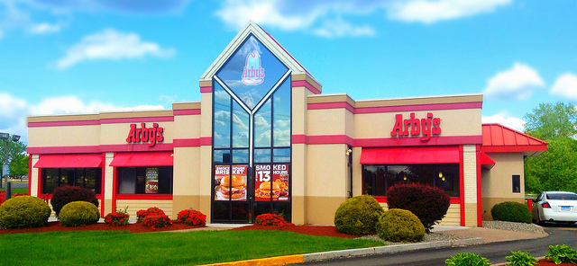
You chose 5
You chose to go to Arby’s and you eat good food
YOU WIN

Slide 8
You chose 6
You go to Wendy's and the food is bad
YOU LOSE

