Slide 1
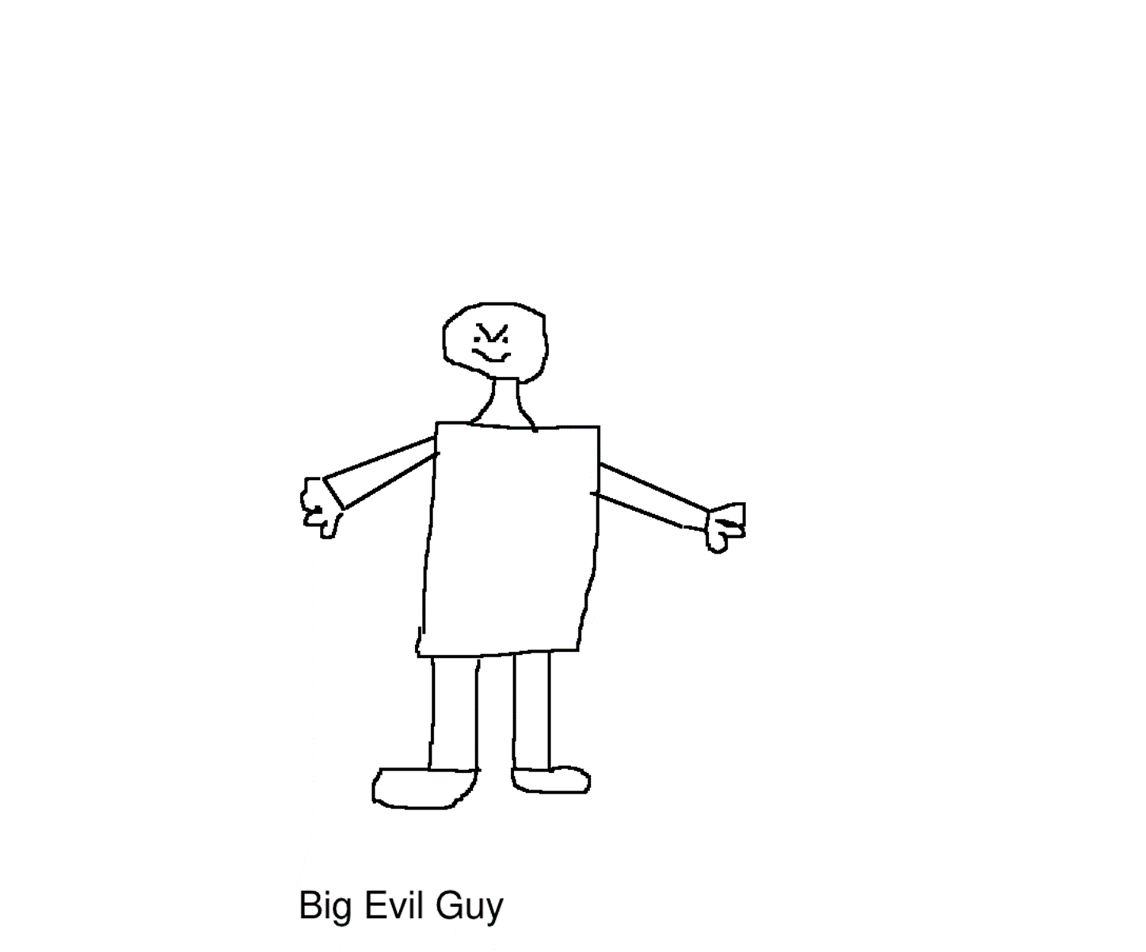
Save Moo Land!
By Alejandro Belgique

Slide 2
Introduction
Big Evil Guy was going to freeze Moo Land with an artic blast ray. The moos of Moo Land were terrified.

Slide 3
Save Moo Land!
You will save Moo Land by…
Challenging him to a dance-off
Stealing his artic blast ray and freezing him

Slide 4
Dance-off
You challenge Big Evil Guy to a dance-off. He sleeps during the dance-off.
YOU WIN
Restart

Slide 5
Steal and freeze
You steal Big Evil Guy’s ray and freeze him. He gets really mad and breaks out of the ice. You will…
Run away!
Fight back!
GAME OVER. You switch stories.

Slide 6
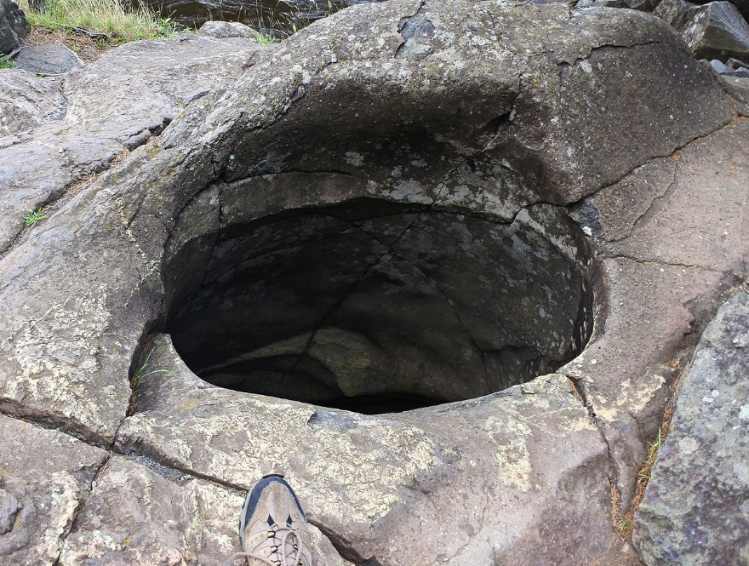
Run!
You run away and fall into a hole!
GAME OVER
Restart

Slide 7
Fight!
You fight Big Evil Guy. He kicks you and you
fly over to a guy with a stop sign. He bounces
you around with the stop sign.
GAME OVER
Restart

Slide 8
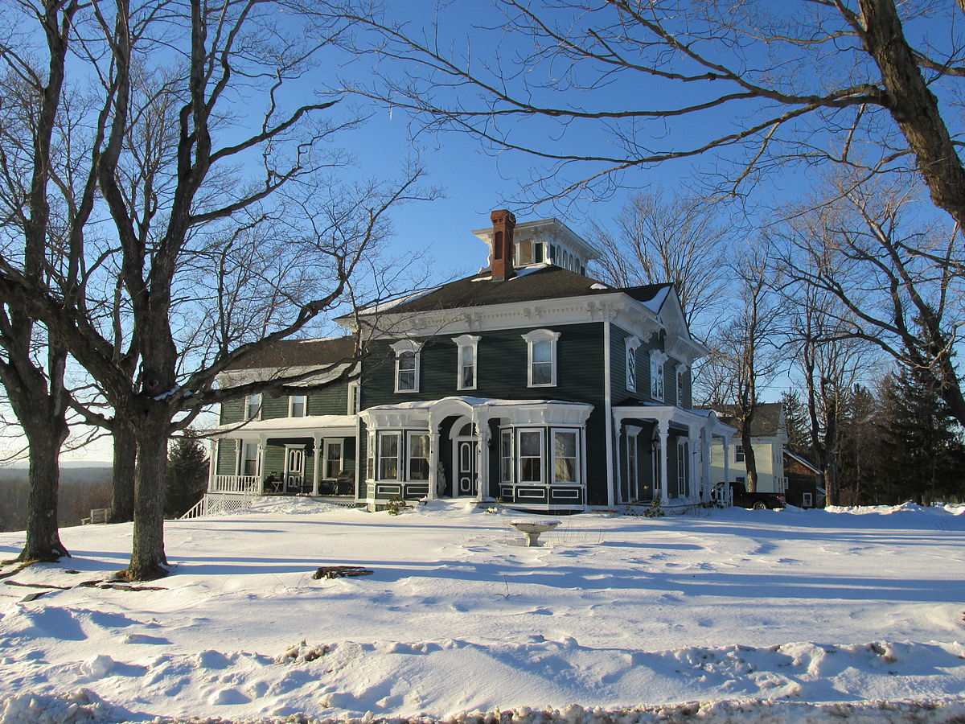
Switch
You switch to the story Lock and Lost.
YOU WIN
Restart

