Slide 1
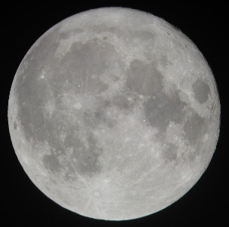
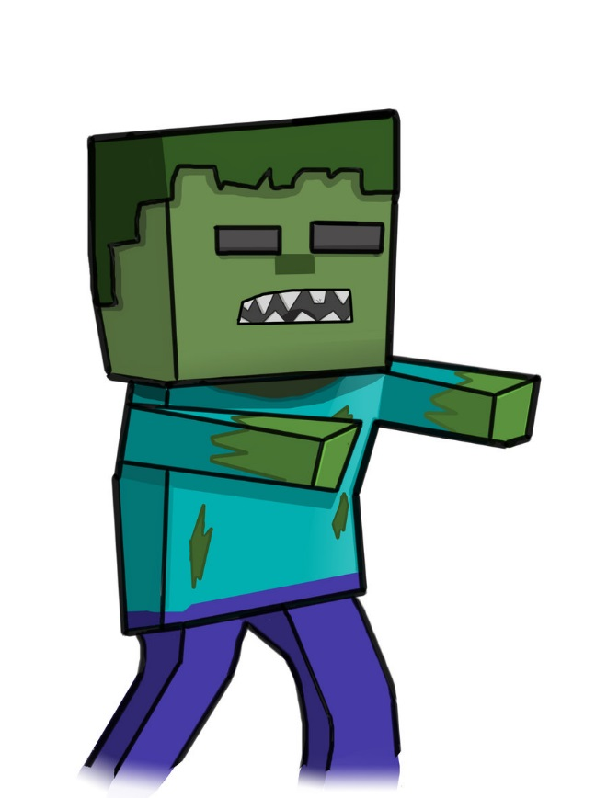
Zombies
By: Amarilis

Slide 2
Once upon a time….
You live in a house and everything is peaceful

Slide 3
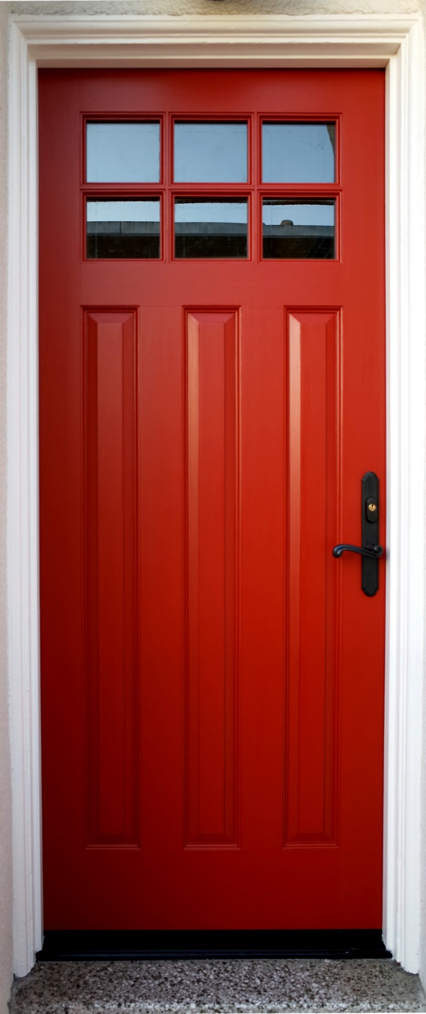
But one night….
You hear a lot of knocking on the door. You heard of people saying there are zombies.
Choice 1 do you go downstairs and open the door
Choice 2 get out of the house

Slide 4
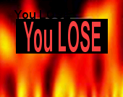
Choice 1
You open the door and there are a lot of zombie and you have no weapons and the zombies eat you.
YOU LOSE
Game over. Play again
Yes
no

Slide 5
Choice 2
You get out of your house and don’t get eaten by the zombies
YOU WIN

