Slide 1
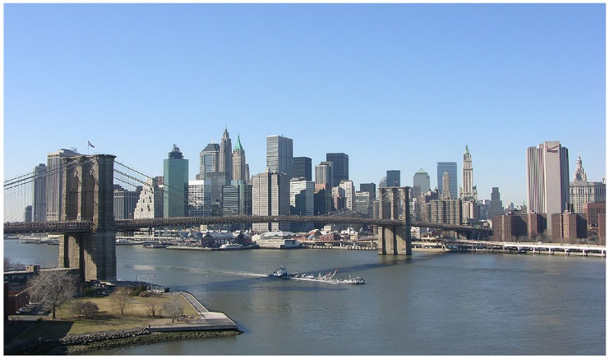
late
By Anders

Slide 2
BEEP BEEP!!!
You wake up to the honking of the New York taxis. You glance at your alarm and start franticly trying to get up. You realize you’re late for the big meeting with your CEO. Once you get ready you rush into the lobby of your apartment building you run out the door you have three options to get to work.
Take a taxi
Take the bus
Ride your bike

Slide 3
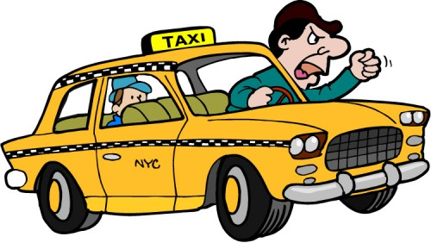
Take a taxi
You call a taxi. It arrives 20 minutes after your meeting is over. Your boss calls you, and tells you your fired.
YOU LOSE

Slide 4
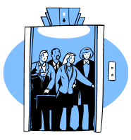
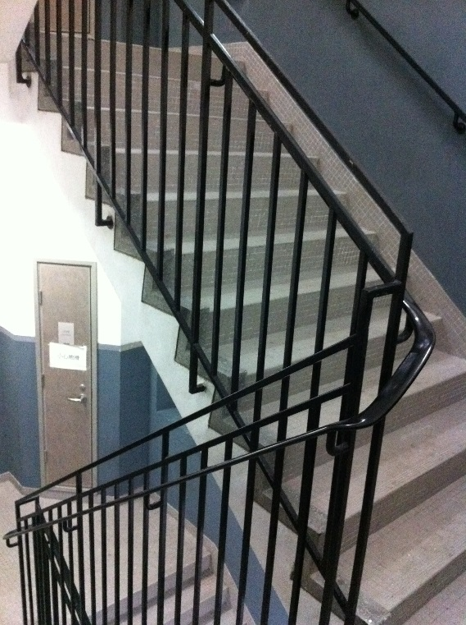
Take the bus
You catch the bus just in time. 5 minutes later your at your building. You have two ways to get to the meeting room.
Take the elevator
Take the stairs

Slide 5
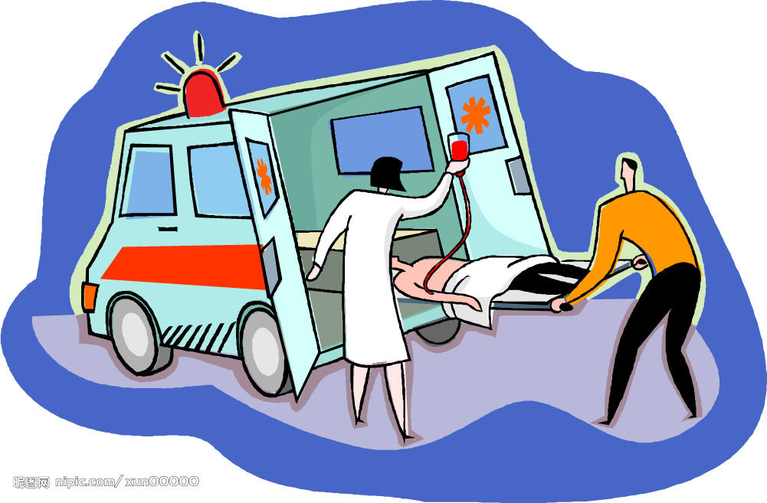
Ride your bike
You hop on your bike and start pedaling. Your so worried about the meeting you don’t notice the runaway garbage truck. The truck hits you and your rushed to the hospital.
YOU LOSE

Slide 6
Take the stairs
You star ferociously climbing the stairs. By the time your at 8th floor your beat.
YOU LOSE

Slide 7
Take the elevator
You get on the elevator. It takes you up to your floor with no delay. You arrive in the meeting room just in time.
YOU WIN!

