Slide 1
The m ofdoo……
By Andres or was it……..

Slide 2
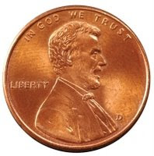
What…..
You wake up in your house and its 3:00 am. And your scared what do you do
1 run to your parents
2 go out side

Slide 3
You ran
1 run to your parents
So you choice run to your parents you know what they wert there you were paniking then you hit your head what do you do
1 Nothing act like a chicken

Slide 4
You went out side
You went out side what were you thinking you were super cold you tried to go inside but the door slammed and got locked and then you got carried away bye a griffen what do you do don don donnnnnnn
Eat
Bob

Slide 5
Bok bok
Bro you chicken you had a dream that you hit your head or was that reality then you got up and in front of you was a deadly……crocodile
fight back
Let your self be eaten

Slide 6
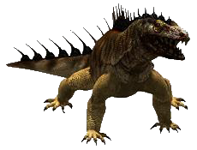
Fight back
What were you thinking you hit him then he got bigger and bigger and then looked like this
Call 911
Tame him

Slide 7
911…………………………………..p
When you typide 9 you were sucked in the phone and in mincraft
One act like steeve
nothing

Slide 8
Tame sham
He was untamabol
Don don dAAAAAAAn
the end

Slide 9
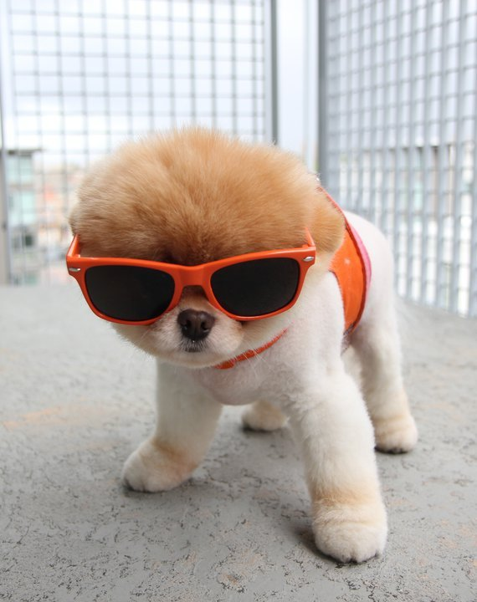
wooooooooooooooow
When you were about to be eaten a skunk came in and did karetey and defeted the crocodile then you touched him and he terd into this person.
Adopt him
Or nothing

Slide 10
Adopt him
Since he nos caratey you win
don’t ask how you won plz
If you want to know how you won go here

Slide 11
This is how you won

